Slide 1

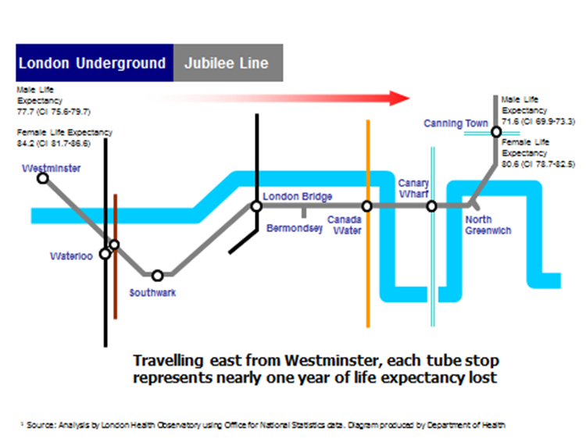
Health: Does place matter?

Slide 2
Key Terms
Determinants of Health | The range of factors that combine together to affect the health of individuals
Inequalities in Health | Differences in health status between different populations and groups
Social determinants of Health | The social, economic and environmental factors that impact on health behaviours and determine the health status of individuals or populations
Cragg, L. Davies, M and MacDowall (2013) Health Promotion Theory 2nd edn McGraw-Hill: Maidenhead

Slide 3
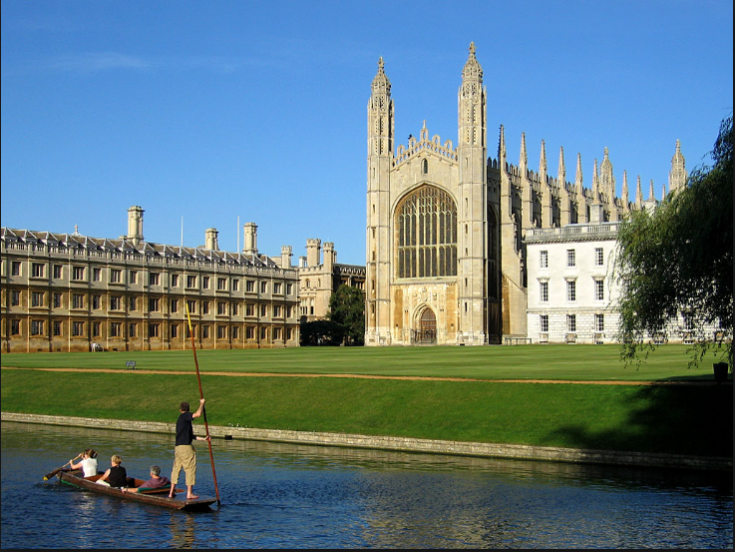

Does life expectancy differ with place?
South Cambridgeshire
A newborn baby born can expect to live to 83…
Blackpool
…. that’s 8.7 years longer than Blackpool where life expectancy is 74.3 years
Office for National Statistics, Life expectancy at birth and at age 65 by local areas in England and Wales, 2011-13. Statistics Bulletin 2014 19/11/14 Available at: http://www.ons.gov.uk/ons/dcp171778_385458.pdf

Slide 4
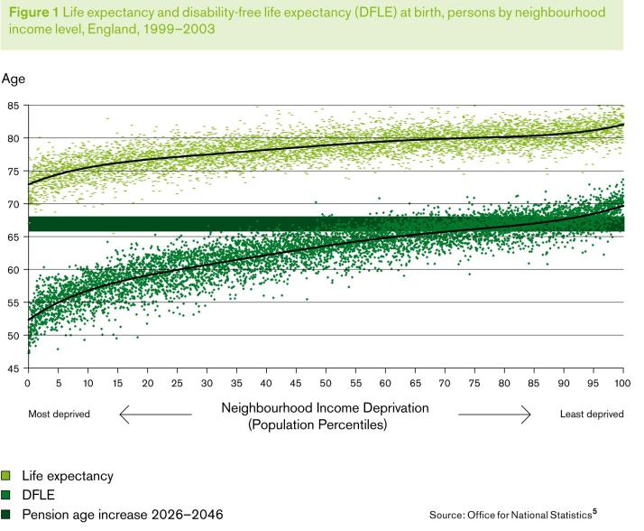
People in the poorest areas die ~ 7 yrs earlier than richest
… & spend more of their shorter lives with disability ~ 17 yrs
Dept of Health (2010) Fair Society, Healthy Lives – Strategic Review of Health Inequalities in England London: The Marmot Review http://www.instituteofhealthequity.org/

Slide 5
Health Drivers
Public Health England (2014) Evidence into action Available at: https://www.gov.uk/government/uploads/system/uploads/attachment_data/file/366852/PHE_Priorities.pdf Accessed 26.11.14

Slide 6
The Social Determinants of Health
“The conditions in which people are born, grow, live, work and age. These circumstances are shaped by the distribution of money, power and resources at global, national and local levels. The social determinants of health are mostly responsible for health inequities - the unfair and avoidable differences in health status seen within and between countries.”
World Health Organisation (2013) The Social Determinants of Health Available at: http://www.who.int/social_determinants/sdh_definition/en/ Accessed 30/9/14

Slide 7

Strategic Review of Health Inequalities in England
Key Purpose:
Identify for the health inequalities challenge, the evidence most relevant to underpin future policy and action.
Show how the evidence could be translated into action
Advise on possible objectives and measures
Publish a report
Professor Sir Michael Marmot

Slide 8

Fair Society, Healthy Lives (The Marmot Review)
Health inequalities are not inevitable or irreversible
Health inequalities result from social inequalities - ‘causes of the causes’ – the social determinants
Focusing solely on most disadvantaged will not be sufficient - need ‘proportionate universalism’
Reducing health inequalities vital to economy - cost of inaction
Marmot, M. (2010) Fair Society, Healthy Lives – Strategic Review of Health Inequalities in England London: The Marmot Review http://www.instituteofhealthequity.org/

Slide 9

The Economic Case
Cost of Inaction
In England, dying prematurely each year as a result
of health inequalities, between 1.3 and 2.5 million extra years of life.
Cost of doing nothing
Action taken to reduce health inequalities will benefit society in many ways. It will have economic benefits in reducing losses from illness associated with health inequalities.
Each year in England these account for:
productivity losses of £31-33B
reduced tax revenue and higher welfare payments of £20-32B &
increased treatment costs well in excess of £5B.

Slide 10
Determinants of Health
Our health is impacted by a range of determinants
Income and Social Status | Greater the gap between rich/poor, greater the difference in health.
Education | Low education levels linked to poor health, more stress and low self confidence.
Physical environment | Safe water, clean air, healthy workplace, safe homes, communities and roads contribute to good health. People in work tend to be healthier, particularly those who have more control over their work conditions.
Social support networks | Greater support linked to better health. Culture and beliefs of family/community impact on health.
Genetics and personal behaviour | Inheritance can influence lifespan, healthiness, likelihood of developing illnesses. Indiv behaviour and coping skills affect health.
Health Services | Access and use of services
Gender | Suffer from different disease at different ages
Notes:
Context of people’s lives determines health.
Blame / credit is inappropriate
Individuals are unlikely to have direct control of many of the determinants

Slide 11
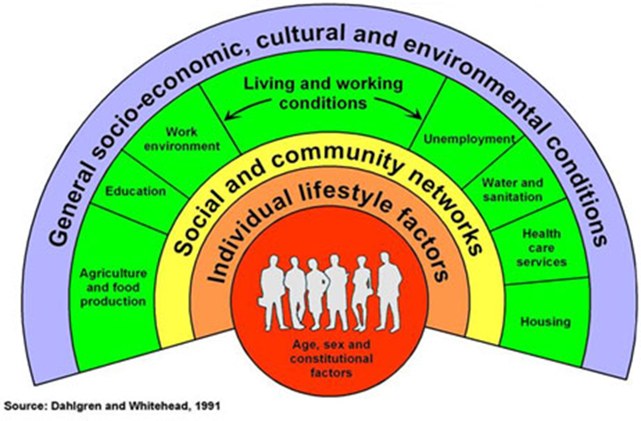
The Determinants of Health
Social and economic environment
Physical environment
Person’s individual characteristics and behaviours
Gap between rich and poor
Whether people are healthy or not depends on their circumstances and environment. Factors such as where we live, state of the environment, genetics, income, education level, relationship with friends and family have considerable impact on health. Access and use of health care services often have a lesser impact.
Gillam, S. Yates, J, & Badrinath, P. (2012) Essential Public Health 2nd edn Cambridge University Press, Cambridge

Slide 12
Our Health Today
Despite universal access to health services we still see deep seated inequalities.
We are falling further behind comparable countries in relative terms.
Healthcare has relatively limited impact on health
Public Health England (2014) Evidence into action Available at: https://www.gov.uk/government/uploads/system/uploads/attachment_data/file/366852/PHE_Priorities.pdf Accessed 26.11.14

Slide 13

The Causes of the Causes
Example: Smoking
Smoking causes illnesses such as COPD,CVD and lung cancer
BUT
It is the social, cultural and environmental factors that largely determines whether someone is more or less likely to smoke and if they do start whether they are likely to quit successfully

Slide 14
Smoking and Health inequalities
Biggest cause of health inequalities in the UK
Accounts for half the difference in LE between richest and poorest
Loss of 10 years of life
Not smoking can allow people to leap the health gap
Disadvantaged areas:
˜½ of all smokers are in R&M occupations
Unemployed 2x likely to smoke as those in employment
Smoking is more socially acceptable
More addicted + smoke more each day
Find it harder to quit
PHE (2015) Tobacco Control: JSNA Support Pack

Slide 15
Cigarette smoking prevalence, Adult 18+, Countries of the UK, 2013

Slide 16
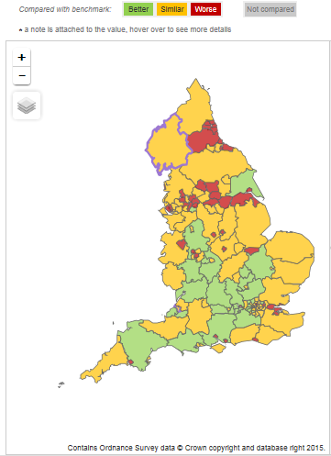
Local Tobacco Control Profiles
Current prevalence in adults - Current smokers (IHS)

Slide 17
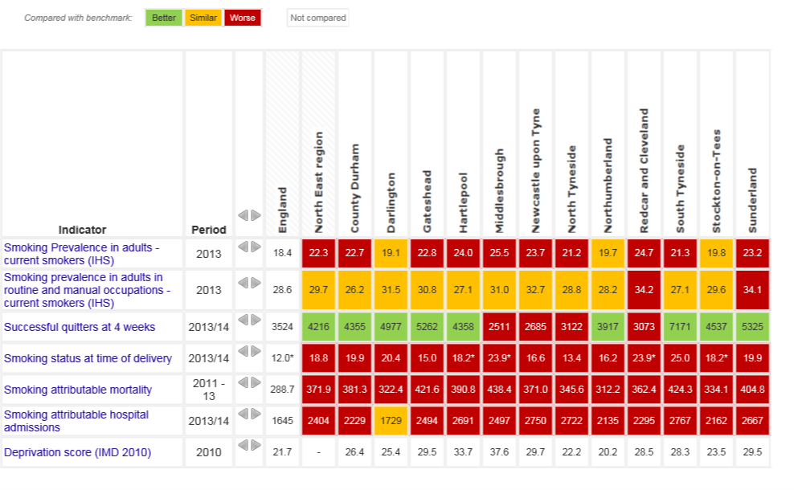
Tobacco Control: North East Overview

Slide 18
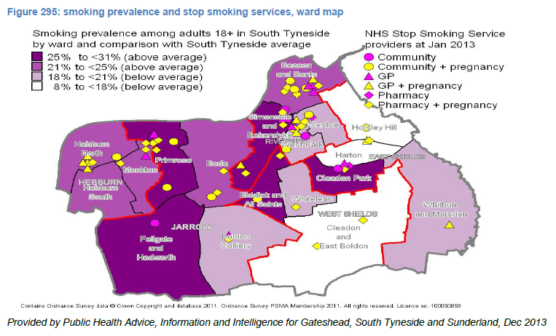
South Tyneside: Ward level

Slide 19
Health Profile England 2014
  Health Profiles www.healthprofiles.info
The general picture shows an improvement in health outcomes e.g.
declining mortality rates in targeted killers (cancers, all circulatory diseases and suicides)
increasing life expectancy, now at its highest ever level
further reductions in infant and perinatal mortality
However in some areas particular challenges remain to achieve and sustain progress:
rising rates of diabetes
rising rates of obesity
For the determinants of health, we are making improvements in some areas:
the percentage of people who smoke
quality of housing stock
However, even where we are seeing improvements, health inequalities are often present across England.

Slide 20
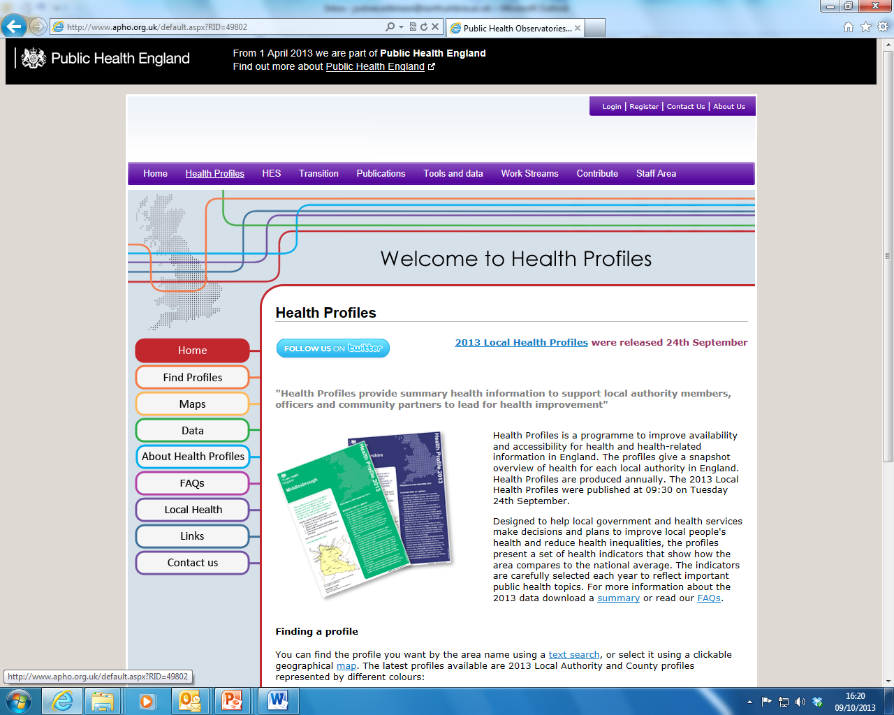
http://www.apho.org.uk/default.aspx?QN=P_HEALTH_PROFILES

Slide 21
Group Discussion
Compare health profiles:
What does the data tell us about health and deprivation? Give examples to illustrate.
If you were the Director of Public Health for this area what would you prioritise? Why?

Slide 22
Summary
Health is determined by a complex interaction between individual characteristics, lifestyle & the physical, social and economic environment
Economic hardship is highly correlated with poor health
Increased levels of education are significantly related to improved health
Improving housing conditions and greater access to green spaces should have a positive impact on health
Kings Fund (2015) Broader determinants of health

Slide 23
References
Cancer Research UK (2014) Tobacco statistics by sex and UK region Available at: http://www.cancerresearchuk.org/health-professional/cancer-statistics/risk/tobacco#heading-One Accessed 11/10/15
Cragg, L. Davies, M and MacDowall (2013) Health Promotion Theory 2nd edn McGraw-Hill: Maidenhead
Dept of Health (2010) Fair Society, Healthy Lives – Strategic Review of Health Inequalities in England London: The Marmot Review http://www.instituteofhealthequity.org/
Gillam, S. Yates, J, & Badrinath, P. (2012) Essential Public Health 2nd edn Cambridge University Press, Cambridge
Office for National Statistics, Life expectancy at birth and at age 65 by local areas in England and Wales, 2011-13. Statistics Bulletin 2014 19/11/14 Available at: http://www.ons.gov.uk/ons/dcp171778_385458.pdf
Public Health England (2014) Evidence into action Available at: https://www.gov.uk/government/uploads/system/uploads/attachment_data/file/366852/PHE_Priorities.pdf Accessed 26.11.14
Public Health England (2015) Local Tobacco Control Profiles for England Available at: http://www.tobaccoprofiles.info/ Accessed 11/10/15
World Health Organisation (2013) The Social Determinants of Health Available at: http://www.who.int/social_determinants/sdh_definition/en/ Accessed 30/9/14

Slide 24
How do we address “wicked problems”?
Are public health ends better served by narrow interventions focused at the level of the individual or the community, or by broad measures to redistribute the social, political, and economic resources that exert such a profound influence on health status at the population level?
Marmot Review 2010 - “there is a gradient in health outcomes, the lower a person's social economic status the worse their expected health”.

