Slide 1
Little leisure centres and libraries in the Big Society. LSA 2015
Geoff Nichols, Sheffield University Management School g.nichols@sheffield.ac.uk
Deborah Forbes, Newcastle University Business School deborah.forbes@newcastle.ac.uk
Lindsay Findlay-King, Northumbria University lindsay.findlay-king@northumbria.ac.uk
Gordon Macfadyen, Northumbria University gordon.macfadyen@northumbria.ac.uk

Slide 2
We ask:
What were the problems volunteer groups faced in asset transfer?
What support did they need?
What support could be provided?
In the context of a critique of the Big Society.

Slide 3
Recent asset transfer in leisure
sports centres, swimming pools and libraries
volunteers plan and execute the transfer to trust status themselves
take roles of governance and delivery afterwards
an alternative to local government closing non-statutory services as a consequence of reduced funding

Slide 4
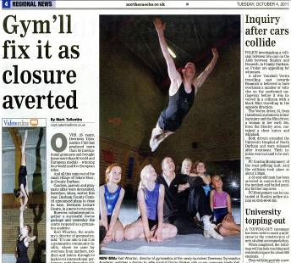
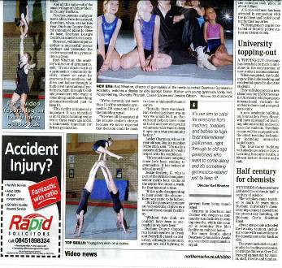

Slide 5
In contrast to the first generation of trusts
E.g. SIV, Edinburgh Leisure, Greenwich Leisure
major objective to avoid non-domestic rates to central government; and avoid CCT
volunteers in governance as trustees; recruited
for their expertise
transfer to trust status led by paid employees
local authority represented on the board
BIG and may expand beyond local area

Slide 6
Review of 5 years of the Big Society
Achievements | Negatives
new kinds of partnerships; voluntary sector resilient, and strengthening communities; volunteering remaining high compared to other countries – although at static levels since 2001. | large companies benefiting - bias against the local and voluntary sector; services not sufficiently meeting the needs of those who most need them –exacerbating gaps rich and poor; lack of dialogue to find a way of adapting to budget cuts; power not significantly transferred from the state; failure to establish a strong partnership with the voluntary sector; failure to mobilise the private sector to work for the common good.

Slide 7
Methods
Semi-structured interviews with managers and volunteers [sometimes the same person] in 11 facilities (libraries, museums and sports centres) which have transferred from local government to volunteer control and one in an authority which developed volunteers to work alongside employees (2014-15).
Review of support and guidance [Sport England, DTS, and N. American]

Slide 8
Example - Bramley Baths Leeds
A small swimming pool and leisure centre - outskirts of Leeds - built in 1904. Used by local residents and schools for swimming lessons.
Opening hours reduced in September 2011 as part of a spending review by Leeds City Council.
Local community group established to support the pool in February 2011 and re-opened in January 2013 as an Industrial Provident Society on a 25 year lease from the Council.
Houses a public gym, swimming pool, steam room and space for community events, meetings and fitness classes.
The trustees are volunteers and paid workers manage the pool and deliver the service.

Slide 9
What support was provided to varying degrees?
Guidance and support with establishing legal entity and business plans
Mentors who have been through the process.
Volunteer development officers – especially in areas of low social capital
Advice and support from local authority staff
Political goodwill

Slide 10
Support – provided to varying degrees
Technical training and support
Rate relief
Favourable leases
Assurance that building liabilities will be met
Clarity over liabilities arising from previous grants.
Redeployment of local authority staff and clarity over application of TUPE regulations.

Slide 11
Summary
our examples are ‘little’. individual and small.
Oligopoly - Of 161 contracts with local authorities, three operators hold 61%. Sports and Leisure Management; Places for People and Greenwich Leisure Limited. ‘predatory trusts’. Is big the default option?
Hard to get a national picture in sport
In libraries – all small local trusts.

Slide 12
Conclusions
important supportive role of Volunteer Advice Centres
contrast in collaboration government / volunteers
has had to be genuine transfer of power
Most support is required in most disadvantaged areas. - but it tends to be delivered to demand.

Slide 13
Conclusions
little evidence of businesses showing leadership in committing resources for the common good

Slide 14
What can we learn – action/support?
Improve and promote Sports England’s asset transfer advice – for local govt as well as volunteers.
Facilitate networking for support
guidance on TUPE
Local to be the default option to promote community engagement
volunteer led transfers should be encouraged, rather than discouraged

Slide 15
What can we learn – action/support?
Favourable rate relief and lease conditions
Technical support and training
support from development officers
businesses to commit resources for the common good
Clarify liability for previous grants

Slide 16
Realistically…
Most of this costs
We are here because of cuts in expenditure
We can’t develop volunteers to provide a service for all [rather than the advantaged] without support.
And this takes time
Funds and time are in short supply!

Slide 17
References
Nichols, G., Forbes, D., Findlay-King, L. and MacFadyen, G. (2015) Is the Asset Transfer of Public Leisure Facilities in England an Example of Associative Democracy? Administrative Sciences. 5(2), 71-87; doi:10.3390/admsci5020071
http://www.mdpi.com/2076-3387/5/2/71
Nichols G. and Forbes D. (2014) The transfer of public leisure facilities to volunteer delivery
http://svrn.group.shef.ac.uk/wp-content/uploads/2013/02/Nichols-and-Forbes-transfer-of-leisure-facilities-to-volunteer-delivery-20141.pdf

Slide 18
Any questions?

