Slide 1
Scholarship, or just social media? Creating an online community to support student engagement and development through group work
May 2015
Neil Percival
L&T Lead
Dept. of Media & Communication Design

Slide 2
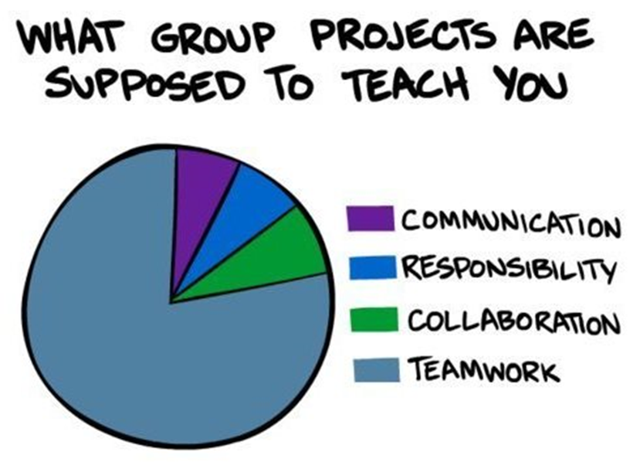
Group work – the good stuff
The pros: great benefit for student engagement, in terms of the valuable interpersonal and organisational skills it develops, and the quality of collaborative work which it enables them to produce (Boud, Cohen, & Sampson, 1999)
Notes:
The story starts with student groupwork which staff and students recognise as potentially a good thing in terms of the quality of the work produced in a team effort and of course the great interpersonal skills it can help to develop from an employability perspective – so it can be a force for good…

Slide 3
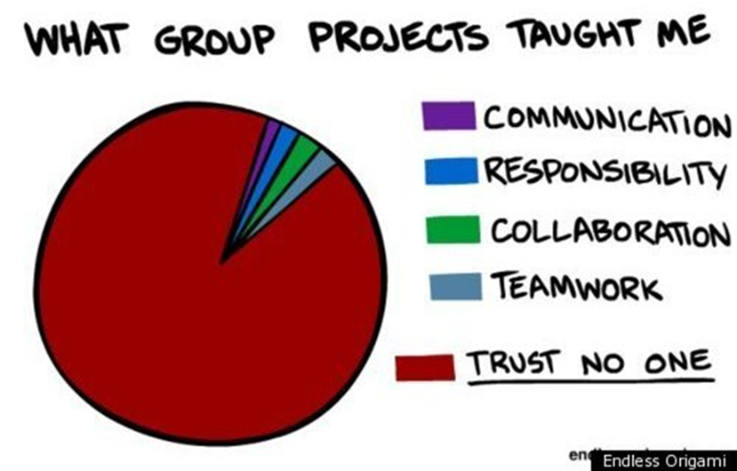
Group work – the bad stuff
The cons: can be a cause of dissatisfaction for students (Davies, 2009), especially if skills required for successful group work are not taught, enabled and supported within the module or programme (McAllister, 1995; Vik, 2001).
Notes:
Or of course it can be a force for evil; if group assessment is overused, or if students have not been equipped with the skills and the support they need to carry it out successfully then all of ther aspirations can end in acrimony.

Slide 4
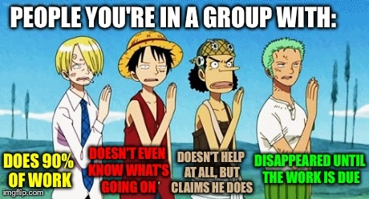
The local situation
Group work – the bad stuff
Notes:
The University recently identified the need to develop and disseminate clear institutional guidelines for student groupwork. The Student Union at Northumbria had identified dissatisfaction with groupwork, and its assessment, as its second highest campaign priority for 2013-14, while NSS qualitative comments had also made this a target area for improvement at institutional level. The University set up a sub-group of an assessment committee looking specifically at group work, and as this is also a big issue for Media programmes, where I am L&T lead, I was eager to take part.

Slide 5
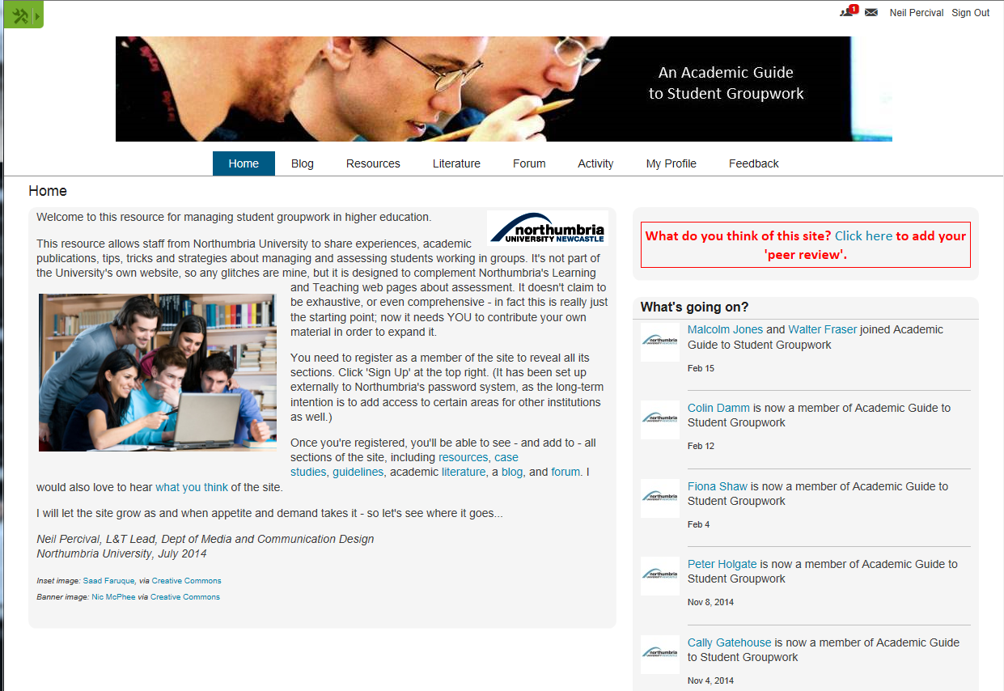
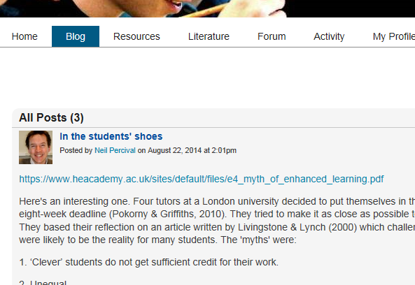
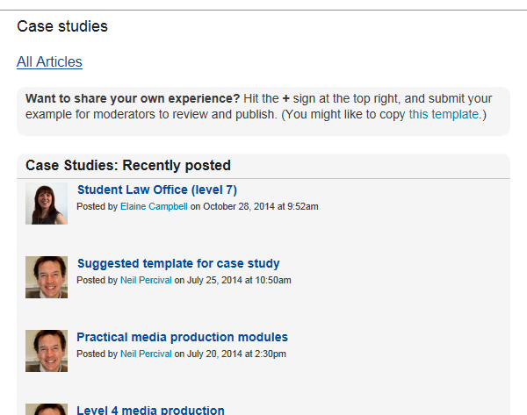
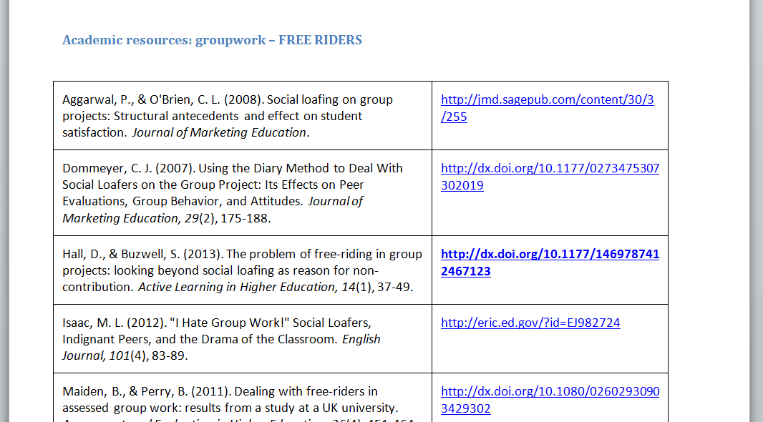
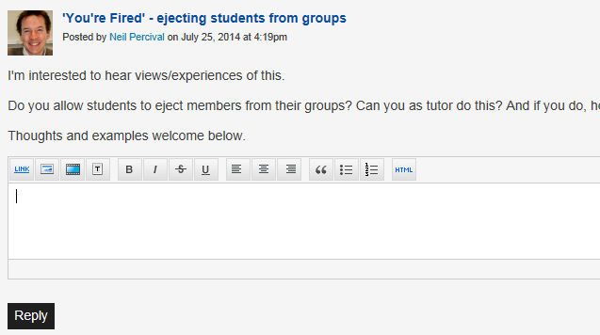
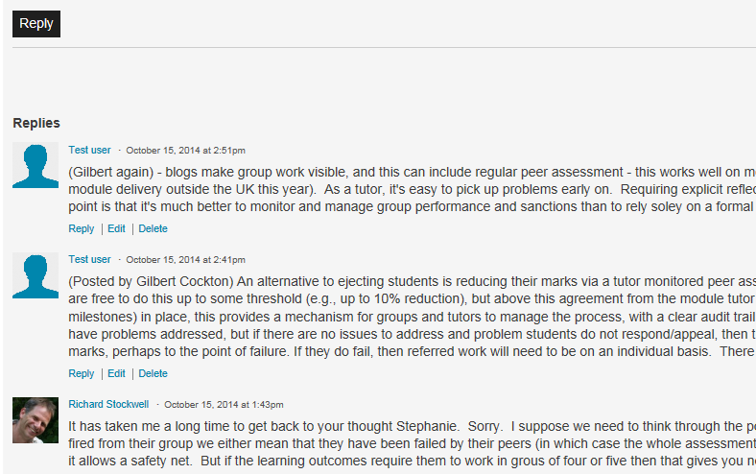
http://groupwork.ning.com
Notes:
As this group progressed, the idea emerged that an online resource could prove a genuinely useful contribution within the institution, in terms of developing and supporting staff management of group work, and removing a key threat to student engagement.
So I built an online community at groupwork.ning.com designed to support academic staff in running effective and engaging groupwork. The site, which you can see here, allows staff to share experiences about managing students working in groups; it also has a blog, case studies, a literature resource with over 200 journal articles, and various sets of guidelines.

Slide 6
Is this ‘scholarship of teaching and learning’?
http://bit.ly/1H8rqZt
http://biologyze.com/2012/07/03/photo-of-the-week-26/
Notes:
This paper is really about - How this fits into the concept of a ‘scholarship of teaching and learning’? This concept implies a form of ‘making public’, usually dependent on the successful outcome of a peer review process. The majority of projects become ‘fixed’ as a tangible, citable component within a body of academic literature once they are formalised as a text for publication. But an online community challenges these processes. Firstly, the project is in itself an ongoing form of ‘making public’ and so the initiative, and the process of placing work in a public domain, are one and the same thing. Secondly, the material being made public goes through the majority of peer scrutiny only after publication, rather than before. And as a result, the artefact being published is not fixed, like a book, article or presentation; it is developed, challenged and revised by a community of users as an ongoing, dynamic process.

Slide 7
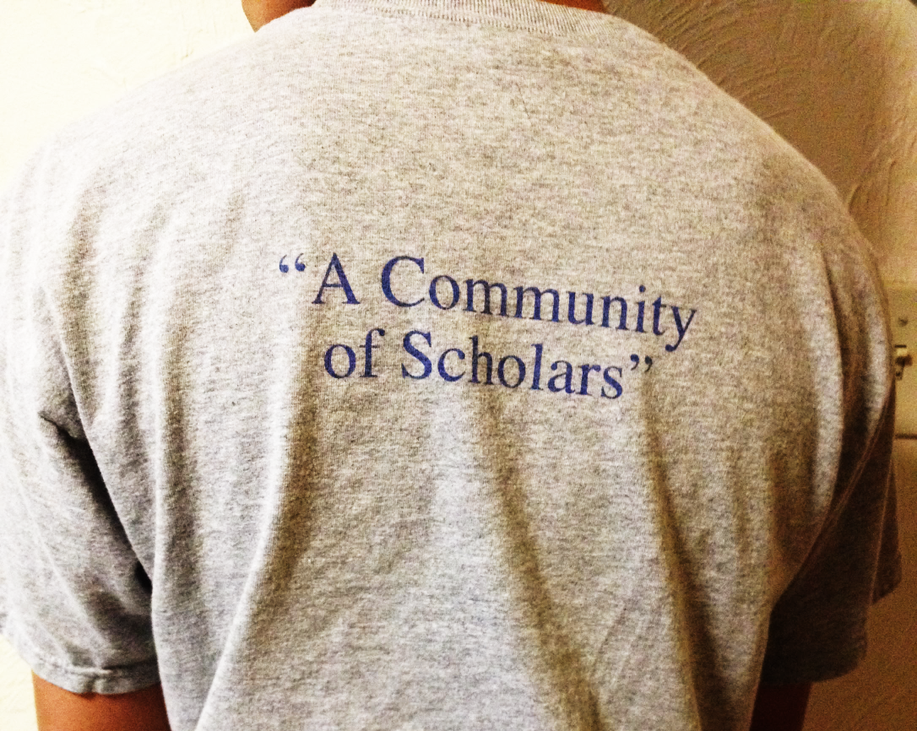
Community of Scholars
Boyer, in coining the term ‘scholarship of teaching’, looked towards a ‘community of scholars’ and “a campus-wide, collaborative effort around teaching” (1990).
http://dailyjade.com/cheeky-self-aware-honors-college-puts-a-community-of-scholars-in-quotes/
Notes:
What does the literature of the scholarship of teaching and learning have to say?
Boyer’s seminal piece of work (1990) was instrumental in coining the term ‘scholarship of teaching’. Boyer lights the way by looking towards ‘a community of scholars’:
“A campus-wide, collaborative effort around teaching would be mutually enriching. A similar case can be made for cooperative research, as investigators talk increasingly about "networks of knowledge," even as individual creativity is recognized and affirmed…”
Although the concept of digital social networking was many years in the future for Boyer, a collaborative online project such as the groupwork resource clearly has potential to support just such a ‘network of knowledge’ – so far so good.

Slide 8
Active communities
Shulman saw teachers as “members of active communities: communities of conversation, communities of evaluation, communities in which we gather with others… to exchange our findings, our methods, and our excuses” (1993)
http://bit.ly/1KRCpb2/
http://emcplus.emc.com/emc-user-community/
Notes:
Shulman, writing a few years after Boyer, saw teaching as community property, and foregrounded the role of communication in the scholarship of teaching (1993). Shulman saw teachers as ‘members of active communities: communities of conversation, communities of evaluation, communities in which we gather with others in our invisible colleges to exchange our findings, our methods, and our excuses’. Once again Shulman’s description prefigures the functionality available on the internet for communication and interaction – perhaps the phrase ‘invisible college’ translates neatly into the modern concept of a ‘virtual community’. 05.22

Slide 9
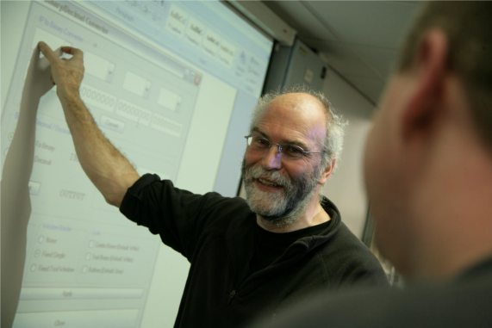
Evidence of effectiveness
Trigwell et al commented that the aim of scholarly teaching was “to make transparent how we have made learning possible…university teachers must… be able to collect and present rigorous evidence of their effectiveness… as teachers.” (Trigwell, Martin, Benjamin, & Prosser, 2000).
http://northumbria.ac.uk
Notes:
One of the most useful articles I read while reflecting on the online project was the piece by Trigwell et al (Trigwell, Martin, Benjamin, & Prosser, 2000). If the aim of teaching is simply to make student learning possible, the writers say, in recalling Ramsden (1992), then
“We believe the aim of scholarly teaching is also simple: it is to make transparent how we have made learning possible. For this to happen, university teachers must be informed of the theoretical perspectives and literature of teaching and learning in their discipline, and be able to collect and present rigorous evidence of their effectiveness, from these perspectives, as teachers. In turn, this involves reflection, inquiry, evaluation, documentation and communication.”

Slide 10
Significant impact
Weston & McAlpine saw the scholarship of teaching as “characterized by an intention to share expertise and develop scholarly knowledge about teaching that has a significant impact on the institution and the field” (2001)
http://bit.ly/1QzoWaU
Notes:
Weston & Mcalpine begin with the same essential definition, but build on it by exploring a model that sees faculty professors as being at one of three stages of progressing towards a scholarship of teaching:
“Phase One… professors begin to see teaching as an essential and engaging aspect of their role, rather than an interference with their research. Phase Two is characterized by a professor initiating a transition from only thinking about his or her own teaching to discussing it with colleagues in the discipline… creating communities of professors who dialogue about teaching, and develop and exchange knowledge about teaching in their discipline… Phase Three is a shift toward growth in scholarship of teaching. This third phase is characterized by an intention to share expertise and develop scholarly knowledge about teaching that has a significant impact on the institution and the field.” (Weston & McAlpine, 2001) we are now heariung words such as rigour and ipact beyond the institutioont

Slide 11
The teaching commons
Huber & Hutchings proposed “the teaching commons, an emergent conceptual space for exchange and community among faculty, students, administrators, and all others committed to learning” (2005)
http://bit.ly/1dVV7TY
Notes:
One final concept is worthy of inclusion at this point. Huber & Hutchings (2005) wrote about the development of a new and broad resource where this scholarship would be fostered:
“…we see the scholarship of teaching and learning as part of a wider phenomenon that we call the teaching commons, an emergent conceptual space for exchange and community among faculty, students, administrators, and all others committed to learning as an essential activity of life in contemporary democratic society… for pedagogical knowledge to circulate, deepen through debate and critique, and inform the kinds of innovation so important to higher education today. “
Huber & Hutchings, in an era barely beginning to perceive the social networking possibilities of the internet, clearly see potential in new technologies to build the ‘teaching commons’ they propose. It is hard not to see an online pedagogic network as a perfect mechanism to circulate and critique pedagogic knowledge in the kinds of ways they describe.

Slide 12
Or maybe not?
The teaching commons
Witman & Richlin (2007) remind us that ‘teaching tips’ are not the same as the scholarship of teaching (2007).
For Weston & McAlpine – it has to have impact outside the institution (2001)
Shulman reminds of the need for peer review: “We develop a scholarship of teaching when our work as teachers becomes public, peer-reviewed and critiqued”. (2001)
Healey is also explicit on the subject: “…if the scholarship of teaching is to match that of research there needs to be a comparability of rigour, standards and esteem” (2000)
Kanuka comments that publication must “make a significant contribution to knowledge... as theory allows you to make public the intellectual basis of findings” (Kanuka, 2011)
Notes:
What about more challenging statements?
Witman & Richlin (2007) remind us that scholarship requires rigour in pedagogic investigation. They argue that ‘academics ...often begin pedagogic studies without baselines and hypotheses, do not keep accurate records of interventions, and fail to report results past “the students liked it”.’ Would the case studies shared in the online community, therefore, count as ‘scholarship’ or what Witman & Richlin more disparagingly call ‘teaching tips” - although such ‘tips’ do still have value in themselves, of course, from a practical perspective. There is no doubt that the blog/comment/discussion culture of a website has little of the rigour of a peer reviewed publication or a well-planned and executed scholarly research exercise, but perhaps it wins out in other ways – by complementing those publications and findings, disseminating them to a wider audience, and by supporting those who are newer to the subject area than others. Other writers have set the bar at a height which an online community struggles to reach: impact outside the institution, peer review comparable with the scholarship of research, and findings within a framework of theory.

Slide 13
Peer review?
Or maybe not?
Online moderation and discussion are genuine and potentially rigorous forms of peer review
http://bit.ly/1cn1m2b
Notes:
But there is certainly peer review, even if this is principally through responses and discussions generated by users in response to other items already posted on the site. Once there is an active community engaged with the site, anyone posting material will be submitting their reflections and findings to the scrutiny of a wider community.
McKinney’s book on the scholarship of teaching and learning (2010) goes one step further by evaluating web postings as a legitimate form of dissemination, alongside articles and presentations.
I believe that the peer review of an online community does bring a sort of rigour; a scrutiny potentially by a far wider group of peers. In addition, unlike a journal or conference, a community like this means that those just starting out can submit their queries to receive support and encouragement at all levels of experience. The group work resource is about both dissemination and development; support, not just scrutiny. (As long as the engagement is there, it is much more about reflection, shared experiences, dialogue and conversation – but all of those elements are part of the scholarship of teaching and learning, as defined in the literature of the scholarship of teaching and learning.)

Slide 14
How public is public?
Peer review?
If scholarship requires ‘making public’- a website could be more genuinely public than a conference paper or journal
http://bit.ly/1EugVLN
Notes:
If scholarship is about ‘making public’. The next question might be: ‘How public is public?’ Publishing in an educational or academic journal might enable dissemination to a ‘public’ audience, but only if it is genuinely open access. Otherwise, one could argue that, although they have been disseminated to a wider audience - they are not really in the ‘public domain’ at all.
So how public does the communication of critical reflection about teaching and learning have to become, to be part of its scholarship? Opinions vary. The community would only be reaching the final stage of Weston & McAlpine’s three-stage model, if it had impact outside the institution (Weston & McAlpine, 2001) – and there are no intentions to make it open access at this stage – it is registered members only.
My own personal view is that the project will contribute in a small way to this scholarship, even if it encourages only a small number of staff at Northumbria to reflect on, and share, some of their own findings with their colleagues – and perhaps for the first time, to engage with some of the existing literature on group work. However, it is hard to see how a resource can become part of a ‘teaching commons’, or receive authoritative peer review, if firewalled to one University. The project needs to achieve engagement beyond this institution if it is to have any significant impact on the scholarship of teaching and learning – and that is the planned next stage

Slide 15
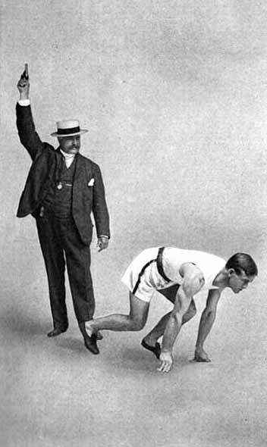
The start of our conversations
How public is public?
As Kreber comments: “…the scholarship of teaching… is represented not just in formal studies informed by the empirical analytical, interpretive or critical sciences, but also in the public dialogue that ensues from posing these questions in the first place… We might do better to think of research findings as the start of our conversations into teaching and learning rather than as the conclusion.” (2013)
http://1.usa.gov/1J3qBmX
Notes:
I am going to end with Carolin Kreber for my conclusion. Via a discussion of the problems of ‘evidence-based’ findings, and ‘making public’ as a form of social action, Kreber goes on inadvertently to describe, rather well, the kind of activity the community is designed to promote:
“…the scholarship of teaching, when interpreted as action, is represented not just in formal studies informed by the empirical analytical, interpretive or critical sciences, but also in the public dialogue that ensues from posing these questions in the first place… We might do better to think of research findings as the start of our conversations into teaching and learning rather than as the conclusion.” (Kreber, 2013)
An online community can certainly encourage conversations in its pages – taking the literature it references as a starting point, and adding to that literature a wealth of individual experience and reflection, which will help to support and develop those academic staff who engage with it. Its users will have to decide for themselves whether its postings have sufficient scholarly rigour and grounding in theory in order to make a genuine contribution to the scholarship of teaching and learning.

Slide 16
Any questions?
Boyer, E. L. (1990). Scholarship reconsidered: priorities of the professoriate. Princeton, NJ: The Carnegie Foundation for the Advancement of Teaching.
Healey, M. (2000). Developing the Scholarship of Teaching in Higher Education: A discipline-based approach. Higher Education Research & Development, 19(2), 169-189. doi: 10.1080/072943600445637
Huber, M. T., & Hutchings, P. (2005). The Advancement of Learning. Building the Teaching Commons. A Carnegie Foundation Report on the Scholarship of Teaching and Learning in Higher Education. The Carnegie Foundation For The Advancement Of Teaching. San Francisco: Jossey-Bass.
Kanuka, H. (2011). Keeping the scholarship in the scholarship of teaching and learning. International Journal for the Scholarship of Teaching and Learning, 5(1), 3.
Kreber, C. (2013). Empowering the scholarship of teaching: an Arendtian and critical perspective. Studies in Higher Education, 38(6), 857-869. doi: 10.1080/03075079.2011.602396
Shulman, L. (1993). Teaching as community property (Vol. 25, pp. 6). Philadelphia: Taylor & Francis Inc.
Shulman, L. (2001). From Minsk to Pinsk: Why a scholarship of teaching and learning? Journal of the Scholarship of Teaching and Learning, 1(1), 48-53.
Trigwell, K., Martin, E., Benjamin, J., & Prosser, M. (2000). Scholarship of Teaching: A model. Higher Education Research & Development, 19(2), 155-168. doi: 10.1080/072943600445628
Weston, C. B., & McAlpine, L. (2001). Making Explicit the Development Toward the Scholarship of Teaching. New Directions for Teaching and Learning, 2001(86), 89-97. doi: 10.1002/tl.19
Witman, P. D., & Richlin, L. (2007). The Status of the Scholarship of Teaching and Learning in the Discipline. International Journal for the Scholarship of Teaching and Learning, 1(1), 14.

