Slide 1
The context
ADSS ahead of university and sector averages in O&M questions
But - 13 programmes out of 32 fell
13 below their JACS code average
Highest correlation matching overall satisfaction rises/falls

Slide 2
The plan
Student-led research project to establish the things that had the greatest impact on student perceptions of organisation
Set up steering group of student reps
They helped to design and run the project

Slide 3
The project
2 student focus groups – lunch and conversation to establish the main themes
Online survey taken by around 170 students

Slide 4
The survey
Listed the key themes identified by the steering group and asked respondents to rank their importance
Specific questions about a ‘buddy system’ and an ‘academic map’

Slide 5
The survey
Listed the key themes identified by the steering group and asked respondents to rank their importance
Specific questions about a ‘buddy system’ and an ‘academic map’

Slide 6
Sorted by total points per factor
Factor | Total | Average
3.04. Tutors reply to emails within 2 days | 726 | 4.4
3.02. Organised access to staff for face to face discussion | 663 | 4.092593
3.06. Availability of 'essential' reading material | 662 | 4.1375
3.01. Standardised organisation of content in Blackboard modules | 620 | 3.82716
3.10. Tutor contact details easy to find on Blackboard module sites | 608 | 3.848101
3.12. Clear information published about module option choices | 607 | 3.993421
3.05. Notification by text message of lecture cancellations | 602 | 3.986755
3.11. Consistent use of electronic submission/feedback | 600 | 3.797468
3.08. Blackboard module sites available 1 week before teaching | 546 | 3.615894
3.03. Lecture/seminar notes on Blackboard 24 hours before | 522 | 3.346154
3.09. No changes to teaching that make the timetable inaccurate | 520 | 3.421053
3.07. Seminar always after the lecture in the timetable cycle | 455 | 3.421053

Slide 7
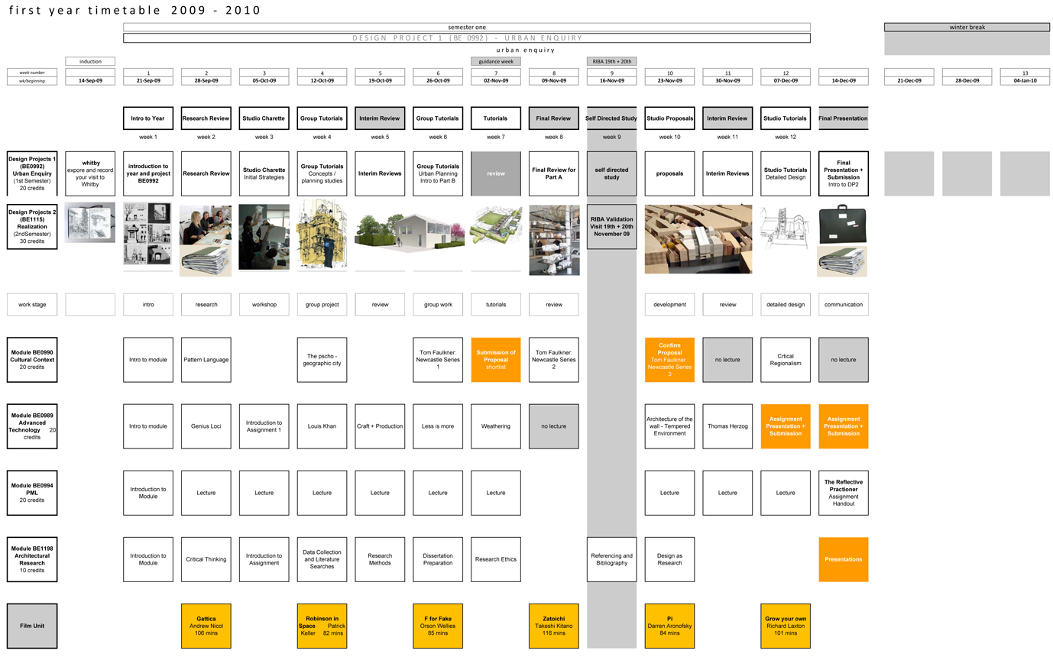
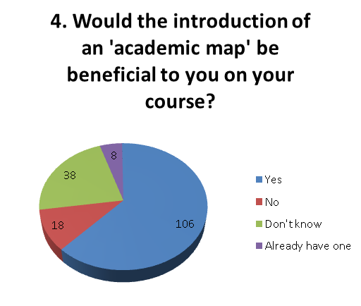
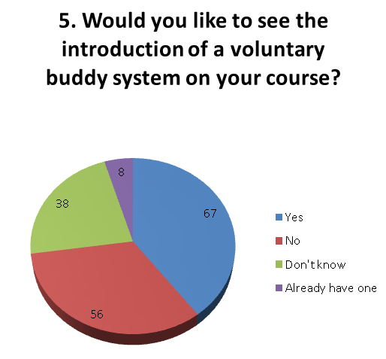
Example of ‘academic map’ shared in survey

Slide 8
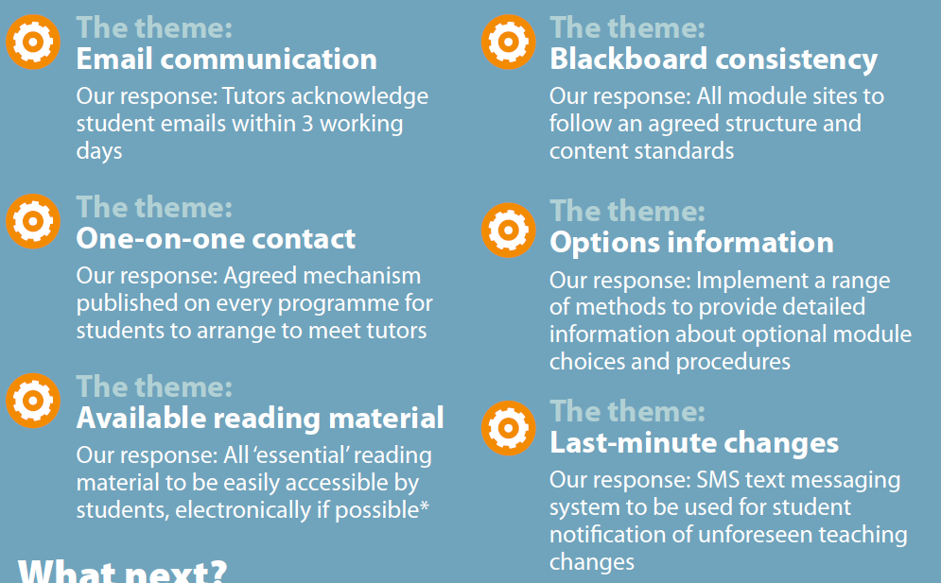

Slide 9
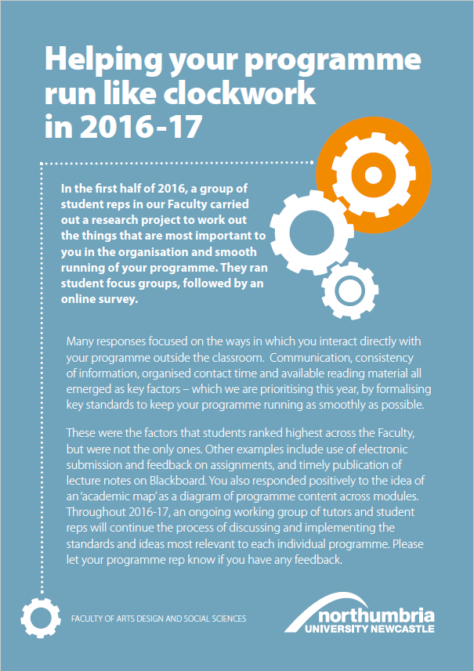
Posters
Student flyers
Staff flyers

Slide 10
We hope we have…
Asked students what ‘organisation and smooth running’ means to them
Responded to the key themes
Begun getting that message loudly back to students
Set the criteria for the NSS
Thanks for your time!

