Slide 1
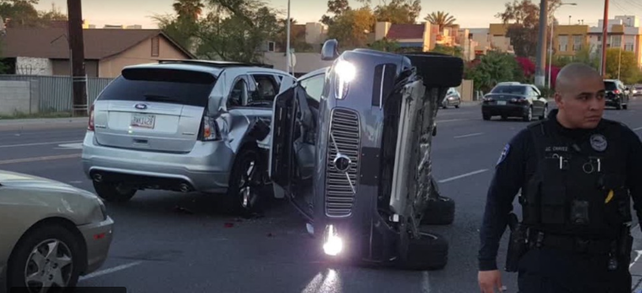
HOW FAR IS THE LAW OF TORT READY TO ADAPT TO DRIVERLESS CARS? John Bates, Northumbria Law School
@MrJohnBates
TRILCon 2017 > Autonomous Vehicles

Slide 2
Image credit: Copyright The Rt Hon Chris Grayling MP Secretary of State for Transport bynumber10gov. Licensed under CC BY-2.0 / image cropped.
“I recently had my first experience of a driverless vehicle. Believe me, it’s an unusual sensation. But it’s our future.
And what a difference it will make to all of us.“
Chris Grayling MP, Secretary of State for Transport, speech to Conservative Party Conference, 3 October 2016

Slide 3
Tort Liability and Driverless Cars
Who may be responsible for harm ‘connected with’ the use of a driverless car?
The driver
The owner (if different)
The manufacturer
The software developer
A third party supplier of services
An infrastructure provider?
A non-driver occupant responding in an emergency?
A third party hacker?

Slide 4
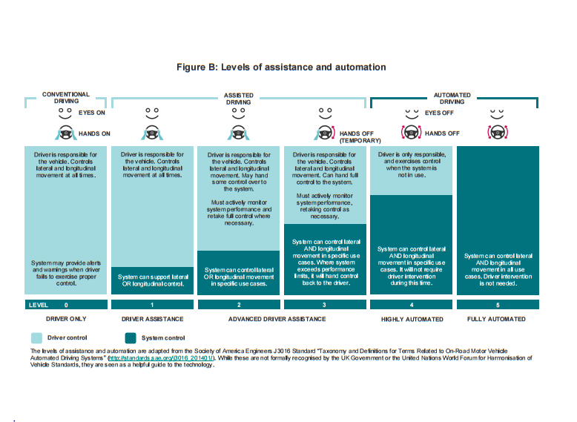
The transition to full automation

Slide 5
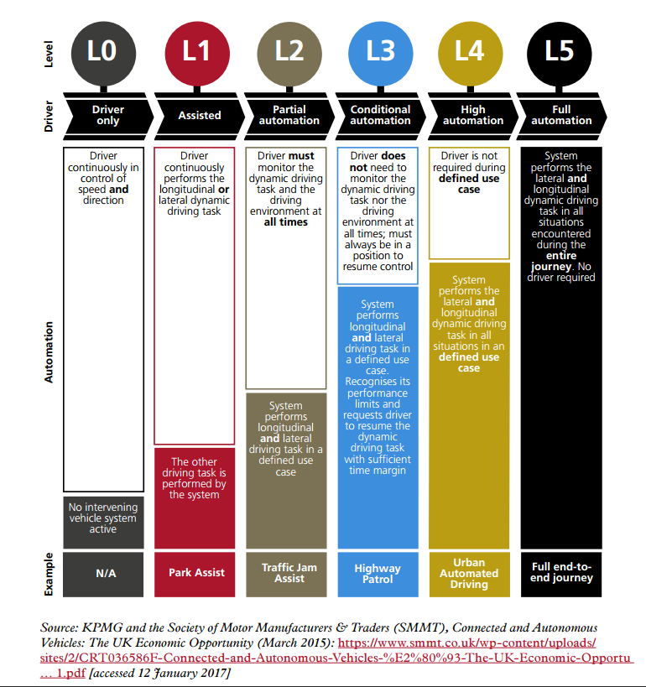

Slide 6
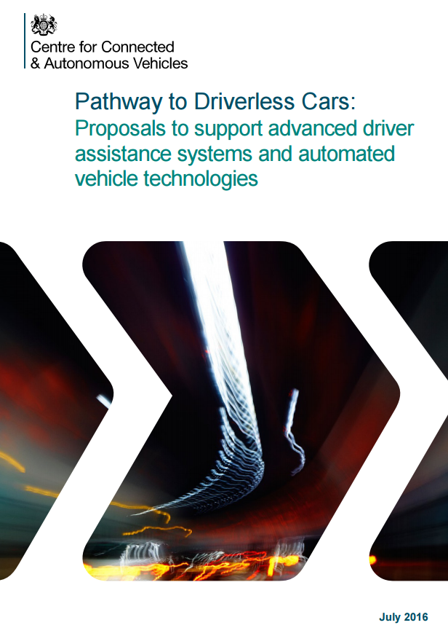
No change on liability rules?
“We are not currently proposing any significant change in our rules on liability in road traffic accidents to reflect the introduction of automated cars…
We think that the existing common law on negligence should largely be able to adapt to this new technology.”
[Department for Transport and the Centre for Connected and Autonomous Vehicles, ‘Pathway to Driverless Cars: Proposals to support advanced driver assistance systems and automated vehicle technologies’, July 2016, paragraph 2.20]

Slide 7
Routes to redress
The ‘product liability’ route
Voluntary self-insurance by manufacturers?
The ‘insurance route’ and the ‘single insurer’ model
Employers’ liability?
The residual role of the law of negligence where there is an element of human conduct

Slide 8
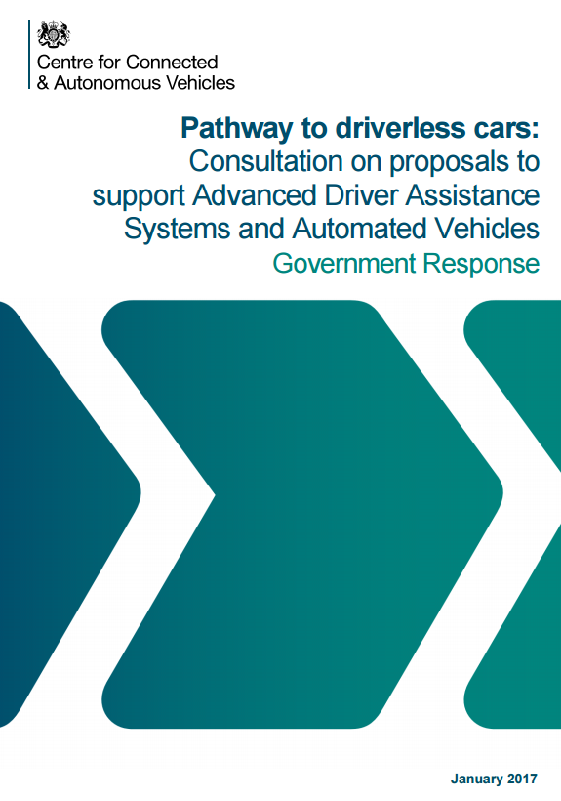
The single insurer model
“This single insurer model would ensure that the driver is covered both when they are driving, and when they have activated the ADF [Automated Driving Function]. In the event of a collision while the ADF was active, the innocent victim (both inside and/or outside the vehicle) would be able to claim from the insurer”
[Department for Transport and the Centre for Connected and Autonomous Vehicles, ‘Pathway to Driverless Cars: Proposals to support advanced driver assistance systems and automated vehicle technologies’, January 2017, paragraph 3.12]

Slide 9
Tort Liability and Driverless Cars
Automated insured vehicle which causes an accident when driving itself | Other circumstances
Accident is caused by… | Liability to be determined by the normal rules of Tort: principally negligence and product liability
An automated vehicle…
When driving itself…
Automated vehicle is insured…
Damage is caused…
To insured person or any other person
INSURER IS LIABLE FOR THAT DAMAGE [cl.2(1), Vehicle Technology and Aviation Bill] (this does not affect any other person’s liability in respect of the accident [cl.2(7)]

Slide 10
Behavioural aspects of autonomous vehicles
How will humans be expected to interact with autonomous vehicles?
What expectations will humans have from interactions with autonomous vehicles?
How well understood are the social and human behavioural changes that may arise from autonomous vehicles?
How will those social and human behavioural changes impact on the application of established principles of common law negligence to conduct by human actors (particularly during the transitional phase)?

Slide 11
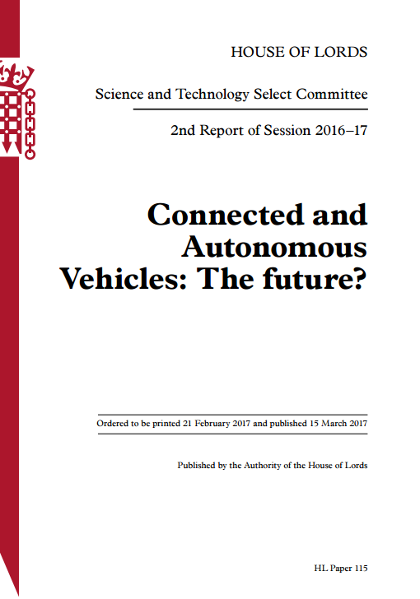
We need to know more about behavioural impacts
“We recommend that the Government should give priority to commissioning work to understand the main social and behavioural questions relating to CAV [Connected and Autonomous Vehicles]…
Paragraph 24.

Slide 12
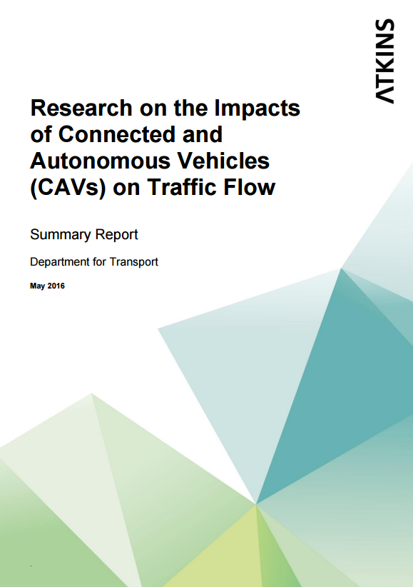
Modelling traffic behaviour in a mixed fleet
“This work should help to counter the possible disadvantages and negative effects of managing a mixed fleet of autonomous and non-autonomous vehicles. The research on human factors must feed in to the modelling work so that as more is understood about human interactions with CAV…”
Paragraph 26.

Slide 13
Behavioural changes and negligence
Duty of care – reasonably foreseeable consequences of conduct (including acts and omissions)
Standard of care – the reasonable person, the reasonably competent driver (or a connected/autonomous car)
Breach of duty – reactions in an emergency, social utility (in a broad and narrow sense)
Causation – reasonably foreseeable conduct acts and breaks in the chain of causation
Defences – reasonable care and a reduction of damages for contributory negligence

Slide 14
Image credit: Copyright Duty by Nick Youngson. Licensed under CC BY-SA 3.0
“[A]t last in this world, with great power there must also come – great responsibility”
“Spider-Man!”, Writer: Stan Lee, Illustrator: Steve Ditko, August 1962, Marvel Comics
THE SIGNIFICANCE OF THE SCOPE OF THE DUTY OF CARE SHAPING REASONABLE FORESEEABILITY OF THE CLAIMANT’S CONDUCT

Slide 15
Reasonable foreseeability of harm
A duty arises to take reasonable steps to avoid causing reasonably foreseeable harm to another
What did the defendant actually know, or ought reasonably to have foreseen, as a consequence of the defendant’s actions?
Knowledge and expectations are shaped by the public discourse about:
How CAVs will behave when interacting with actors; and
How actors should behave when interacting with CAVs

Slide 16
Reasonable foreseeability of harm
Influencers of knowledge and expectations:
Public awareness and publicity
Public education
Driver education (including the Driving Test)
Product information
Highway Code
Themes:
Trust in the machine
Assumptions of responsibility and reliance on assurances given by manufacturers and product developers
The problem of an evolving data pool

Slide 17
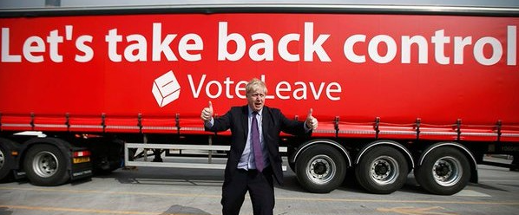
Image credit: Copyright Duty by Nick Youngson. Licensed under CC BY-SA 3.0
ACTS, OMISSIONS AND AUTONOMOUS VEHICLES TO INTERVENE OR NOT TO INTERVENE?

Slide 18
Interventions
Should a driver be under a positive duty to:
Engage assistive technology
Disengage assistive technology to take back control in an emergency
Are these ‘pure omissions’ or all part of a train of actions? Mitchell v Glasgow City Council [2009] UKHL 11, per Baroness Hale:
‘A driver who takes to the roads and thus is an actor in the drama is liable for the things which he fails to do as well as for the things which he does. His failure to keep a proper lookout, or to indicate when he proposes to change direction, is an omission. But he took the action of propelling his car in a particular way.’

Slide 19
Interventions
How far should a system monitor, promote and warn of a need for an intervention?
Ethical issues and a duty to intervene: relationship with the doctrine of necessity

Slide 20
THE EVOLUTION OF THE REASONABLE PERSON OVER TIME
From the man on the Clapham Omnibus to a reasonable person on a Boris Bus with an Oyster Card

Slide 21
The standard of care
What standard of behaviour is expected of an autonomous vehicle towards actors?
A reasonably competent driver?
A reasonable artificially intelligent driving system – the expert standard?
What standard of behaviour is expected of actors when interacting with an autonomous vehicle?
A reasonably competent driver (+ CAV-qualified?)
Differential standard for vulnerable road users:
Pedestrians
Cyclists
Children
People with impairments
Animals

Slide 22
The standard of care
Emphasis is on reasonable safety, not absolute safety, and the standard provided by a CAV will be higher than a human, as time progresses.
Standards for CAVs and actors will evolve over time, as market penetration improves. (Analogy with Baker v Quantum Clothing)
The problem of disharmony, particularly with differential standards and specifications, and further with shared/pooled autonomous vehicles.

Slide 23
Particular aspects relevant to breach
Incentivised driver distractions and habitual inattentiveness (analogy with contributory negligence of employees)
Machine-learning of driver behaviours
Impaired reaction and response times
Emergency action and interventions in the ‘agony of the moment’
Social utility (in a narrow sense)
Social utility (in a broad sense) representing benefits of CAVs
The relevance of insurance and the disconnect from moral blameworthiness

Slide 24
Image credit: Copyright Chain by Aqua Mechanical. Licensed under CC BY-2.0
CONDUCT IN A CAUSATION ENQUIRY
HOW CAN A CLAIMANT’S CONDUCT IMPACT ON THE CAUSATION OF LOSS?

Slide 25
Causative aspects
Factual causation
Would the engagement/disengagement of the assistive technology have any causative potency?
The role of predictive analytics (from personalised data and from big pooled data)

Slide 26
Causative aspects
Legal causation:
Notions shaped by big data and personalised data relating to the driver driving feedback design and data sharing:
- Reasonable foreseeability of types of harm
- Reasonable foreseeability of extent of harm
Reasonable foreseeability of the way in which the harm arises
The application of the ‘thin skull’ principle to unknown vulnerabilities of actors

Slide 27
Causative aspects
Novus actus interveniens: is the event reasonably foreseeable within the scope of the defendant’s duty?
Driver conduct (relevant to exclusion of insurance liability)
Unauthorised modifications to system software
Failure to update software as required by a policy
Acts of nature
Connectivity fallouts (live and non-live)
Acts of a third party
hacking

Slide 28
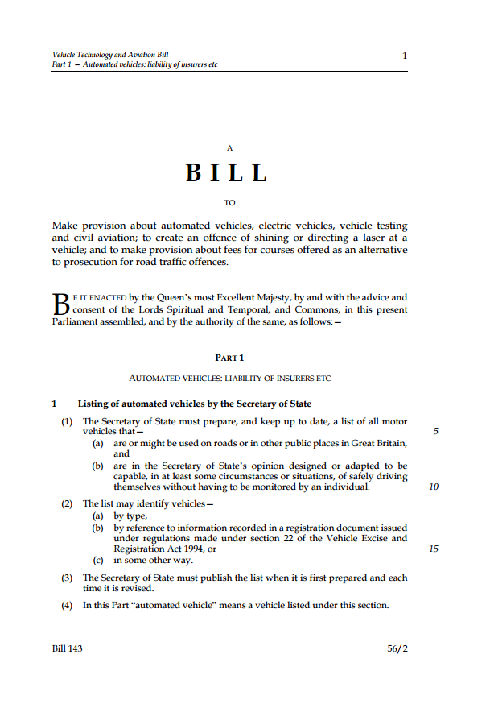
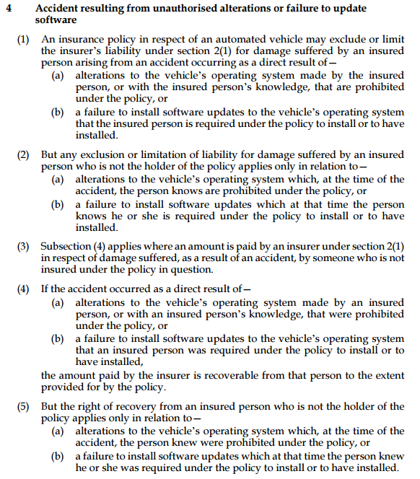
Unauthorised use, failure to update software

Slide 29
Connectivity fallouts
UK A and B roads:
6% no mobile voice coverage
20% no 4G mobile data coverage
[SMMT estimated 48% of British roads with full 3G coverage and 18% with full 4 G coverage]
Is an interconnectivity fallout reasonably foreseeable?
Who should bear the risks of a connection fallout?
Data updates / software maintenance and pricing plans – what of the impecunious owner and the ‘thin wallet’?

Slide 30
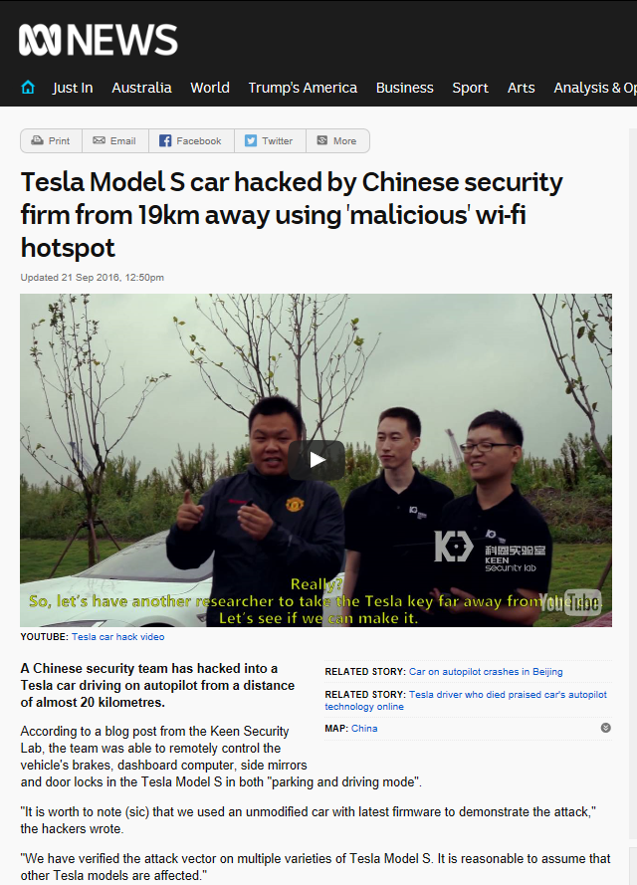
Cybersecurity compromise
Reasonably foreseeable consequence?
Liability for consequential loss caused by cybersecurity breach
Increased risks of criminal or terrorist security compromise
Demonstrating causative potency of failure to update software
Reliance on manufacturer’s instructions
Additional insurance?

Slide 31
Defences
Contributory negligence
‘Relative blameworthiness’
Analogy with ‘custodian’ cases where imbalance of power?
Reliance on assurances in product information and publicity with an assumption of responsibility?
Failure to engage onboard safety systems
Would an intervention have actually made any difference, given blunted reaction times, lack of familiarity with controls etc.?
Growing considerations of individual characteristics?
Evolving standard of reasonable care to avoid reasonably foreseeable harm to oneself
Causative potency to damage (not accident)
Evolving notions of justice in reducing damages commensurate with transition towards automated vehicles?

Slide 32
Employer’s Liability?
A recognised gap in the government’s proposals [para 3.42, Response]
The relationship with the employers’ common law duty in negligence to provide reasonably safe equipment, reasonably safe system of work etc. (recognised as a high standard) for which compulsory insurance is required.

Slide 33
Employer’s Liability?
The relationship with the ‘strict liability’ regime under the Employers’ Liability (Defective Equipment) Act 1969:
Employee suffers personal injury in the course of his employment in consequence of a defect in equipment provided by his employer for the purposes of the employer’s business and the defect is attributable wholly or partly to the fault of a third party (whether identified or not)
Injury shall be deemed to be also attributable to the negligence on the part of the employer (whether or not he is liable in respect of the injury apart from the Act), but
Without prejudice to the law relating to contributory negligence and to any remedy by way of contribution or in contract or otherwise which is available to the employer in respect of the injury.)

Slide 34
‘How far is the law of tort ready to adapt to driverless cars?’
In its July 2016 Consultation Paper, ‘Pathway to Driverless Cars: Proposals to support advanced driver assistance systems and automated vehicle technologies’, the United Kingdom’s Department for Transport concluded:
‘We are not currently proposing any significant change in our rules on liability in road traffic accidents to reflect the introduction of automated cars. We still think a fault based approach combined with existing product liability law, rather than a new strict liability regime, is the best approach for our legal system. We think that the existing common law on negligence should largely be able to adapt to this new technology’
What impact will the evolution of driverless cars have on the application of existing common law principles of negligence of a human actor where harm is caused in a road traffic accident? Should a driver be liable for an omission to engage (or disengage) onboard automotive assistance? What standard of care is expected of a driver stepping in to take control? How far are perceptions of trust and risk relevant to a transitional phase with a mix of autonomous and non-autonomous traffic? What new risks are created by autonomous vehicles, such as reliance on third party services (such as mapping), interoperability failures with other systems (such as highway control), faults in data collection and sharing (such as telemetrics and onboard records of driver autonomy) and of cyber-security comprises (including hacked systems).
The common law of negligence is predicated on the piecemeal development of principles and their application incrementally through case law and decisions of appellate courts. That is a naturally time-consuming process, and recent reform proposals may remove many road traffic accident claims from the litigation process. Is the civil justice system equipped effectively to deal with driverless vehicles?
This paper hopes to explore some of these issues.

Slide 35
HOW FAR IS THE LAW OF TORT READY TO ADAPT TO DRIVERLESS CARS? John Bates, Northumbria Law School
@MrJohnBates
TRILCon 2017 > Autonomous Vehicles

