Slide 1
‘ODR, Fixed Costs and Personal Injury Claims Process reform A Perfect Storm for Access to Justice?’ John Bates, Northumbria Law School
@MrJohnBates
SLSA 2017 > Medical Law, Healthcare and Bioethics

Slide 2
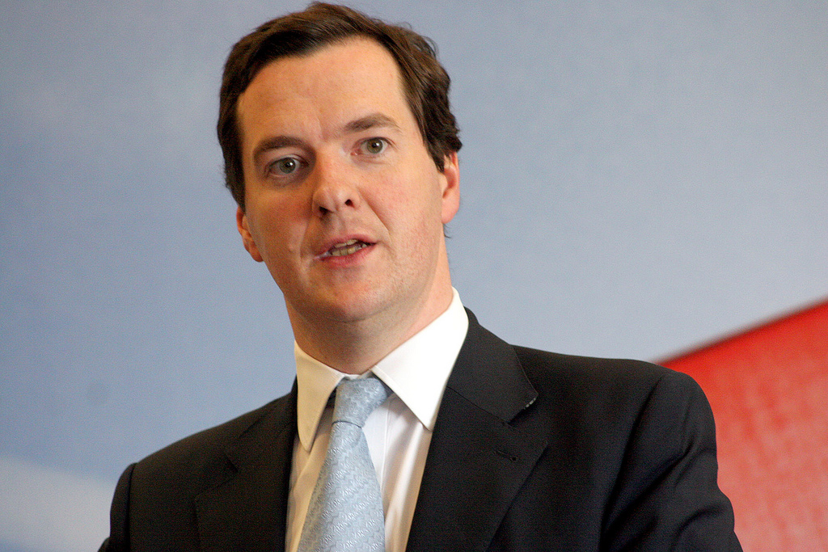
Image credit: Copyright George Osborne 0486am by Altogetherfool. Licensed under CC BY-2.0 / image cropped.
“We’re going to bring forward reforms to the compensation culture around minor motor accident injuries.”
George Osborne MP
Chancellor of the Exchequer, Spending Review and Autumn Statement, 25 November 2015

Slide 3
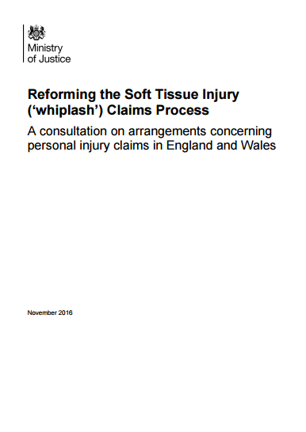

Slide 4
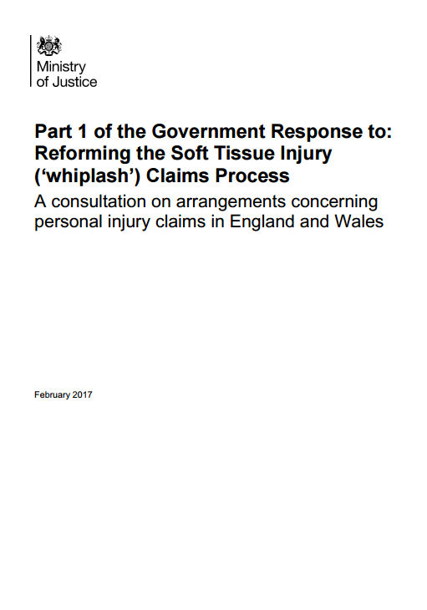

Slide 5
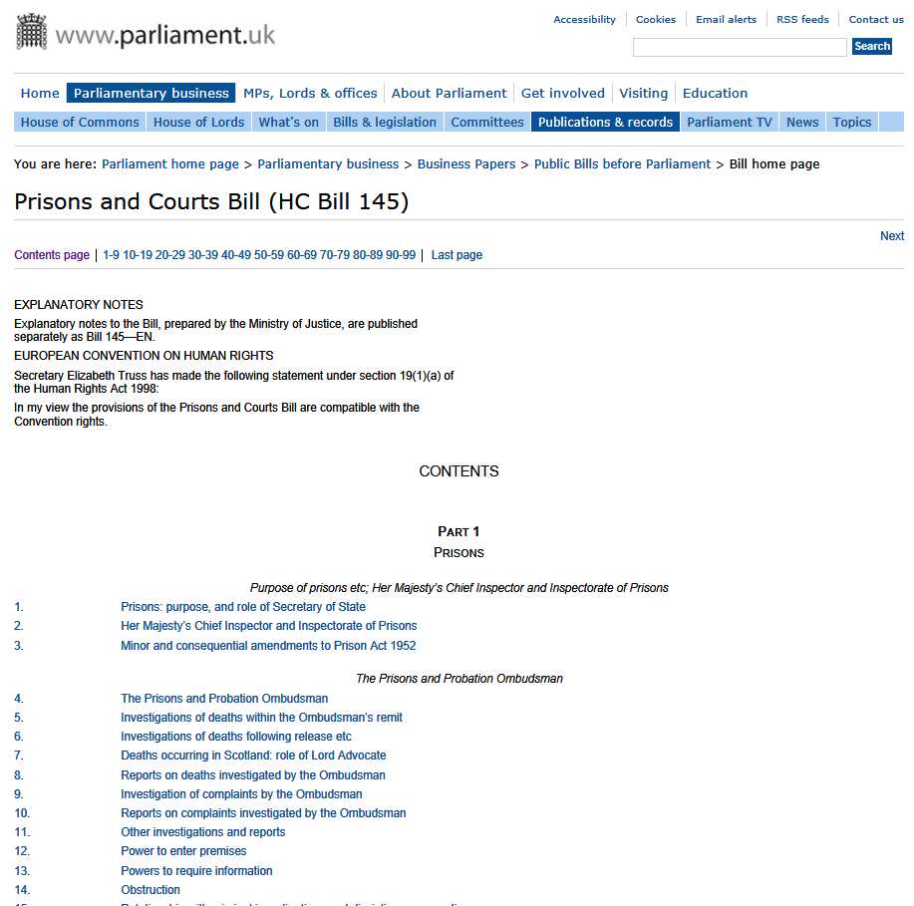

Slide 6
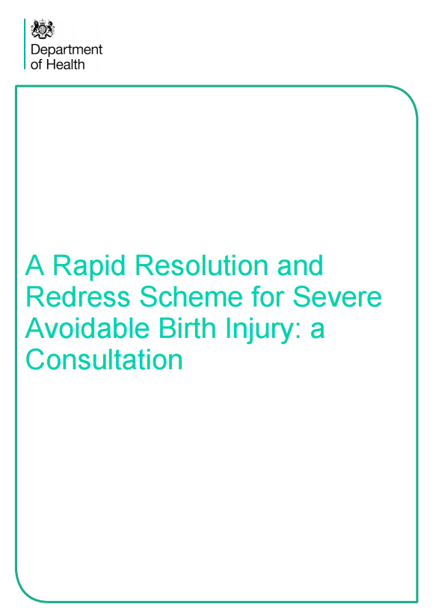

Slide 7
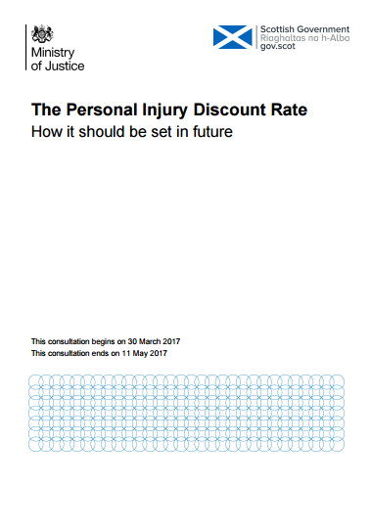

Slide 8
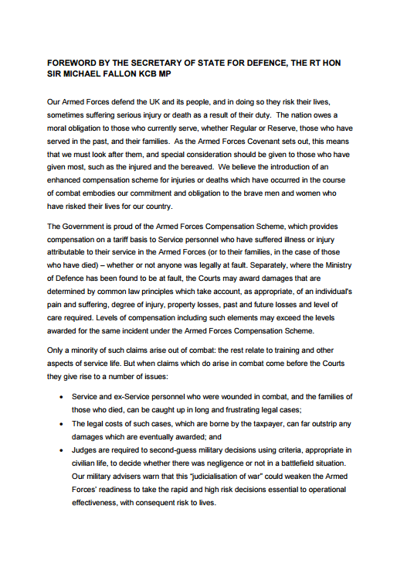

Slide 9
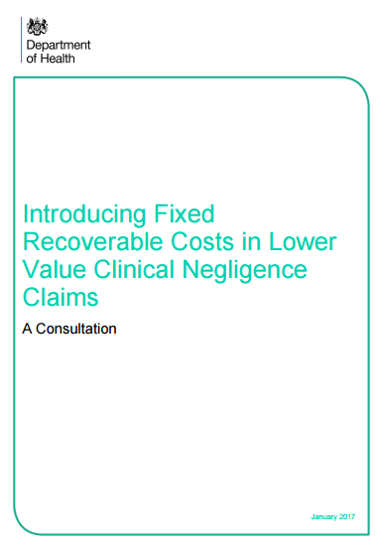

Slide 10
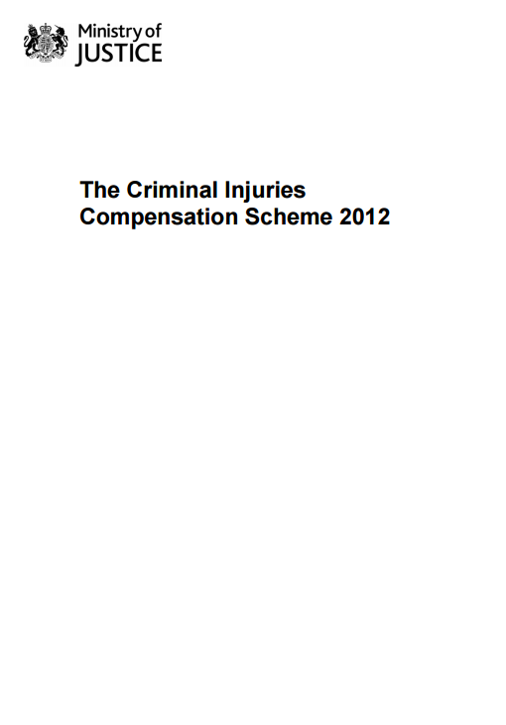
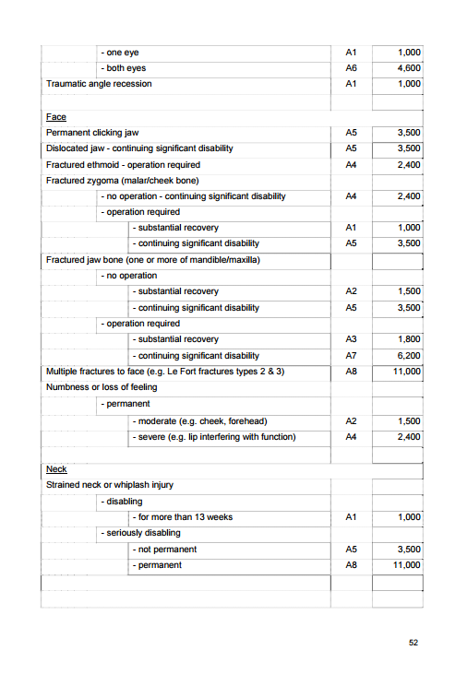

Slide 11
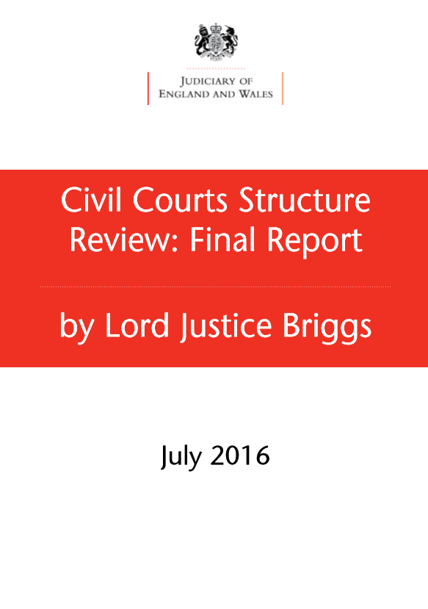

Slide 12
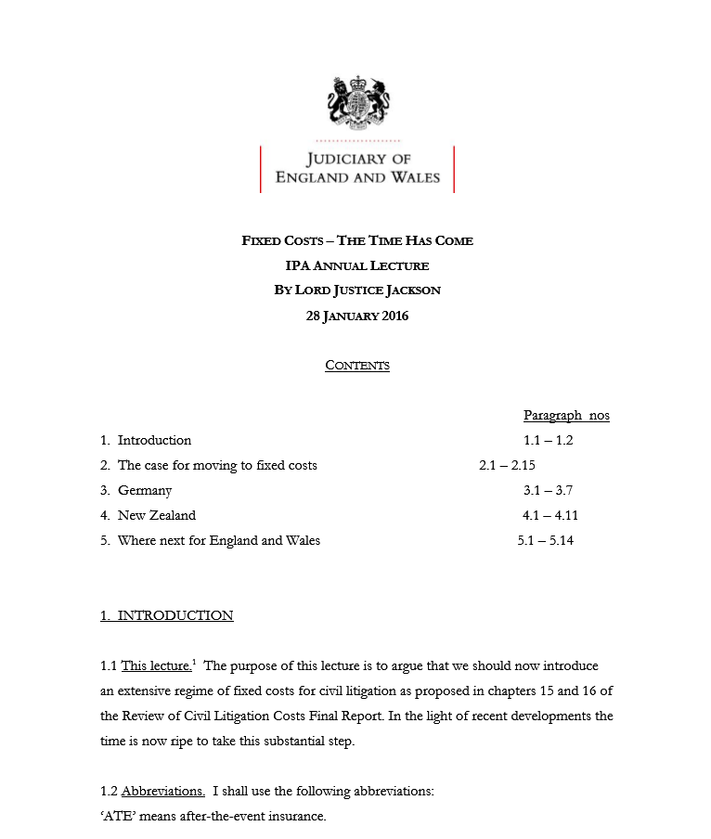
‘… we should now introduce an extensive regime of fixed costs for civil litigation as proposed in chapters 15 and 16 of the Review of Civil Litigation Costs Final Report. In the light of recent developments the time is now ripe to take this substantial step.’

Slide 13
What’s going on?
Reforming the Soft Tissue Injury (‘whiplash’) Claims Process
The Prison and Courts Bill
Lord Justice Jackson’s Review of Fixed Recoverable Costs
Implementation of Lord Justice Briggss’ Civil Courts Structure Review
Department of Health’s consultation on Fixed Recoverable Costs for Clinical Negligence Claims
Department of Health’s consultation on A Rapid Resolution and Redress Scheme for Severe Avoidable Birth Injury
Ministry of Justice consultation on The personal injury discount rate: how should it be set in future
Ministry of Defence consultation on Better Combat Compensation

Slide 14
Concerns
Damages
Costs
Process
Funding
Access to Justice
Timing

Slide 15
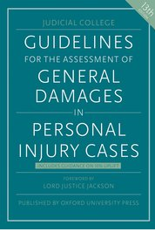
Damages
Tariffs
Digital approach cf. analogue approach
Ossification
Taxonomy
Psychological injury
A flawed basis: heavy discounts from old data
Disproportionate impact on low income claimants

Slide 16
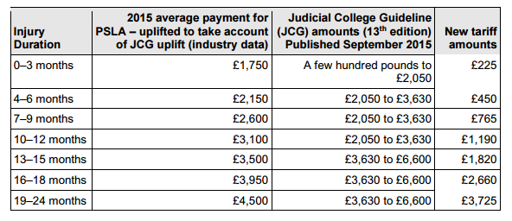
Damages

Slide 17
Costs
The failure of costs management
Are there any advantages to open costs?
Fixed Recoverable Costs: Where are we?
The future

Slide 18
Process
Changes to the Small Claims Track (SCT)
Structural inequality of arms
Harm cf. mechanism of injury
Financial incentives to settle:
no-costs and no Part 36
no refundability of hearing fee
appetite/resources for ADR
Litigants in Person
Access to Portals
Access to MedCo

Slide 19
Funding
The impact of a change to the SCT
A change in the basket of risks for CFAs
The ‘call for evidence’ and the MoJ’s response
To BTE or not to BTE?
Disbursement funding

Slide 20
Behaviours
Disenfranchisement
Disengagement
Displacement
De-skilling
Pressure to extend
Technology

Slide 21
‘ODR, Fixed Costs and Personal Injury Claims Process reform: A Perfect Storm for Access to Justice?’
In January 2017 there were three significant developments presenting real challenges for access to justice for those injured as a result of negligence.
First, the Lord Chief Justice and the Master of the Rolls issued a joint statement endorsing the Final Report of Lord Justice Briggs’ Civil Courts Structure Review, which they described as ensuring ‘that the overall system for civil justice is improved for its users in a coherent as well as comprehensive manner.’ Chapter 6 of the Report recommended the introduction of an Online Court, eventually to be made compulsory for cases within its jurisdiction, and with a fixed recoverable costs model.
On the same day, the Ministry of Justice closed its consultation on ‘Reforming the Soft Tissue (‘Whiplash’) Claims Process’ which included controversial proposals to remove the right of injured people to claim damages for some types of pain, suffering and loss of amenity, the introduction of a fixed tariff for damages for other injuries and an increase in the scope of the small claims track. The Government’s stated aim was to implement the reforms as soon as possible.
Finally, Lord Justice Jackson commenced his review of fixed recoverable costs as an extension of his previous Review of Civil Litigation Costs, commissioned by the Lord Chief Justice and the Master of the Rolls. In an earlier speech, Lord Justice Jackson had proposed an extension of fixed recoverable costs to claims with a value of up to £250,000.
How will this concatenation of reforms impact on access to justice in personal injury and clinical negligence claims, where individuals face well-resourced tortfeasors, in what has been described as a ‘paradigm instance of litigation in which the parties are in an asymmetric relationship’?
This paper aims to explore some of these topical issues.

Slide 22
‘ODR, Fixed Costs and Personal Injury Claims Process reform A Perfect Storm for Access to Justice?’ John Bates, Northumbria Law School
@MrJohnBates
SLSA 2017 > Medical Law, Healthcare and Bioethics

