Slide 1

INFECTION PREVENTION AND CONTROL PRACTITIONER
CORE COMPETENCES
&
HOW THEY INTERACT With REVALIDATION OF NMC REGISTRATION

Slide 2
AIM
TO PROVIDE INSIGHT (and examples) INTO HOW COMPETENCES AND REVALIDATION CAN BE INTERTWINED

Slide 3

OSTRICH THEORY?

Slide 4
IN HEALTH AND SOCIAL CARE
essential that all workers are equipped with the necessary, knowledge, competencies, proficiencies, and essential skills, to deliver a high standard of IPC practice across the wide spectrum of health and social care.
Department of Health (2010) Health And Social Care Act 2008: code of Practice on the prevention and control of infections and related guidance Department of Health London Available at: http://www.legislation.gov.uk/

Slide 5
Is IPC practice unique?
it crosses all disciplines and areas of health and social care practice, while dovetailing with not only some elements of public health but also some within infectious diseases

Slide 6

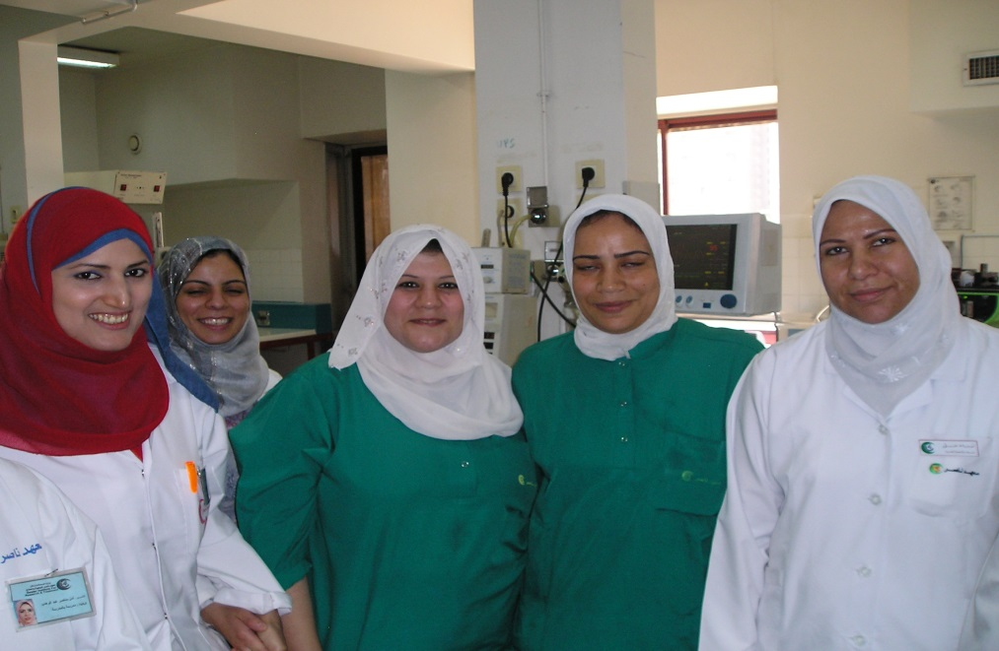
SPECIALIST PRACTITIONERS
Are IPCP unique?

Slide 7
Specialist Practitioners
All specialist practitioners have core elements or domains of practice, it is the specialist knowledge and specialist domains of individual specialities that create diversity in how they practice and assess competency.

Slide 8

Revalidation
Built on existing 3-year renewal (Prep) cycle
Ongoing demonstration of continued fitness to practice throughout career
Promotion of the Code as part of day to day practice and personal development
Encouraging positive behaviours
A positive affirmation – not about searching for ‘bad’ practice
Notes:
This is the first phase of revalidation and it is being introduced within the NMC’s existing legislative framework.
Revalidation is not a point in time assessment or a test. It is about demonstrating that you (nurses and midwives) are keeping up to date and fit to practice throughout your career. The Code is central to this.
Revalidation should also encourage a range of positive behaviours, for example, it should challenge those who work in professional isolation to engage with peer networks and wider professional development initiatives.
It should encourage employers and organisations to have a greater understanding of the standards set by the NMC. It should also encourage greater access to professional development and appraisals, especially those nurses and midwives who have traditionally struggled to access this kind of support.
It is not an exercise to try and find bad practice. The NMC’s revalidation model is based on positive affirmations of good practice.

Slide 9
The revalidation model
3 years
Meeting requirements and building a portfolio
12 months
Confirmation from a third party
Application for renewal of registration
45 days
Notes:
This is a high-level overview of the model:
Over the three year period, nurses and midwives need to engage in professional development activities and meet the revalidation requirements. They should keep this information in a portfolio (the next slide explains these requirements)
In the final year of their three-year registration period, nurses and midwives need to have a discussion with their line manager about their revalidation. They will need to take along their portfolio and use it to demonstrate to their line manager that they have met the revalidation requirements. NMC guidance will provide other options for registrants that don’t have a line manager.
45 days prior to the end of the date their renewal application is due, nurses and midwives will need to log onto NMC Online and apply to renew their registration. They will be asked to declare that they have complied with all of the revalidation requirements

Slide 10
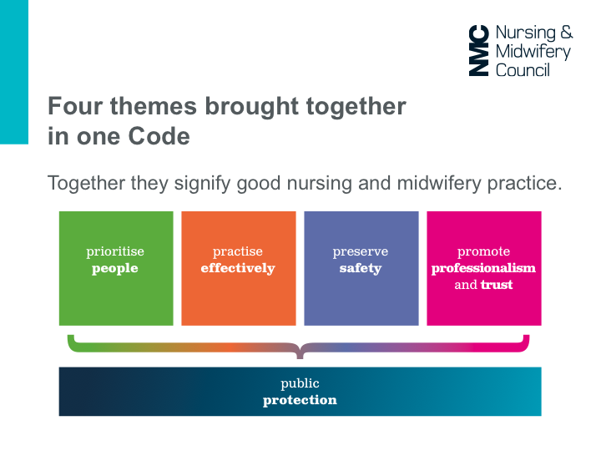
The new Code themes:

Slide 11
What does revalidation entail?
The Code
Practice Hours
CPD
Feedback
Reflection and discussion
Professional indemnity arrangement
Health and character
Confirmation

Slide 12
Revalidation requirements
Questions asked:
Is practice only clinical practice?
The Code
Practice Hours
450 hours
CPD
Feedback
Reflection and discussion
Professional indemnity arrangement
Health and character
Confirmation
Collected evidence to use:
1. Pay slips
2. Contract of employment
3. Job description
Notes:
Total practice hours required:
Nurse - 450
Midwife - 450
Nurse and SCHPN - 450
Midwife and SCHPN - 450
Nurse/SCHPN and Midwife Or Midwife/SCHPN and Nurse – 900
Only hours that are relevant to nursing or midwifery practice can be counted.
This is unchanged for now.
Scope of practice: Education, research, clinical, management.

Slide 13
Revalidation requirements
40 hours of CPD required
  at least 20 hours participatory
  related to scope of practice
The Code
Practice Hours
CPD
40/20
Feedback
Reflection and discussion
Professional indemnity arrangement
Health and character
Confirmation
Detailed guidance provided
Collected evidence to use:
1. Agenda for meetings/minutes
2. Programme for study days/ notes from session/ certificate of attendance
3. Copies of articles read, including the hyperlinks.
Notes:
CPD
All registrants are required to undertake a minimum of 40 hours of CPD in each three year renewal period.
Of those 40 hours, at least 20 hours must be participatory learning.
All CPD included in these hours must be relevant to your scope of practice as a nurse or midwife. This means that some mandatory training should not be included if it does not directly relate to your practice as a nurse or midwife.
NMC guidance on how to revalidate will provide a list of examples of CPD, including examples that are participatory CPD.

Slide 14
Revalidation requirements
The Code
Practice Hours
CPD
Feedback
5 instances
Reflection and discussion
Professional indemnity arrangement
Health and character
Confirmation
Related to practice
  Broad options
  Not necessarily formal
Questions:
1. To be used as the basis for the discussion with registrant (see next)
2. Annual review over 3 years can be included
Notes:
Requirement: Feedback on their practice
All registrants must obtain at least five instances of feedback about their practice
Feedback can come from a range of sources and does not have to be formal feedback.
As well as collecting feedback directly from service users and colleagues, you can think about the feedback you get through reviewing complaints, team performance reports and serious event reviews. You are encouraged to think broadly about where to seek feedback.

Slide 15
Revalidation requirements
The Code
Practice Hours
CPD
Feedback
Reflection (5 instances) and discussion with a registrant
Professional indemnity arrangement
Health and character
Confirmation
Biggest source of discussion amongst pilots
Level of reflection
best practice,
or achievable for all
Template provided
Notes:
Requirement: reflections on CPD, feedback and the Code
You will need to record at least five written reflections on CPD, feedback and the Code.
Each reflective account could be about a specific instance of feedback or CPD, or could reflect a broader theme across your CPD and feedback.
Each reflection should:
Explain what you learnt
How you changed or improved your practice; and
How it is relevant to the Code
You will need to discuss your reflections with another NMC registrant. If your line manager is an NMC registrant, you can have this conversation as part of your confirmation discussion.
The NMC will provide a template that you can use if you find it helpful.

Slide 16
Revalidation requirements
The Code
Practice Hours
CPD
Feedback
Reflection and discussion
Professional indemnity
through your employer, professional body or private insurance provider
Health and character
Confirmation
Notes:
Professional indemnity arrangements
You will need to declare that you have in place (or will have when necessary) an appropriate indemnity arrangement as part of your online application.
Information on the provenance of the arrangement will be requested as part of the declaration (i.e. through your employer, professional body or private insurance provider).
As with existing

Slide 17
Revalidation requirements
The Code
Practice Hours
CPD
Feedback
Reflection and discussion
Professional indemnity arrangement
Health and character
Self declaration
Confirmation
Notes:
Declaration of health and character
All registrants must provide a health and character declaration as part of their online application.
Any registrant who has been convicted of any criminal offence or been issued with a formal caution, over the three years prior to the renewal of their registration, must provide details as part of their renewal application.

Slide 18
COMPETENCE FRAMEWORKS
viewed as an integral part of workforce development (Larkin 2014)
increasingly utilised to increase not only knowledge and skills but also transparency, into not only these attributes, but also attitudes and behaviours (Thorpe 2015).
Also an ethical obligation for healthcare professionals to maintain competence within their work arena (Alison2009, Nursing and Midwifery Council [NMC] 2015).
Notes:
This ensures continued professionalism and protects the patients and public.

Slide 19
OPPORTUNITY
the changes required by the NMC, regarding revalidation of nurse/midwife practitioners, on their register (NMC 2015), implies that many IPCP can now link their professional identity, work appraisals, performance, personal and professional development, reflections and fitness to practice, directly to competences, during the revalidation process of their registration

Slide 20
Portfolios
Participants will compile a portfolio to include:
  A record of the practice hours completed and the context and settings of practice in which it was undertaken
  Five reflective accounts on feedback on their practice and their CPD activities and linking this to Code requirements
  CPD related evidence
  Professional indemnity arrangement information
  Confirmation-related documents
NMC guidance sets out detailed records that should be kept in the portfolio.

Slide 21
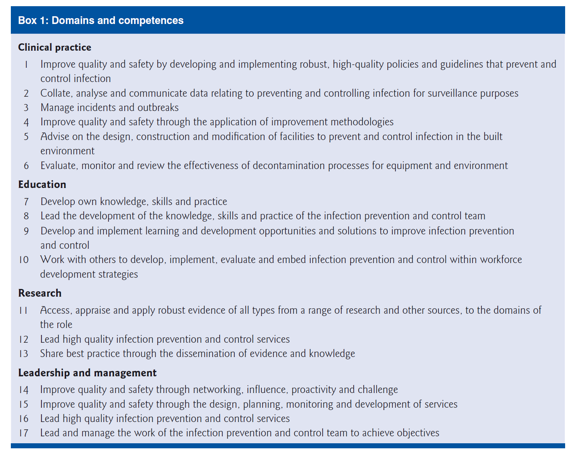
Competences for IPCP (Burnett 2011)

Slide 22
Competencies for Link personnel
European Centre For Disease Control [ECDC](2013) Core competencies for infection control and hospital hygiene professionals in the European Union. ECDC Stockholm
http://ecdc.europa.eu/en/publications/Publications/infection-control-core-competencies.pdf
Royal College of Nursing (2012) The role of the Link Nurse in infection prevention and control (IPC) developing a link nurse framework. RCN London
https://www2.rcn.org.uk/__data/assets/pdf_file/0006/481515/004310.pdf

Slide 23
So How do the current competences fit with revalidation?
When self assessing your competence consider how THE FOUR THEMES OF THE NMC CODE sit within your reflections and THE CURRENT DOMAINS OF COMPETENCY
This will all enable you to have a more productive appraisal in terms of your professional and personal development needs and possible career progression.

Slide 24

Guide to completing practice hours log To record your hours of practice as a registered nurse and/or midwife, please fill in a page for each of your periods of practice. Please enter your most recent practice first and then any other practice until you reach 450 hours. You do not necessarily need to record individual practice hours. You can describe your practice hours in terms of standard working days or weeks. For example if you work full time, please just make one entry of hours. If you have worked in a range of settings please set these out individually. You may need to print additional pages to add more periods of practice. If you are both a nurse and midwife you will need to provide information to cover 450 hours of practice for each of these registrations. | Work setting Ambulance service Care home sector Community setting (including district nursing and community psychiatric nursing) Consultancy Cosmetic or aesthetic sector Governing body or other leadership GP practice or other primary care Hospital or other secondary care Inspectorate or regulator Insurance or legal | Maternity unit or birth centre Military Occupational health Police Policy organisation Prison Private domestic setting Public health organisation School Specialist or other tertiary care including hospice Telephone or e-health advice Trade union or professional body University or other research facility Voluntary or charity sector Other | Scope of practice Commissioning Consultancy Education Management Policy Direct patient care Quality assurance or inspection Registration Nurse Midwife Nurse/SCPHN Midwife/SCPHN Nurse and Midwife (including Nurse/SCHPN and Midwife/SCPHN)
Dates: | Name and address of organisation: | Your work setting (choose from list above): | Your scope of practice (choose from list above): | Number of hours: | Your registration (choose from list above): | Brief description of your work:
(Please add rows as necessary)

Slide 25
Please provide the following information for each learning activity, until you reach 35 hours of CPD (of which 20 hours must be participatory).
For examples of the types of CPD activities you could undertake, and the types of evidence you could retain, please refer to Guidance sheet 3 in How to revalidate with the NMC.
Guide to completing CPD record log
Examples of learning method Online learning Course attendance Independent learning | What was the topic? Please give a brief outline of the key points of the learning activity, how it is linked to your scope of practice, what you learnt, and how you have applied what you learnt to your practice. | Link to Code Please identify the part or parts of the Code relevant to the CPD. Prioritise people Practise effectively Preserve safety Promote professionalism and trust

Slide 26
Example
Template: Continuing Professional Development (CPD) record log- Please provide the following information for each learning activity. You may be required to upload additional evidence in relation to your record of CPD.
For examples of the types of CPD activities you could undertake and the types of evidence you could keep in your portfolio please refer to Annex 2 of ‘How to revalidate with the NMC’.
Dates | Method Please describe the methods you used for the activity. For example: Online learning, Course attendance, Independent learning | Topic(s) Please give a brief outline of the key points of the learning activity, how they are linked to your scope of practice, what you learnt, and how you have applied what you learnt to your practice | Link to Code Prioritise people Practise effectively Preserve safety Promote professionalism and trust | Number of hours | Number of participatory hours
01/13 – 06/13 | Course attendance (face-to-face) including self-study. Location: University of Worcester Title: Independent prescribing from the community practitioner formulary. | Course: The module focuses on the knowledge, understanding and assessment required for the V150 community practitioner nurse prescriber. Link: Lymphoedema Nurse Specialist Application: The V150 enabled me to prescribe the necessary resources to manage patients efficiently/effectively. | Prioritise People (2/3/4) Practise effectively (6/78/9) Preserve Safety (13/18/19) Professionalism and trust (20/21/22.2/25.1) | 120 | 60

Slide 27
Dates: | Method Please describe the methods you used for the activity: | Topic(s): | Link to Code: | Number of hours: | Number of participatory hours:
25/4/16 | Link Group Meeting | Chaired by Lead infection & prevention Practitioner(IPCP) Explained new audit tool for trust wide audit on use of aprons Application: My role as a link practitioner , has been enhanced by the knowledge and practical skills I will gain from undertaking this audit within my work area. Links to some IPCP competence criteria within the domains of Clinical practice, Education and Leadership and Management | Practise effectively (6/7/8/9) Preserve Safety (18/19) Professionalism and trust (20/21/23) | 2 | 2
1/2/16 | Mentorship programme | Course: The module focuses on the mentoring, supporting enhancement of knowledge understanding and clinical skills assessment in the clinical environment | Prioritise People (2/3/4) Practise effectively (6/78/9) Preserve Safety (13/18/19) Professionalism and trust (20/21/22.2/25.1) | 200 | 30
 |  |  |  | Total: 2 | Total: 2

Slide 28

You must use this form to record five written reflective accounts on your CPD and/or practice-related feedback and/or an event or experience in your practice
And how this relates to the Code. Please fill in a page for each of your reflective accounts, making sure you do not include any information that might identify
a specific patient, service user or colleague. Please refer to our guidance on preserving anonymity in Guidance sheet 1 in How to revalidate with the NMC.
Reflective account:
What was the nature of the CPD activity and/or practice-related feedback and/or event or experience in your practice?
What did you learn from the CPD activity and/or feedback and/or event or experience in your practice?
How did you change or improve your practice as a result?
How is this relevant to the Code? Select one or more themes: Prioritise people – Practise effectively – Preserve safety – Promote professionalism and trust

Slide 29

Example
You must use this form to record five written reflective accounts on your CPD and/or practice-related feedback and/or an event or experience in your practice
And how this relates to the Code. Please fill in a page for each of your reflective accounts, making sure you do not include any information that might identify
a specific patient, service user or colleague. Please refer to our guidance on preserving anonymity in Guidance sheet 1 in How to revalidate with the NMC
Reflective account:
What was the nature of the CPD activity and/or practice-related feedback and/or event or experience in your practice? Link Group Meeting. Chaired by Lead infection & prevention Practitioner(IPCP) Explained new audit tool for trust wide audit on use of aprons. Afterwards read Burnett, E (2011) Outcome Competences for Practitioners in Infection Prevention and Control Journal of Infection Prevention 12 (2) 67-90 Department of Health (2010) Health And Social Care Act 2008: code of Practice on the prevention and control of infections and related guidance Department of Health London Available at: http://www.legislation.gov.uk/ accessed 23/6/15 European Centre For Disease Control [ECDC](2103) Core competencies for infection control and hospital hygiene professionals in the European Union. ECDC Stockholm Sopirala M.M.et al. (2014) Infection Control Link Nurse Program: An interdisciplinary approach in targeting health care-acquired infection American Journal of Infection Control 42 353-9
What did you learn from the CPD activity and/or feedback and/or event or experience in your practice? My role as a link practitioner, has been enhanced by the knowledge and practical skills I will gain from undertaking this audit within my work area. I have learnt about clinical audit processes, been able to comment on the advantages and negatives of the audit tool used and felt I was listened to. Also indicated to me that one of the core behaviours of a LP is to be an active participant in the link person network (RCN 2012).
How did you change or improve your practice as a result? Much more aware of importance of protecting patients by ensuring that best evidence is actually being applied into practice. As a Link practitioner, this sits well within the core competences (IPS 2011)of clinical practice (2, 3 & 5) for ensuring policy compliance, effective and evidence based patient care and working in partnership with IPCP. This also relates to the RCN (2012) link worker guidance and facilitates me being able to be pro-active in preventing and controlling infection within my own work arena.
How is this relevant to the Code? Select one or more themes: Prioritise people – Practise effectively – Preserve safety – Promote professionalism and trust
Practise effectively – Preserve safety – Promote professionalism and trust

Slide 30

You must use this form to record five written reflective accounts on your CPD and/or practice-related feedback and/or an event or experience in your practice
And how this relates to the Code. Please fill in a page for each of your reflective accounts, making sure you do not include any information that might identify
a specific patient, service user or colleague. Please refer to our guidance on preserving anonymity in Guidance sheet 1 in How to revalidate with the NMC.
Reflective account:
What was the nature of the CPD activity and/or practice-related feedback and/or event or experience in your practice?
Course attendance (face-to-face) including self-study. Title: Independent prescribing from the community practitioner formulary. The module is part of an overall MSc qualification in ‘Lymphoedema Care’. The module focuses on critical analysis of the underpinning theory and practice in the assessment/management of patients diagnosed with mild/moderate lymphoedema.
What did you learn from the CPD activity and/or feedback and/or event or experience in your practice?
This module has helped me to think more critically and reflect on my own practice. I have learned by standing back, reflecting on what I have read and heard and reviewing them from different perspective. I enjoyed attending lectures for this module as I gain more understanding on what is expected of this assignment. I also enjoyed the group tutorial section as it help to interact with a smaller group. However this made me sometimes uncomfortable as am not very confident when put on the spot. But overall this module has helped me grow more confidence in these situation and helped me to critically analyse my own practice.
How did you change or improve your practice as a result?
The theory/practice has enhanced my practice with those patients diagnosed with mild/moderate lymphoedema. The V150 enabled me to prescribe the necessary resources to manage patients efficiently/effectively. The theory/practice has enabled to me develop a greater understanding of research, and how it relates to the construction of my evidence base
How is this relevant to the Code? Select one or more themes: Prioritise people – Practise effectively – Preserve safety – Promote professionalism and trust In terms of core competences relates to domains of research education and clinical practice
Prioritise People (2/3/4), Practise effectively (6/78/9), Preserve Safety(13/18/19) Professionalism and trust (20/21/22.2/25.1)
Example

Slide 31
Example
Reflective account:
What was the nature of the CPD activity and/or practice-related feedback and/or event or experience in your practice? Data protection mandatory training
What did you learn from the CPD activity and/or feedback and/or event or experience in your practice?
Gained insight into the Data Protection Act and Caldicott requirements for each organisation has a senior person responsible for ensuring confidentiality of data not only patients but also within the organisation This enhances patient safety through accurate documentation, record keeping and storage of patient /staff information.
How did you change or improve your practice as a result? Much more aware of importance of protecting information As a Lead Infection prevention and Control practitioner, this sits well within the core competences (IPS 2011)of leadership for communicating effectively and facilitates me being able to Maintain strong links with the organisation’s Communications Department in a being responsive and pro-active manner to ensure clear accurate information is publicised during outbreaks and other critical events
How is this relevant to the Code? Select one or more themes: Prioritise people – Practise effectively – Preserve safety – Promote professionalism and trust
Practise effectively – Preserve safety – Promote professionalism and trust

Slide 32
IPCP working outside of secondary care environments
e.g. primary care, mental health, etc., there are often areas of overlap or dovetailing in respect of competence.
For example, how many community specific IPCP meet not only the IPS competences, but also some or all of the public health competencies(Faculty of Public health 2010)?
A link person may also have professional competencies to meet alongside the link competencies e.g. CCU, Sexual Health, Chemo standards

Slide 33
In Practice?
Many practitioners who are new to the specialism
Many very experienced practitioners who work at advanced levels of practice and have expanded their scope of professional practice to embrace complex interventions and technologies (DH 2010).
Link Persons can link (if appropriate ) the core competences for link personnel to their revalidation
Varied Skill mix within teams and new type of care worker with a higher skillset being introduced.
Notes:
Many practitioners who are new to the specialism may require a career start framework, but there are many

Slide 34
Appraisal and confirmation
The revalidation model is designed to build on existing employment processes of which appraisal is an important and preferred vehicle.
The NMC expects that a part of the appraisal is spent reviewing a nurse or midwife’s performance in relation to the Code and reviewing their revalidation portfolio.
Competency frameworks should be an integral element of registrants appraisal systems
This will enable the appraiser to make the confirmation.
It will be up to employers to decide how to build confirmation into their appraisals.
The NMC will accept a confirmation conversation outside appraisal for those who have not had an appraisal

Slide 35
Coming Your way in 2016/17
New revised competences for IPCP are expected in September- December 2016

Slide 36

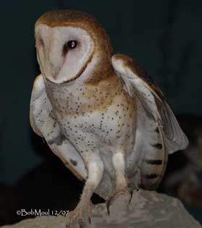
Summary
Ostrich- no hiding place, there is no escape from revalidation- Panic as deadline looms for you?
OR OWL Wise and prepared embrace the change , keep ahead of schedule,
regularly reflect/complete documentation.

Slide 37
REFERENCES
Alison, A. (2009) Ethical issues of working in partnership in Carnwell, R and Buchanan J (2014) Effective Practice in Health, Social care and Criminal justice. University Press Maidenhead Chapter 4
Burnett, E (2011) Outcome Competences for Practitioners in Infection Prevention and Control Journal of Infection Prevention 12 (2) 67-90
Department of Health (2010) Health And Social Care Act 2008: code of Practice on the prevention and control of infections and related guidance Department of Health London Available at: http://www.legislation.gov.uk/ accessed 23/6/15
European Centre For Disease Control [ECDC](2103) Core competencies for infection control and hospital hygiene professionals in the European Union. ECDC Stockholm
Freeman, S. Gray, D. (2013) A Career and Development Framework for Infection Prevention and Control Nurses Journal of Infection Prevention 14 (6) 204-207
Larkin, P. (2014) Clinical competency or complex conundrum? International Journal of Palliative Nursing 20 (9) 419
Royal College of Nursing (2012) The role of the Link Nurse in infcetion prevention and contorl (IPC) developing a link nurse framework. RCN London
Thorpe, A. (2015) Skills and activities for health and well-being in Wilson,F, Mabhala,M. Massey,A. (2015) Health Improvement And Well-Being; Strategies For Action Open University Press Maidenhead Chapter 10

Slide 38


Slide 39
Joan Cochrane
Programme Leader
Northumbria University
Faculty of Health &Life Sciences
Public Health & Well Being
CPD
Coach lane Campus
Coach Lane
Newcastle
NE7 7 XA
Tel:- 0191 2156078
Email joan.cochrane@northumbria.ac.uk ©

