Slide 2
Managing organizational hubris through purpose
Dr. Sarah Bowman, Northumbria University, UK
Gloria Walker, Hult International Business School, UK

Slide 3
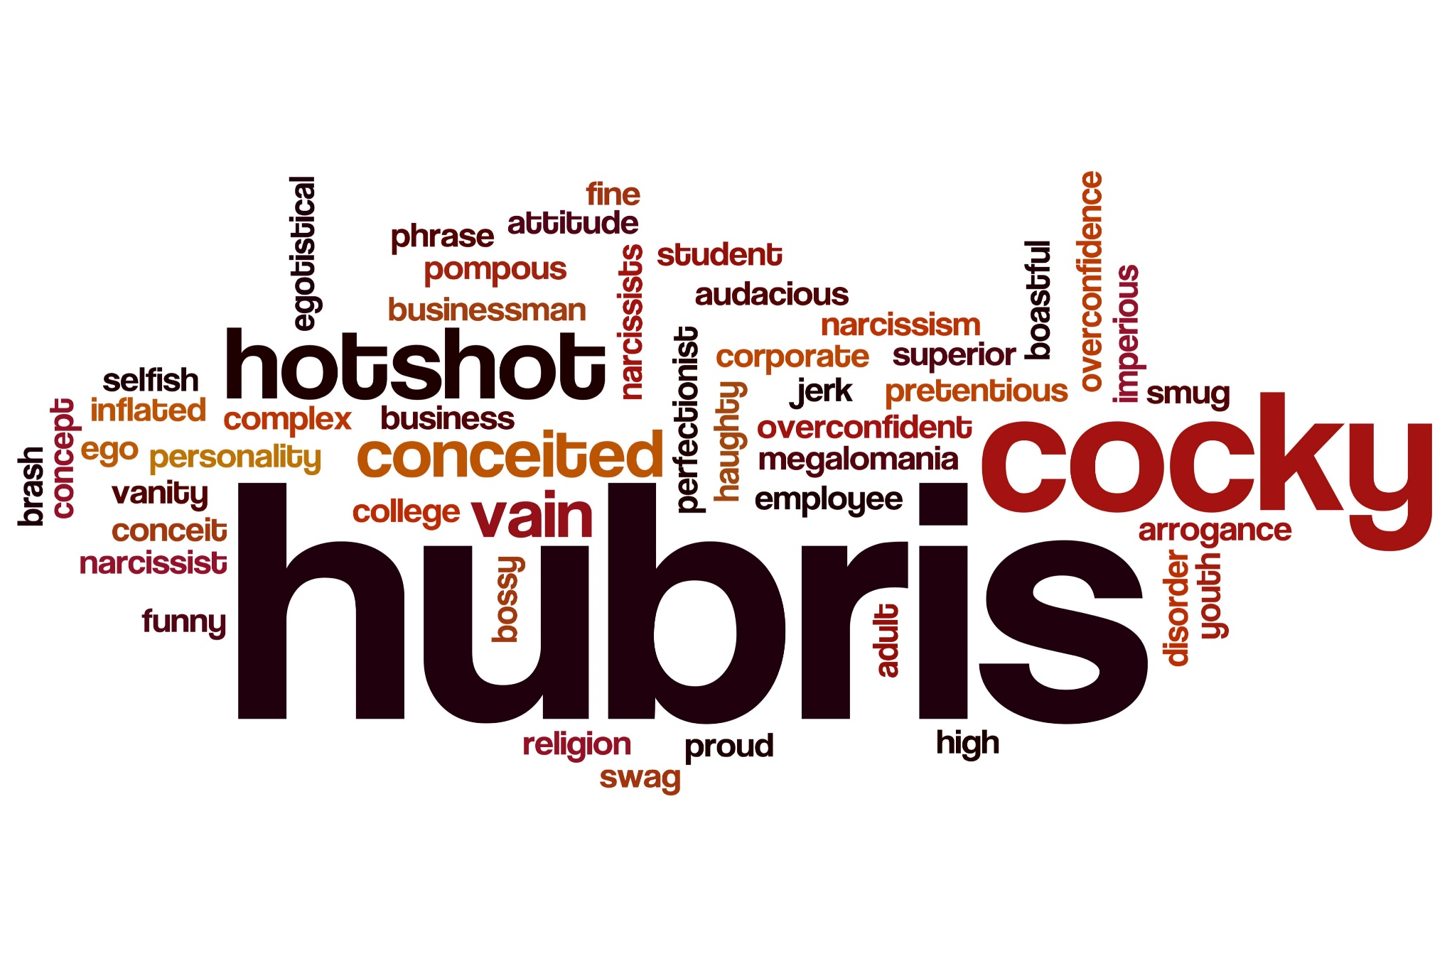

Slide 4
Structure of presentation
The problem – the hubris hypothesis
What we know – literature
Our proposition – a conceptual anti-hubris communications model
Implications, contribution and further research

Slide 5
What’s the problem?
Governance has increased but organizations still fail/take poor decisions
Enron
Global Crossing
WorldCom
More recently in the UK
Carillion
Arcadia
Uber
Facebook/Cambridge Analytica
Politicians
Common theme: Hubris (both organizational and CEO)

Slide 6
What do we know?
Picone, Dagnino and Mina (2014)
Hubris traits exhibited to greater extent by CEOs, senior executives
Hubris has a good and bad side; some hubris necessary as positively influences performance but there is a tipping point

Slide 7
Hubris Syndrome = need 3 or 4 of these “excruciatingly unflattering” traits (Daedalus Trust)
1.Seek self-glorification
2.To enhance personal standing
3.Are excessively conscious of their own image
4.Display messianic tendencies
5.“I am the organisation”
6.Use the royal “we”
7. Excessive confidence in their own judgements and are contemptuous of others’ opinions
8.Display exaggerated self-belief
9.Feel they’re accountable only to history
10.Believe unshakably that they will be vindicated
11.Are out of touch, isolated
12.Are restless, reckless, impulsive
13.Are impractical – overlooking detail and possible unwanted outcomes
14.Implement incompetently – fail to attend to details through excessive self-confidence

Slide 8
Hubristic People
Seek glory and legacy
Want to take action to cast them (and organization) in a good light
Self-confidence in delivering objectives
Disproportionate concern with image and presentation
CAN LEAD TO RISKY DECISION MAKING

Slide 9
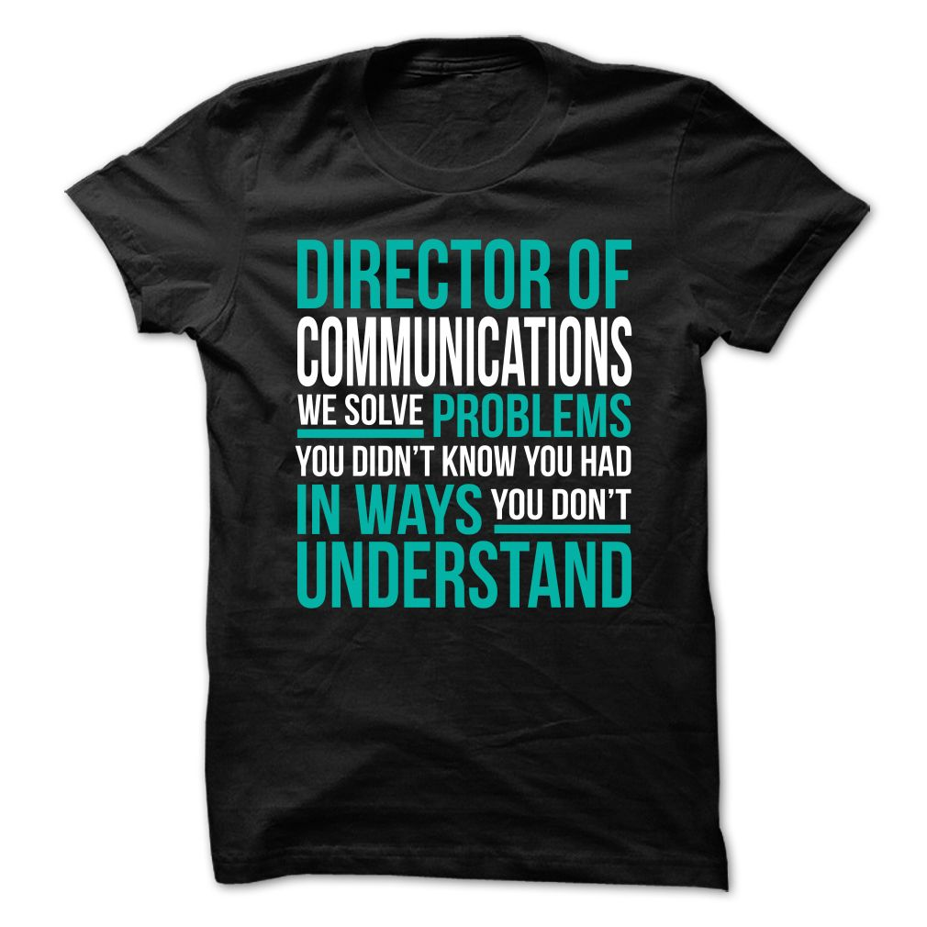
To mitigate this…
The literature suggests (and Daedalus Trust) hubristic individuals need ‘toe-holders’ to anchor them and the organization in reality…..
In other words, redirect these traits and minimise risk……

Slide 10
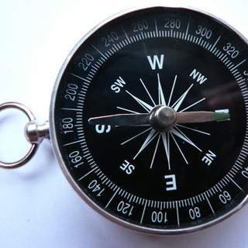
A critical connection
How can communications help reduce this risk?
By using social impact and purpose
“an aspirational reason for being which inspires and provides a call to action for an organization and its partners and stakeholders” (EY, 2016:9)

Slide 11
The anti-hubris model - Is this an adapted communications model?
Anti Hubris Toolkit
Empowering the Board
Listening to Faint Signals
De-isolating and grounding the CEO
Adapted Anti-Hubris Toolkit based on Robinson and Sadler Smith (2016), The Hubris Project, University of Surrey
Communication and Social Listening

Slide 12
In Summary
Literature suggests that organizational hubris remains one of the main contibutors to reputational damage
We argue communication professionals are best placed to identify symptoms of hubris and mitigate its impact
Professionals must take positive aspects of hubris and redirect hubristic behaviour towards organizational purpose

Slide 13
Moving Forward
More interdisciplinary research
Link anti hubris model to communication
More studies

Slide 14
References and further reading
http://www.daedalustrust.com
EY Report Winning with Purpose, May 2016, available at: https://www.ey.com/Publication/vwLUAssets/EY-purpose-led-organizations/$FILE/EY-purpose-led-organizations.pdf (accessed 17 November 2018).
Kahneman, D., Slovic, P., and Tversky, A. (1982). Judgment under uncertainty: Heuristics and biases. Cambridge University Press, New York, NY.
Moore, D. A., and Healy, P. J. (2008). “The trouble with overconfidence”. Psychological Review, Vol. 115, No. 2, pp. 502-517.
Robinson, G. and Sadler-Smith, E. (2016) Developing an Anti-Hubris Toolkit, The Hubris Project, Surrey Business School. Available at: http://www.daedalustrust.com/anti-hubris-toolkit-takes-important-step-2016/
Owen, D., and Davidson, J. (2009). “Hubris Syndrome: An acquired personality disorder? A study of US Presidents and UK Prime Ministers over the last 100 years”. Brain, A Journal of Neurology, Vol. 132, No. 5, pp. 1396-1406.
Picone, P., Dagnino, G., and Mina, A. (2014). “The Origin of Failure: A multidisciplinary appraisal of the hubris hypothesis and proposed research agenda”. The Academy of Management Perspectives, Vol. 28, No. 4, pp. 447-468.

