Slide 1
ILA Conference - Leadership Scholarship Track
Experiences and constructions of following: Advancing understandings through visual research methods.
Rachael Morris
Newcastle Business School
Northumbria University, UK
Notes:
What I’ll cover today
Added in extracts from the visual diaries, which weren’t presented in the paper

Slide 2
Presentation outline
What I’ll cover today
My research focus
Problematizing the extant literature
Research methodology and design
Visual methods
An introduction
Photo elicitation interviews
Reflections from my research
Conclusion
Questions

Slide 3
My research focus
PhD working title
Explorations of constructions and experiences of following within the UK public sector: A follower-focused, multi-method study.
Current stage
Final year
Data analysis
My paper
Capturing my reflections on the use of visual methods so far

Slide 4
Problematizing the extant literature
Imbalance between followership and leadership
Lack of qualitative, constructionist approaches
Widely acknowledged (Bjugstad et al, 2006; Carsten et al, 2010)
Publications and literature reviews (Uhl-Bien et al, 2014)
Stigma/understanding what it means vs. romancing of leaders (Rost, 2008; Kellerman, 2008; Meindl et al, 1985)
Conceptual discussions of contemporary ideas (Baker, 2007; Carsten et al, 2010)
Quantitative tendency (Crossman & Crossman, 2011)
Exploring what we mean by ‘follower’ (Carsten et al, 2010)
Lack of follower-focused approaches
Followership as an ‘afterthought’ (Kelley, 2008; Avolio & Reichard, 2008)
Follower centric vs, follower focused (Kean et al, 2011)
Focusing on interconnected processes and not isolating followers (Kellerman, 2007; Baker, 2007; Srinivasan & Holsinger, 2012)

Slide 5
Research methodology
Epistemological positioning- relational social constructionism
Focus on:
Interactions and dialogue between individuals (McNamee & Hosking, 2012)
processes: ongoing, complex (Burr, 2003)
Meaning making as occurring through interactions with others (Cunliffe, 2008), and in relation to local cultural surroundings and historical experiences (McNamee & Hosking, 2012)

Slide 6
Research design
Phase One
Semi-structured interviews
Phase Two
Visual research diaries
Phase Three
Photo elicitation interviews
Aim of achieving richer insights and deep reflections through the use of:
Qualitative methods
Multiple methods
Visual methods

Slide 7
Visual methods- an introduction
Used predominantly in sociology and anthropology fields (Ray & Smith, 2012; Bateson & Mead, 1942)
Limited application to organizational studies (Warren, 2009)
Numerous ways of incorporating visual methods and collecting visual data in research
E.g.
Photographs and video/film – content analysis
Drawing
Photo elicitation interviews
Visual diaries

Slide 8
Photo elicitation interviews
“…the interpretation of photographs by research participants”
(Collier, 1967; Collier & Collier, 1986)
Type of method
Consists of photo-voice and photo-elicitation (Slutskaya et al, 2012)
Value of method
Active participation (Stayaert et al, 2012)
Flexible method (Ray & Smith, 2012; Prosser & Schwartz, 2004)
Applied to research designs in many ways (Clark-Ibanez, 2007)
Who produces the images
Existing or new images
Who chooses which images to discuss
Sense making (Srivastava & Thomson, 2009)
Deep reflection through time away from the researcher

Slide 9
Reflections on initial interviews
Overcoming difficulties in constructing following
Gaining rich insights into lived experiences- narratives and storytelling
Achieving richer descriptions of following

Slide 10
Overcoming difficulties in constructing following
Initial interviews
Struggling to explain
Short, simplistic responses
Reliance on descriptions of leaders
“…we just have to do what we’re told”
“…being led by the leader…you’re fulfilling the tasks that they need to be fulfilled”
“following is, erm, you are the person that has a leader or somebody that you’re going to take notice of”

Slide 11
Achieving richer descriptions of following
A chance to reflect in the diaries
Richer explanations
Personal reflection rather than detached understandings
More complex understandings
“I’m definitely a follower there, I’m being told exactly what to do. I just take my mind away from it and do basically what I’m told to do…so I’m definitely not a leader in that situation and its quite nice to be disempowered in that situation, because if it was left to me I would probably not do half the things that they tell me to do”

Slide 12
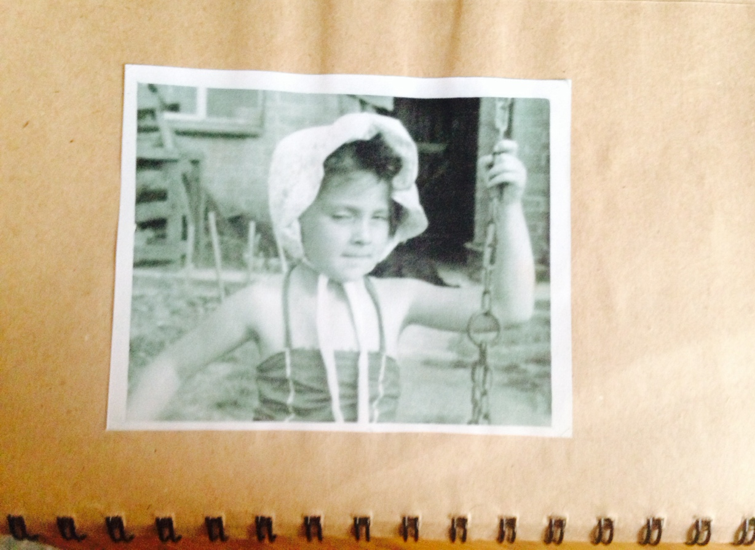
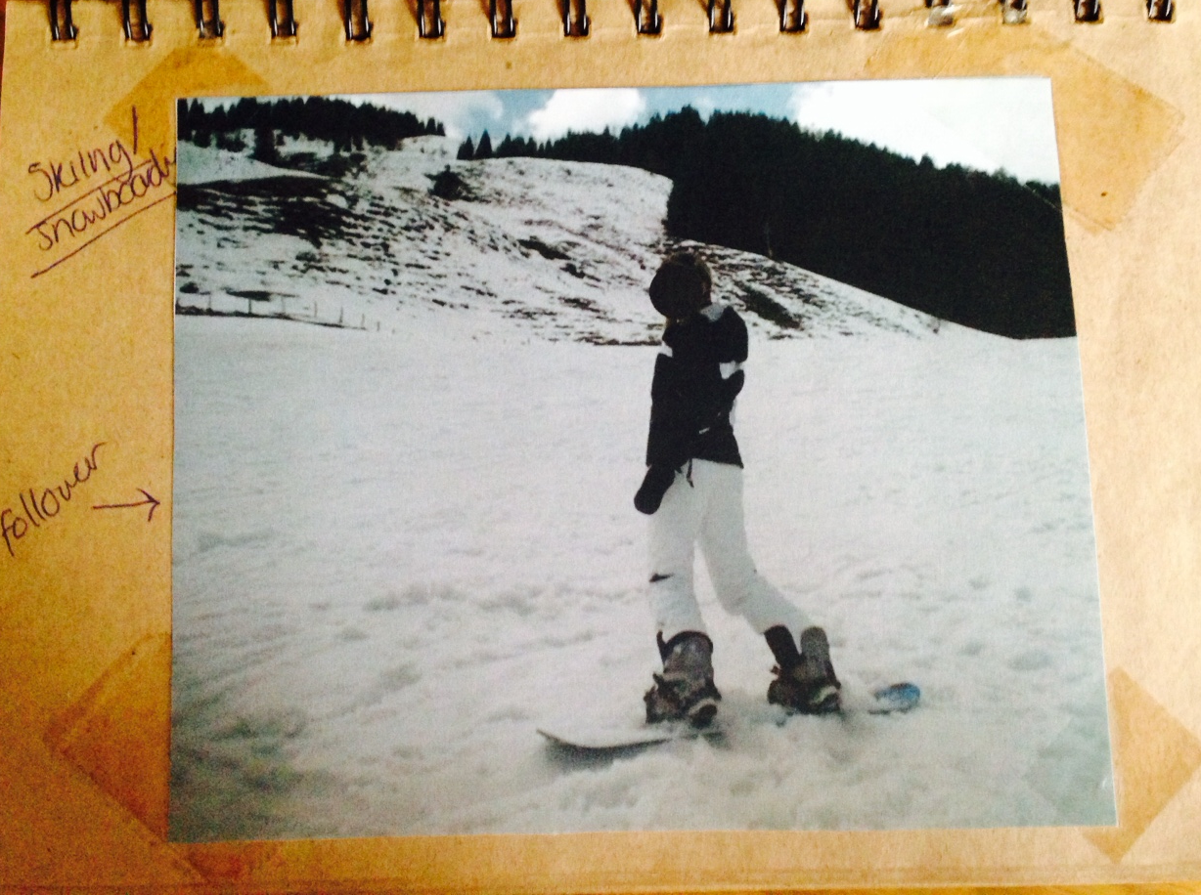
Gaining rich insights into lived experiences- narratives and storytelling
A chance to tell their stories
Images enabled contextual richness to be captured
Participant and researcher identifying and focusing on different aspects
Co-constructions of meaning

Slide 13
Conclusion
Provided an outline of my research focus, arguing for the need for empirical research to focus on processes of following using qualitative methods.
Provided an overview of visual research methods
Discussed the value of adopting photo elicitation interviews to achieve this
Overcoming difficulties in constructing the ‘f’ word
Capturing lived experiences of participants
Encouraging deep reflective meaning making
Allowing for co-constructions of meaning making
Encouraging active participation
My research contribution

Slide 14
Thank you for listening…
Rachael Morris
Newcastle Business School
Northumbria University, UK
rachael.l.morris@northumbria.ac.uk

Slide 15
References
Avolio, B. J., & Reichard, R.J. (2008). The rise of authentic followership. In Riggio, R.E., Chaleff, I. & Lipman-Bluman, J. (Ed.) The art of followership (pp. 325-337). San Francisco, CA: Jossey-Bass.
Baker, S. D. (2007). Followership: the theoretical foundation of a contemporary construct. Journal of leadership and organizational studies, 14(1), 50-60.
Bateson, G. & Mead, M. (1942). Balinese Character: A Photographic Analysis. New York: New York Academy of Sciences.
Bjugstad, K., Thach, E. C., Thompson, K. J., & Morris, A. (2006). A fresh look at followership: A model for matching followership and leadership styles. Journal of Behavioral and Applied Management, 7(3), 304-319.
Burr, V. (2003). Social Constructionism. (2nd ed). East Sussex: Routledge.
Carsten, M.K., Uhl-Bien, M., West, B.J., Patera, J.L. & McGregor, R. (2010). Exploring social constructions of followership: a qualitative study. The Leadership Quarterly, 21, 54-562.
Clark-Ibanez, M. (2007). Inner-city children in sharper focus: Sociology of childhood and photo-elicitation interviews. In G. C. Stanczak (Ed.), Visual research methods: Image, society and representation (pp. 167-195). London: Sage.
Collier, J. (1967). Visual anthropology: Photography as a research method. Beverly Hills, CA: Sage.
Collier, J.J. & Collier, M. (1986) Visual anthropology: photography as a research method. Albuquerque: University of New Mexico Press.
Crossman, B. Crossman, J. (2011). Conceptualising followership- a review of the literature. Leadership, 7(4), 481-497.
Cunliffe, A. L. (2008). Orientations to social constructionism: relationally responsive social constructionism and its implications for knowledge and learning. Management Learning 39(2), 123-139.
Kean, S., Haycock-Stuart, E., Baggaley, S. & Carson, M. (2011). Followers and the co-construction of leadership. Journal of Nursing Management, 19, 507-516.
Kellerman, B. (2007). What every leader needs to know about followers. Harvard Business Review, 85(12), 84-91.
Kellerman, B. (2008). Followership: How followers are creating change and changing leaders. USA: Harvard Business Review Press.

Slide 16
References
Kelley, R.E. (2008). Rethinking followership. In Riggio, R.E., Chaleff, I. & Lipman-Bluman, J. (Ed.) The art of followership (pp. 325-337). San Francisco, CA: Jossey-Bass.
McNamee, S. & Hosking, D.M. (2012). Research and social change: a relational constructionist approach. New York: Taylor & Francis.
Meidl, J.R., Ehrlich, S.G. & Dukerich, J.M. (1985). The romance of leadership. Administrative Science Quarterly, 30, 78-102.
Prosser, J., & Schwartz, D. (2004). Photographs within the sociological research process. In S. N. Hesse-Biber & P. Leavy (Eds.), Approaches to qualitative research. A reader on theory and practice (pp. 334–349). New York: Oxford University Press.
Ray, J.L. Smith, A.D. (2012). Using photographs to research organizations: evidence, considerations, and application in the field study. Organisational Research Methods, 15(2), 288-315.
Rost, J.C. (2008). Followership: An outmoded concept. In Riggio, R.E., Chaleff, I. & Lipman-Bluman, J. (Ed.) The art of followership (pp. 325-337). San Francisco, CA: Jossey-Bass.
Slutskaya, N. Simpson, A. Hughes, J. (2012). Lessons from photo elicitation: encouraging working men to speak. Qualitative Research in Organizations and Management: An International Journal, 7(1), 16-33.
Srinivasan, J. & Holsinger, J.W. (2012). The yin-yang of followership-leadership in public health. Journal of Public Health, 20, 95-98.
Srivastava, A., & Thomson, S. B. (2009). Framework analysis: a qualitative methodology for applied policy research. JOAAG, 4(2), 72-9.
Steyaert, C. Marti, L. Michels, C. (2012). Multiplicity and reflexivity in organizational research: towards a performative approach to the visual. Qualitative Research in Organizations and Management: An International Journal, 7(1), 34-53.
Warren, S. (2012). Psychoanalysis, collective viewing and the "social photo matrix" in organizational research. Qualitative Research in Organizations and Management: An International Journal, 7(1), 86-104.
Uhl-Bien, M. R., Riggio, R. E., Lowe, K. B., & Carsten, M. K. (2014). Followership theory: A review and research agenda. The Leadership Quarterly, 25(1), 83-104. doi:10.1016/j.leaqua.2013.11.007

