Slide 1
“Is there really no room at the inn?”
The innkeeper only has one double room, who will he give it to? The disabled person, the pregnant woman or the homosexual couple?

Slide 2
Anti-Discrimination Law and its relationship with Equality
Purpose of anti-discrimination law is to promote the principle of equal treatment
The law creates a hierarchy because of the different levels of protections it affords to the groups covered by it
What happens when the competing rights collide?

Slide 3
Equality
What do you mean when you think about equality?
Level playing field
Equivalent
Equal opportunities
The same treatment
Equality for all

Slide 4
Politician’s and Equality
David Cameron in his speech to the 2015 Conservative Party Conference
“Fair chance”
“Equal shot”
“Real equality”

Slide 5
Equality
Jeremy Corbyn
“…greater equality and opportunity for all”
“Move society towards “real” gender equality”

Slide 6
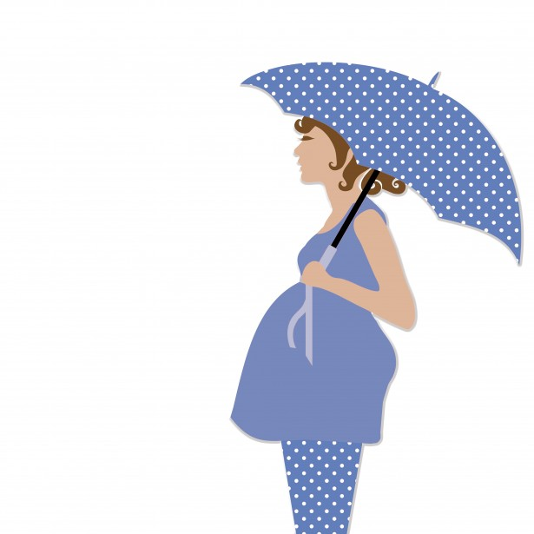
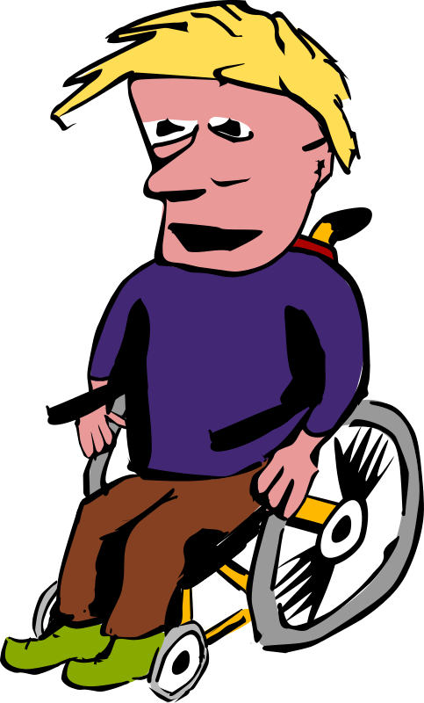
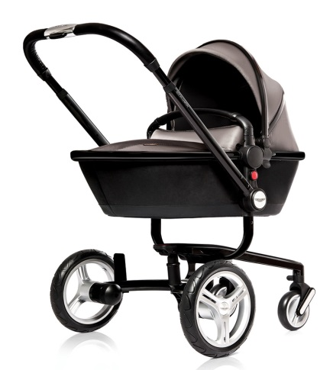
Pushchair v Wheelchair Paulley v First Group Plc

Slide 7
Religious Belief v Sexual Orientation Bull v Hall [2013]UKSC 73 and Black v Wilkinson [2013] EWCA Civ 820

Slide 8
Religious Belief v Sexual Orientation Gareth Lee v Ashers Baking Co. Ltd. and Colin McArthur and Karen McArthur 19/05/2015 Belfast County Court
“Support Gay Marriage”

Slide 9
Religious Belief v Sexual Orientation Ladele v Islington LBC

Slide 10
Equality/Fair Treatment
Be Kind to One Another
Merry Christmas Everyone

