Slide 1
‘Patient knows best’ and the ‘Paradigm’ patient tensions of relative blame in a clinical context John Bates, Northumbria Law School
@MrJohnBates
SLSA 2017 > Medical Law, Healthcare and Bioethics

Slide 2
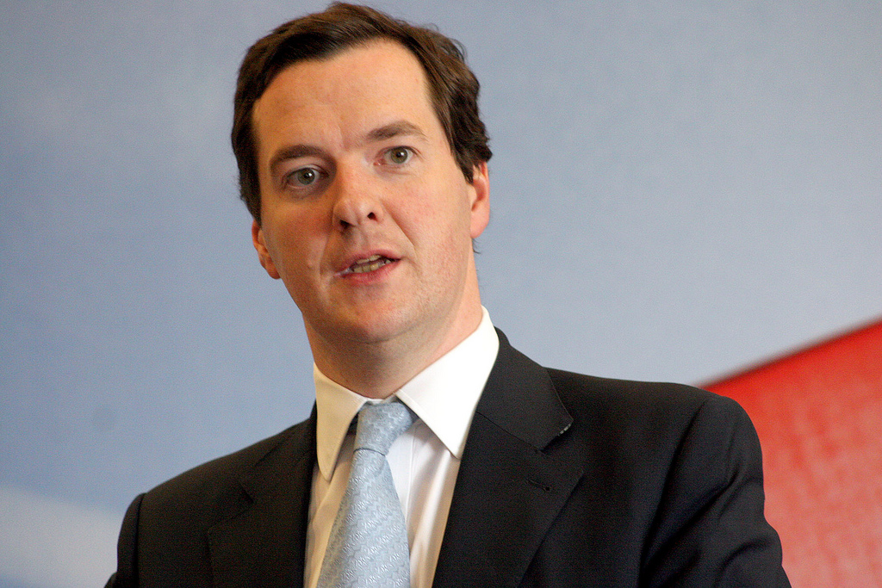
Image credit: Copyright George Osborne 0486am by Altogetherfool. Licensed under CC BY-2.0 / image cropped.
“[W]e have always said that there are no rights without responsibilities. No help without conditions.”
George Osborne, speech to Conservative Party Conference, 29 September 2008

Slide 3
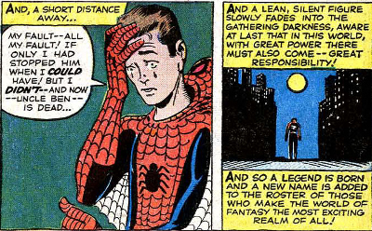
Image credit: 'With Great Power Comes Great Responsibility' at QuoteInvestigator 1962 August (Cover Date), Amazing Fantasy #15 (Formerly: Amazing Adult Fantasy), Comic Book Story Title: “Spider-Man!”, Writer: Stan Lee, Illustrator: Steve Ditko. Published by Marvel Comics, New York.)
“[I]n this world, with great power there must also come – great responsibility”
“Spider-Man!”, Writer: Stan Lee, Illustrator: Steve Ditko, August 1962, Marvel Comics

Slide 4
A patient’s ‘responsibility’
Language of ‘responsibility’ directed at blameworthiness and causation of damage rather than an enforceable obligation
In different elements of the negligence analysis, conduct may be relevant, at different thresholds, for different purposes, with different policy justifications, and have different effects

Slide 5
Conduct and impact
Blurred lines in the discourse on the impact of a claimant’s conduct…
Scope of the defendant’s duty
Standard of care expected
Breach of the defendant’s duty
Factual cause of claimant’s damage
Legal cause of claimant’s damage
A claimant’s novus actus interveniens
Contributory negligence
Volenti non fit injuria
Ex turpi causa non oritur actio
Quantification of damages

Slide 6
The elements of contributory negligence
“Where any person suffers damage as the result partly of his own fault and partly of the fault of any other person or persons, a claim in respect of that damage shall not be defeated by reason of the fault of the person suffering the damage, but the damages recoverable in respect thereof shall be reduced to such extent as the court thinks just and equitable having regard to the claimant’s share in the responsibility for the damage…”
Law Reform (Contributory Negligence) Act 1945, s.1(1)

Slide 7
Image credit: Copyright Duty by Nick Youngson. Licensed under CC BY-SA 3.0
“[A]t last in this world, with great power there must also come – great responsibility”
“Spider-Man!”, Writer: Stan Lee, Illustrator: Steve Ditko, August 1962, Marvel Comics
THE SIGNIFICANCE OF THE SCOPE OF THE DUTY OF CARE SHAPING REASONABLE FORESEEABILITY OF THE CLAIMANT’S CONDUCT

Slide 8
The scope of contributory negligence
A claimant may be guilty of contributory negligence even if the ‘very purpose’ of the duty owed by the defendant is to protect the claimant from the very loss or damage which the claimant has suffered as a result of the defendant’s breach of duty.
Astley v Austrust Ltd (1999) (HCA)

Slide 9
The scope of contributory negligence
In many cases, it may be proper for a claimant to rely on the defendant to perform its duty. But there is no absolute rule.
The duties and responsibilities of the defendant are a variable factor in determining whether contributory negligence exists and, if so, to what degree.
In some cases, the nature of the duty owed may exculpate the claimant from a claim of contributory negligence; in other cases the nature of that duty may reduce the claimant's share of responsibility for the damage suffered; and in yet other cases the nature of the duty may not prevent a finding that the claimant failed to take reasonable care for the safety of his or her person or property.
Contributory negligence focuses on the conduct of the claimant. The duty owed by the defendant, although relevant, is one only of the many factors that must be weighed in determining whether the claimant has so conducted itself that it failed to take reasonable care for the safety of its person or property.
Astley v Austrust Ltd (1999) (HCA)

Slide 10
“The doctor is therefore under a duty to take reasonable care to ensure that the patient is aware of any material risks involved in any recommended treatment, and of any reasonable alternative or variant treatments. The test of materiality is whether, in the circumstances of the particular case, a reasonable person in the patient’s position would be likely to attach significance to the risk, or the doctor is or should reasonably be aware that the particular patient would be likely to attach significance to it.”
Montgomery v Lanarkshire Health Board (General Medical
Council intervening) [2015] UKSC 11, [2015] AC 1430
[87] (Lord Kerr)
(emphasis added)

Slide 11
LIMB 1: A REASONABLE PERSON IN THE PATIENT’S POSITION
THE EVOLUTION OF THE REASONABLE PERSON OVER TIME
From the man on the Clapham Omnibus to a reasonable person on a Boris Bus with an Oyster Card

Slide 12
Image credit: Copyright Freedom by The unnamed. Licensed under CC BY-2.0 / image cropped.
LIMB 2: RISKS ATTACHED BY THE PARTICULAR PATIENT
A MULTI-FACTORIAL, FACT-SENSITIVE ASSESSMENT SHAPED BY THE DUTY

Slide 13
“the assessment of whether a risk is material cannot be reduced
to percentages. The significance of a given risk is likely to reflect a variety of factors besides its magnitude: for example, the nature of the risk, the effect which its occurrence would have on the life of the patient, the importance to the patient of the benefits sought to be achieved by the treatment, the alternatives available, and the risks involved in those alternatives. The assessment is therefore fact-sensitive, and sensitive also to the characteristics of the patient.”
Montgomery v Lanarkshire Health Board (General Medical
Council intervening) [2015] UKSC 11, [2015] AC 1430
[89] (Lord Kerr)
(emphasis added)

Slide 14
Determining ‘fault’ of the claimant
How to rationalise the patient’s right to self-determination without a sanction of not taking ‘reasonable’ care for safety?
What standard is expected of the claimant?
A purely objective reasonable patient?
Have the characteristics of the reasonable patient changed over time?
The inquisitive patient, the researching patient, the less reliant patient, the more autonomous patient?
The purely subjective actual patient?
The themes of the participative dialogue in Montgomery shape notions of the foreseeability of the patient’s conduct and, in turn, the scope of the healthcare professional’s duty to the patient

Slide 15
Image credit: Copyright We stand out in a crowd by Charles and Adrienne Esseltine. Licensed under CC BY-2.0
THE SIGNIFICANCE AND MATERIALITY OF RISKS
A MULTI-FACTORIAL, FACT-SENSITIVE ASSESSMENT SHAPED BY THE DUTY

Slide 16
A taxonomy of ‘fault’?
The scope of the defendant’s duty shapes the notion of relative blameworthiness
A qualitative difference for patient conduct related to different aspects of a duty – e.g. risks within scope of information duty cf. risks reasonably foreseeable otherwise?
Timing:
Pre-dating breach of duty
‘Mixed up’ in the scope of the duty and the issue of breach
Subsequent to the breach
Capacity, autonomy, decision-making and a nuanced spectrum of (reasonably foreseeable) responses?

Slide 17
Examples of patient conduct
Before the breach of duty:
Delay in contacting health services (Hardaker)
Attempts to self-treat (Hardaker)
Drug addiction (St George)
Smoking (Badger) [-20%]
Dieting (Almario v Varipatis)
Alcohol (Almario v Varipatis; Commonwealth v Maclean)
But – a higher standard of care owed to vulnerable patients, and a reflection of the ‘eggshell skull’ rule in respect of causation in law.

Slide 18
Examples of patient conduct
Continuing/mixed up with the breach of duty:
Failing to give a comprehensive history, including circumstances and the seriousness of a condition (Morrison; Friedsam, Baird)
Concealment of proximate medical history (Zeb)
But – a clear professional duty to take a proper history…

Slide 19
Examples of patient conduct
After the breach of duty, within the scope of a continuing dialogue:
Failing to chase up an appointment (P v Sedar)
Failing to attend a check-up (Ibrahim [-25%]; Pidgeon [-2/3]); Sims (-20%)
Failing to undertake recommended treatment (Geest)
Self-discharge from hospital against advice (Wei Fan)
Failing to report deterioration in symptoms (on advice in a discharge booklet) (Goddard)
After the breach of duty, outside the scope of a continuing dialogue:
Failing to limit post-treatment activities/gradual rehabilitation (Brushman)
Failing to manage medication (including from an unorthodox source) (Crossman) [- 2/3]
Self-harm and suicide (Reeves) [- 50%]; Corr) cf. Calvert (-30%)?

Slide 20
Image credit: Copyright Chain by Aqua Mechanical. Licensed under CC BY-2.0
CONDUCT IN A CAUSATION ENQUIRY
HOW CAN A CLAIMANT’S CONDUCT IMPACT ON THE CAUSATION OF LOSS?

Slide 21
Causative potency of the claimant’s ‘fault’
The need for fault to be causatively potent to the damage
Proximity to the breach
The difficulties of ascribing a causal potency to conduct in clinical negligence cases: evidential gaps and uncertainties
Fault and foreseeability scope of duty: analogies with treatment of the threshold for conduct of the claimant/a third party amounting to a novus actus

Slide 22
Justice and equity in reducing damages
A backstop
Relative blameworthiness for damage
Avoiding a micro-analysis

Slide 23
Challenges
‘Lifestyle’ choices
Failure to engage in a ‘participative dialogue’
The other side of medical candour: medical histories
(Dis)engagement with treatment
Impact on behavioural choices
Advise, encourage, remind – and resources constraints
Focus on the scope of the health professional’s duty?
Scrutiny of reasons for exercising autonomous choice?

Slide 24
Image credit: Nigel Poole QC. Copyright Kings Chambers
“I have seen contributory negligence pleaded in my clinical negligence cases more times in the last 12 months than in the previous 24 years put together. Perhaps this is coincidence. Perhaps there is a trend developing and others will have had the same experience. Maybe there is a policy being put into action.”
Nigel Poole QC, Head of Kings Chambers

Slide 25
Conduct and other aspects of negligence
Antecedent conduct as a first of successive sufficient factual causes of damage? (Zeb)
Novus actus interveniens by the claimant?
Volenti non fit injuria?
Failure to mitigate in respect of losses attributable to the conduct?

Slide 26
Analogies with other causes of action
Professional Negligence beyond the clinical context
Employers’ liability:
Personal, non-delegable duty of care
High standard of care reflecting:
Defendant’s control over claimant
Claimant’s relative lack of autonomy over matters within employer’s scope
Reluctance to find contributory negligence
Trespass to the Person: respect for an individual’s right to bodily integrity, reflected in being actionable per se, the claimant-friendly ‘direct consequences’ rule of causation, and the lack of any defence of contributory negligence.
Deceit

Slide 27
Other jurisdictions
Canada
Australia
United States

Slide 28
Image credits
[1] 'With Great Power Comes Great Responsibility' at QuoteInvestigator 1962 August (Cover Date), Amazing Fantasy #15 (Formerly: Amazing Adult Fantasy), Comic Book Story Title: “Spider-Man!”, Writer: Stan Lee, Illustrator: Steve Ditko. Published by Marvel Comics, New York.)
[2] Copyright George Osborne 0486am by Altogetherfool. Licensed under CC BY-2.0 / image cropped.
[3] Copyright Duty by Nick Youngson. Licensed under CC BY-SA 3.0
[4] Copyright Freedom by The unnamed. Licensed under CC BY-2.0 / image cropped.
[5] Nigel Poole QC. Copyright Kings Chambers
[6] Copyright We stand out in a crowd by Charles and Adrienne Esseltine. Licensed under CC BY-2.0
[7] Copyright Chain by Aqua Mechanical. Licensed under CC BY-2.0

Slide 29
‘“Patient knows best” and the “paradigm” patient: the tensions of relative blame in a clinical context’
In Montgomery v Lanarkshire Heath Board [2015] UKSC 11, Lord Reed and Lord Kerr considered that ‘patients are now widely regarded as persons holding rights, rather than as the passive recipients of the care of the medical profession. They are also widely treated as consumers exercising choices’ The Royal College of Surgeons described Montgomery as a ‘resolute move away from the more paternalistic traditional model of consent and towards a patient-centred perspective.’
In ordinary negligence claims, a defendant may raise the partial defence of contributory negligence: if the court is satisfied on a balance of probabilities, that the claimant has been blameworthy relative to the defendant’s conduct, the fault has contributed to the harm sustained and that it would be just and equitable to reduce damages, then damages may be reduced.
Yet contributory negligence has rarely been successful in clinical negligence claims. Why is this? The pre-Montgomery paternalistic approach to the scope of the healthcare practitioner’s duty of care and the patient’s reliance on this led to a weighting of ‘relative fault’ towards the practitioner. Is this now changing? In Zeb v Frimley Health NHS Foundation Trust [2016] EWHC 134 arguments were heard about a patient’s failure to continue with a previous course of treatment and failure to give an accurate history to a treating practitioner.
How far does the greater public understanding of the consequences of healthcare and lifestyle choices shape the expectations of the ‘paradigm’ claimant? To what extent can pre- and in-treatment ‘lifestyle’ choices, including exercise, diet and substance abuse, be considered to be causally potent blameworthy conduct leading to a reduction in damages? How do other jurisdictions approach this issue?
This paper aims to explore some of these topical issues.

Slide 30
‘Patient knows best’ and the ‘Paradigm’ patient tensions of relative blame in a clinical context John Bates, Northumbria Law School
@MrJohnBates
SLSA 2017 > Medical Law, Healthcare and Bioethics

