Slide 1
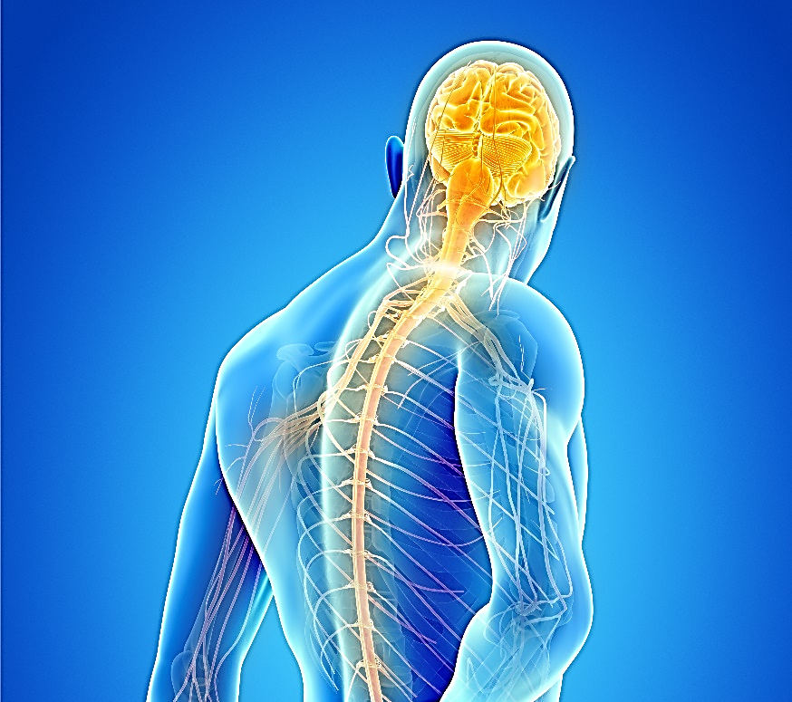
Preoperative pain planning and management: A critical ethnographic examination and exploration of day surgery practices
Claire Ford, PGD, BSc(Hons), RN.
Graduate Tutor, Northumbria University, Department of Nursing, Midwifery and Health
claire.ford@Northumbria.ac.uk

Slide 2
Introduction
Surgery is one of the most common mechanisms for causing pain (Ward, 2014).
Individualised analgesic requirements explored preoperatively (Pinto et al., 2012)
Abundance of literature examining preoperative pain planning for inpatients, but limited for day surgery patients.
80% of UK surgical procedures day case (AAGBI, 2011a)

Slide 3
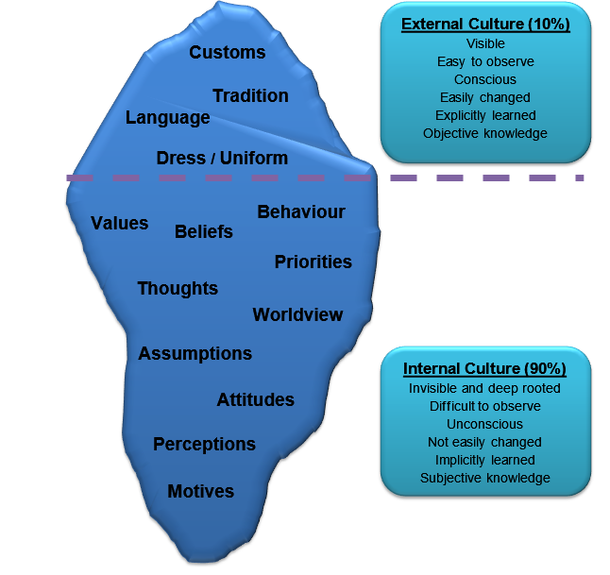
Overall aims and objectives

Slide 4
Methodology and Methods
Critical ethnography and critical social theory
Phased study design – four stages
Data collection method – observations, field notes, reflective diaries, auto-recorded interactions and staff interviews
Ethical approval from University, Trust and IRAS
Exclusion and inclusion criteria for staff and patients
Qualitative and quantitative data - analysed, triangulated and member checked

Slide 5
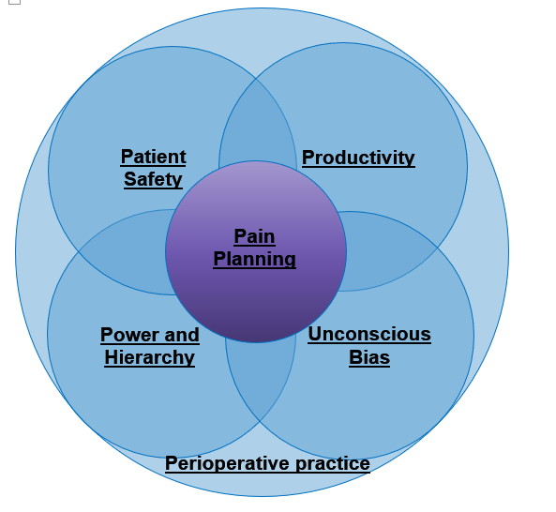
Data collection and results
130 hours of practice observed
100 preparative anaesthetic visits
24 nurse-led preassessments
20 staff interviews
9 months of field notes and reflective diaries
Quality checking by supervisor
Four central themes emerged

Slide 6
Theme 1) Prioritisation of Patient Safety

Slide 7
Pain versus patient safety – time in seconds
100 visits r_{s} = -.104, n=100, p = 0.3 negative relationship
Junior staff only r_{s} = -.430, n=48, p = 0.002 strong negative relationship

Slide 8
Time (3.38 seconds)
S28: “We'll try and get you as conformable as we can before you wake up.”
Time (4.5 seconds)
S27: “Lots of pain relief and anti-sickness medications whilst you’re asleep, okay?”
Time (8.2 seconds)
S17: “I'll give you a little bit of painkiller erm during the anaesthetic, and if you need something for discomfort afterwards then we'll give you want ever you need.”

Slide 9
S21: “So, my priority is always safety! Is it safe to proceed?”
S5: “My main priority is to get them through their operation safely!”
S6: “(Sigh) safety that’s what I want. We’re obsessed with their safety. Patient safety’s huge.”

Slide 10
Theme 2) Productivity and Process Flow

Slide 11
S3: “The workload when I came 10 years ago was much quieter than it is now. I would say we used to have maybe 15 to 20 patients per day then, now it has doubled. So the activity has increased threefold since I have came.”
S6: “I'm just thinking you know from the patients perspective you know we’re so tunnel visioned, what are patients thinking when they are coming in nervous and there is all this activity going on. You hope that you don't give them more reason to be nervous you know what I mean (laugh).”

Slide 12
Duration of anaesthetic visits in seconds

Slide 13
S16: “There is a bit of a queue to see the patient, as the surgeon is going round and consenting them, the nurse on the ward is admitting them, and everybody is trying to see the first patient and make sure that they’re sorted.”

Slide 14
P18: “I feel like we’re being herded like cattle”.
S8: I feel that sometimes it’s a bit like a conveyor belt”.

Slide 15
Theme 3) Paternalistic Practice and Hierarchies of Power

Slide 16
S1: “I would like to see nurses have more of a role in decision-making about what pain relief would be appropriate for the patient.
S6: But yes if we had a little bit more…. or even if they gave us some choices. And trust that we would know.”
S10: “One of the sisters on the day unit had said, “this patient didn’t know about pre-analgesia”, well they wouldn’t know, because we didn’t know ourselves. I just think that people who are meant to give the information should be told it first.

Slide 17
S23: Are you okay with paracetamol?
P29: Yes.
S23: Are you okay with Ibuprofen?
P29: Yes.
S23: And are you okay with codeine?
P29: Yes.
S23: These are your medications for afterwards.”

Slide 18
S22: It shouldn’t be too sore, paracetamol, brufen, and wouldn’t even think you need much more than that really.
P65: Just I’m a bit apprehensive cos I’ve never been under anaesthetic before.
S22: Well it's not a proper anaesthetic, erm.... I'm not sure if that’s gonna make you more or less.... but don’t worry about it.

Slide 19
S16: “I don’t say to people would you like the surgeon to put local in. I tend to sort of say that’s what we are going to do….I suppose I am making assumptions. I have never thought about it before, but yes I’m making assumptions that people are quite happy with that because we all know people do feel disempowered when they come into hospital. So I suppose I am being a bit paternalistic there.

Slide 20
Theme 4) Unconscious Bias (Surgery and Gender)

Slide 21
S22: “Okayee doke, so this is pretty straightforward stuff. It’s not a major procedure shouldn’t be too sore afterwards, it should settle down quite quickly.”
S29: “Getting into the theatre and recovery room are actually longer than the surgery itself.”
S13: “Okay, well I’m the anaesthetist. I'll be looking after you while you’re asleep having this minorish operation from our perspective.”
S16: “So they are having a look inside your bladder and I little stretch this morning?”

Slide 22
Time spent with patients – surgical speciality

Slide 23
S15: “I think in orthopaedics we are so geared to fast track measures, to ameliorate the pain and get them into physio. That the emphasis is there and there is so much input invested in orthopaedics in the way of information giving and talking about blocks, that it looks much bigger than the emphasis placed on the other specialities I think.”
S19: “I mean it is all to do with resources and money. Orthopaedics make an enormous amount of money and therefore have an enormous amount of resources, the general surgeons and the gynaecologist don’t make any money at all, in fact they lose a vast amount of money, so therefore the resources aren’t really there for them. So I guess in a little way they might be slightly disadvantaged.”

Slide 24
Time spent with patients – staff gender

Slide 25
MALE UROLOGY PATIENT S26: “You’re having an operation in a delicate area, so it can be sore.”
FEMALE GYNAECOLOGY PATIENT S26: “From our perspective. It’ll be kind of like period pains, if that!.”

Slide 26
I: “Can you think of a time when a patient’s pain was difficult to manage? S4: I find I have a lot more patients who’ve had gynae procedures who’ve experienced quite a lot of…. I wouldn’t say unmanageable, but they’ve had a lot more than they expected to have. In the last lady who’d had an ablation…. she had everything from the drug chart that I could give her.”
S13: To be honest I think sometimes gynae patients might get a slightly raw deal, because some people see gynae as less major than general surgery, but at the end of the day if you’re having an abdominal hysterectomy you’re having a laparotomy, and it is a major abdominal procedure. So I think those patients tend to probably get a worse deal for postop analgesia.”

Slide 27
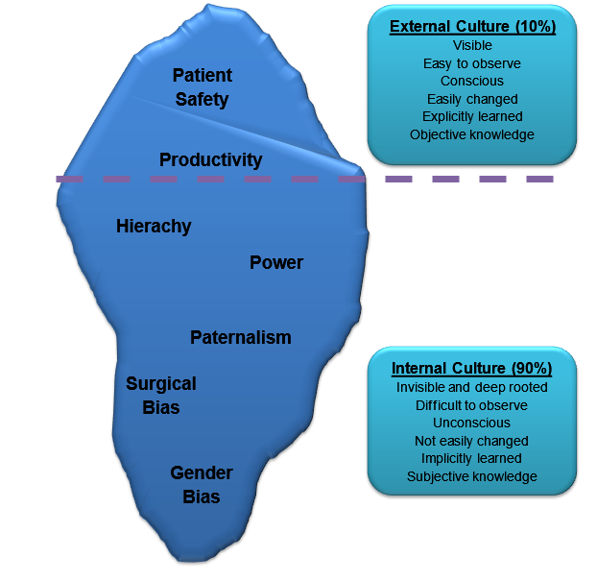
Summary

Slide 28
Questions
Claire Ford
Tel: 0191 215 6345
Email: claire.ford@northumbria.ac.uk

Slide 29
References
Ward, C. W. (2014) 'Procedure-specific postoperative pain management', MEDSURG Nursing, 23(2), pp. 107-110.
Pinto, P. R. et al. (2012) 'The mediating role of pain catastrophising in the relationship between presurgical anxiety and acute postsurgical pain after hysterectomy', Pain, 153, pp. 218-226.
The Association of Anaesthetists of Great Britain, Ireland and The British Association of Day Surgery. (2011a) Day case and short stay surgery. London: The Association of Anaesthetists of Great Britain, Ireland and The British Association of Day Surgery.

