Slide 1
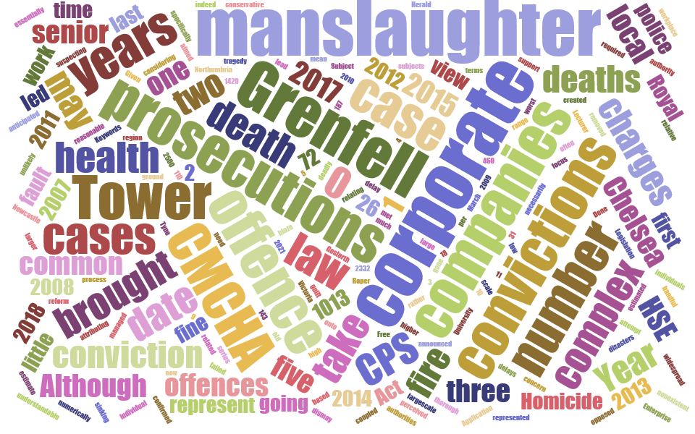
CORPORATE MANSLAUGHTER OFFENCES – RESTORING DIGNITY OR COMPOUNDING FEELINGS OF INJUSTICE?
Victoria Roper
Senior Lecturer, Northumbria University, United Kingdom
Notes:
Introduce yourself

Slide 2
What is corporate manslaughter?
In the UK we have a statutory criminal offence which applies to organisations (companies, other bodies corporate etc.) which are responsible for negligently causing a person’s death
Notes:
Not intentional. Involuntary manslaughter.
An ‘organisation is defined in the Act as a corporation (e.g. a company) , a police force, certain government departments and Crown bodies listed in a schedule and some unincorporated bodies (such as partnerships) where they are an employer. For the purposes of the Act a corporation does not include a corporation sole but includes any body corporate wherever incorporated. Ibid. s. 25.
Ibid. s. 1(2)(b).
Ibid. Schedule 1.
Ibid. s. 1(2).

Slide 3
Why does the UK have a specific CM offence?
Prior to the Corporate Manslaughter and Corporate Homicide Act 2007 (CMCHA) the UK did not have a specific CM offence.
It was theoretically possible for a company to be convicted of the common law offence of gross negligence manslaughter but this was only ever successful in a handful of cases involving very small companies.
The main drivers for the introduction of the Act were:
Concern that the rate of workplace deaths was too high
Concern that following a number of high profile disasters it proved impossible to secure any manslaughter convictions against the companies responsible despite findings of clear fault
Notes:
Fatal injury rate was 0.79 deaths per 100,000 workers in 2007/2008. Rate now 0.45. Compares favourably to USA – Rate for 2017 was 3.5 https://www.bls.gov/charts/census-of-fatal-occupational-injuries/rate-of-fatal-work-injuries-per-100000-fte-by-age.htm . Bureau of Labor Statistics.
The Herald of the Free Enterprise was a ferry that capsized in 1987 with a death toll of 193. A prosecution of the company failed as negligence could not be attributed to anyone who could be identified as the directing mind of the company.

Slide 4
What is basis of liability under the CMCHA?
An ‘organisation’ is guilty of the section 1 offence if it:
owed a duty of care to the deceased:
there was a gross breach of that duty;
the way in which the organisation’s activities were managed or organised by its senior management was a substantial element in the breach; and
this caused the deceased to die.
Duty of care is wider than just a duty owed to workers, covers visitors to premises, users of services and goods and even those in custody
Main penalty is a unlimited fine.
Notes:
The accompanying explanatory notes state: ‘the usual principles of causation in the criminal law will apply... this means that the management failure need not have been the sole cause of death; it need only be a cause (although intervening acts may break the chain of causation in certain circumstances)

Slide 5
Why not just rely on Health and Safety law?
The CMCHA is intended to complement health and safety law.
An organisation which was guilty of a health and safety offence could have always faced a potentially unlimited fine.
Paul Almond argues that health and safety offences are not regarded as ‘real’ crimes: “regulatory…law…is rarely, if ever, perceived as constituting a meaningful form of criminal law”.
Griffin and others have also explicitly argued that family members of victims might feel justice had been better served if a specific charge of corporate manslaughter was brought against the organisation that caused their loved one’s death, rather than just a health and safety prosecution
Notes:
Health and safety offences in the UK impose liability for the exposure of persons to risk rather than the specific harm caused which is why they are often viewed as being ‘technical crimes’.

Slide 6
How the CMCHA is working in practice
26 convictions in 11 years
All convictions of companies
Mainly micro and small companies prosecuted
Cases overwhelming involve workers although a few prosecutions involving members of the public etc.
No prosecutions arising from disasters involving large scale loss of life to date

Slide 7
Grenfell Tower
In June 2017 seventy two people lost their lives when a fire broke out at a high rise block of flats called Grenfell Tower in London in the UK
The fire quickly spread around the building due to flammable cladding that had been installed during a recent refurbishment
The local authority the Royal Borough of Kensington and Chelsea (RBKC) had always owned the building and was the landlord
Management of the social housing in the tower was devolved a separate legal entity, Kensington and Chelsea Tenant Management Organisation (TMO)
Notes:
This is a community within one of London’s most socially unequal boroughs, where wealth and poverty are neighbours. Although Kensington and Chelsea is one of the wealthiest local authorities in the country, Grenfell Tower was situated in one of the most deprived areas in England.
RBKC was the landlord for all the social housing tenants.

Slide 8
Grenfell Tower
A residents’ organisation, Grenfell Action Group, had voiced concerns about safety at Grenfell Tower and the discharge of the local authority/TMO’s duties before the fire.
“It is a truly terrifying thought but the Grenfell Action Group firmly believe that only a catastrophic event will expose the ineptitude and incompetence of our landlord, the KCTMO, and bring an end to the dangerous living conditions and neglect of health and safety legislation that they inflict upon their tenants and leaseholders.”
Grenfell Action Group November 2016 (7 months before fire)
Notes:
This is a community within one of London’s most socially unequal boroughs, where wealth and poverty are neighbours. Although Kensington and Chelsea is one of the wealthiest local authorities in the country, Grenfell Tower was situated in one of the most deprived areas in England.
RBKC was the landlord for all the social housing tenants.

Slide 9
Grenfell Tower aftermath
Within a few days of the fire, the local community mobilised to advance their claims to fair legal treatment, establishing a group, Justice4Grenfell (J4G).
J4G has made it clear that for justice to be served, it wants corporate manslaughter prosecutions as well as the criminal prosecution of individuals.
Within only a day of the fire, MP David Lammy, who lost a friend in the fire, had labelled it as ‘corporate manslaughter’ and called for arrests to be made.
A Police investigation was also launched in the days following the fire, and in July 2017 the police issued a statement saying that there were ‘reasonable grounds’ to suspect the RBKC and the TMO of the offence of corporate manslaughter.
There is also an ongoing public inquiry
Notes:
J4G is a community-led organisation, focused on the long term goal of obtaining justice for the bereaved families, survivors, evacuated residents and the wider local community. On the 14th of each month, J4G organises a silent walk to the Grenfell site in a show of solidarity and protest.

Slide 10
Grenfell Tower – the CMCHA’s biggest test to date?
Whilst the Grenfell community may have initially been heartened by the announcement of the police that corporate manslaughter and other charges were being considered, two years on from the fire there is dismay at the fact no charges have yet to actually be filed.
Campaigners have reacted with anger to recent news that criminal charges relating to the Grenfell Tower fire are now unlikely to happen until 2021
Delay doesn’t mean charges won’t be brought, but if they are there are still some significant hurdles to overcome:
Number of charges – up to 72 (most to date 4 and that prosecution failed)
Vast amounts of evidence - 187 police offers and civilian staff, over 31 million documents, 2,500 physical exhibits, 2,332 witness statements and 460 companies involved in renovations at Tower over the years
Technicality of the Act – criticism of the senior management test in particular
Cases do not always result in conviction – 3 acquittals and 1 charge dismissal to date
Notes:
J4G is a community-led organisation, focused on the long term goal of obtaining justice for the bereaved families, survivors, evacuated residents and the wider local community. On the 14th of each month, J4G organises a silent walk to the Grenfell site in a show of solidarity and protest.
MNS Mining case

Slide 11
False hope?
Even where there is a single fatality, and the circumstances surrounding the death are much more straightforward, the deceased’s family cannot be assured that a corporate manslaughter prosecution will be pursued
Often easier to allow Health and Safety Executive to just pursue H&S charge(s)
26 CM convictions to date but Regulatory Impact Assessment suggested we should have had around 110-143
144 workers killed a year and around 100 members of the public killed in work related activities
For the majority of these victim’s families, the CMCHA offers a false hope that the entity that caused their loved ones death will be convicted of an offence that reflects the seriousness of the crime committed
Notes:
J4G is a community-led organisation, focused on the long term goal of obtaining justice for the bereaved families, survivors, evacuated residents and the wider local community. On the 14th of each month, J4G organises a silent walk to the Grenfell site in a show of solidarity and protest.
MNS Mining case

Slide 12
Concluding thoughts
CM offence introduced with good intentions and may play a role in improving safety culture within organisations.
However, this paper has questioned the assumption that such offences consistently plays a positive role in restoring dignity to families and communities.
We should be cognisant that such offences, if they fail to live up to expectation, might only serve to reinforce feelings of injustice for family members and/or communities.
In the case of Grenfell, no prosecution or a failed prosecution would be a further blow to a community which already feels betrayed and marginalised by the authorities who were meant to care for it.
The UK experience should therefore serve as a warning to other jurisdictions which are considering implementing similar offences. Careful thought should be given to the drafting of such offences so they can be employed when needed and to ensure they are ultimately viewed as delivering justice rather than creating a perception of further injustice.
Notes:
J4G is a community-led organisation, focused on the long term goal of obtaining justice for the bereaved families, survivors, evacuated residents and the wider local community. On the 14th of each month, J4G organises a silent walk to the Grenfell site in a show of solidarity and protest.
MNS Mining case

Slide 13
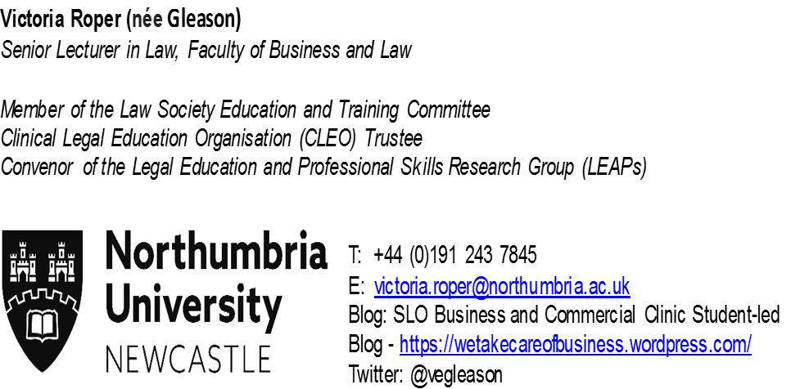
Questions/thoughts/comments?
Publications:
Victoria Roper (2018) “The Corporate Manslaughter and Corporate Homicide Act 2007 – A Ten Year Review” The Journal of Criminal Law Volume 82 Issue 1
Victoria Roper and Raymond Arthur, (2018) “Criminal Liability for Child Deaths in Custody and the Corporate Manslaughter and Corporate Homicide Act 2007” Child and Family Law Quarterly Volume 30 Issue 2
Grenfell Tower: criminal charges delayed, but that doesn’t mean there won’t be justice, The Conversation, 12 March 2019
https://theconversation.com/grenfell-tower-criminal-charges-delayed-but-that-doesnt-mean-there-wont-be-justice-113215

