Slide 1


INCREASING UNDERSTANDING OF THE GROWTH OF HOT FOOD TAKE-AWAYS: The Role of Environmental Health
Wednesday 14 October 2015
Justine Wilkinson

Slide 2
Background
Most of us are eating or drinking more than we need to and are not active enough and as a direct consequence levels of being overweight or obese are increasing.
(HSCIC, 2015).

Slide 3
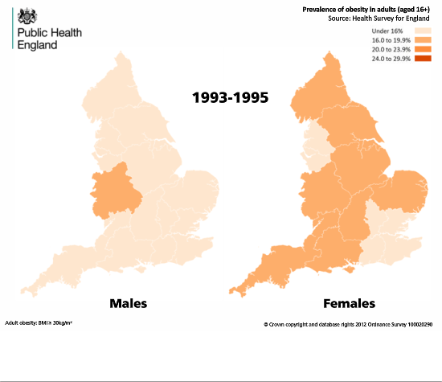
Public Health England (2015)
Notes:
Series of slides to show progression of obesity over last two decades – demonstrates rapidity of change, and scale of the problem.
NOTE that this is all adults

Slide 4
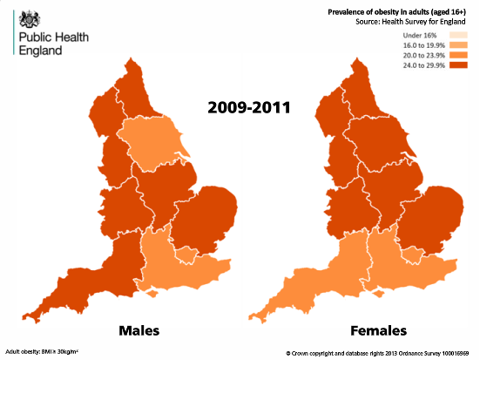
Public Health England (2015)

Slide 5

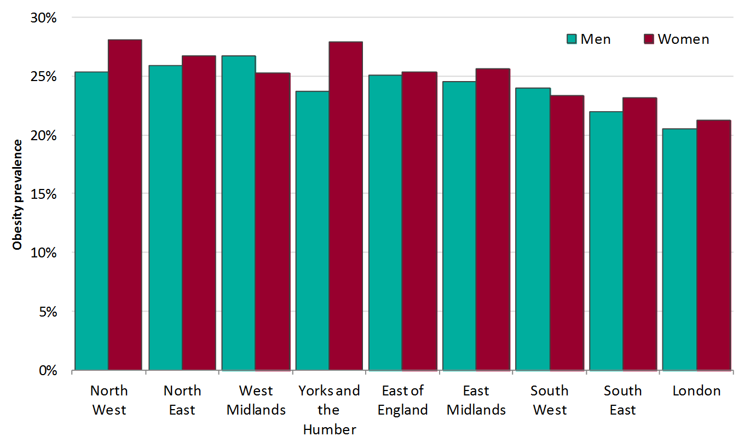
Prevalence of adult obesity by region
Health Survey for England 2009-2011 (3-year average)
Adult (aged 16+) obesity: BMI ≥ 30kg/m²
Public Health England (2015)
Notes:
Prevalence of obesity among adults varies by region in England.
Adult (aged 16+ years) age standardised obesity prevalence by English Region. The data in this chart were produced to create time-series maps for the Obesity Knowledge and Intelligence website, therefore no confidence limits are provided with the prevalence estimates.
http://www.noo.org.uk/visualisation/adult_obesity
The analysis for this chart was produced using Health Survey for England data from the UK Data Archive:
http://www.data-archive.ac.uk/.

Slide 6
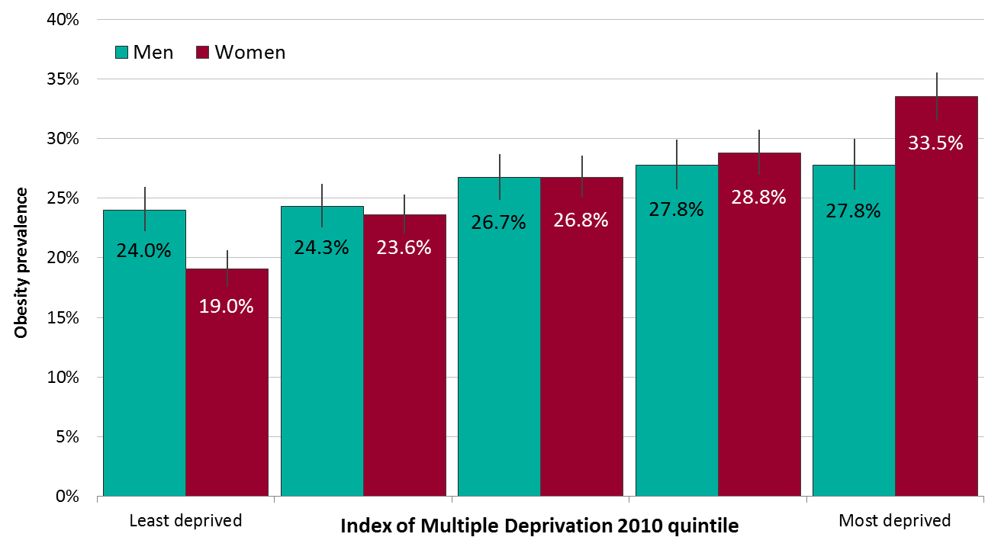
Adult obesity prevalence by deprivation
Health Survey for England 2011-2013
The chart shows 95% confidence intervals
Adult (aged 16+) obesity: BMI ≥ 30kg/m²
Deprivation measure is Index of Multiple Deprivation (IMD) 2010
Public Health England (2015)
Notes:
More information and analysis is available in the Adult Obesity and Socioeconomic Status data factsheet, available to download at http://www.noo.org.uk/NOO_pub/Key_data
The analysis for this chart was produced using Health Survey for England data from the UK Data Archive:
http://www.data-archive.ac.uk/.

Slide 7
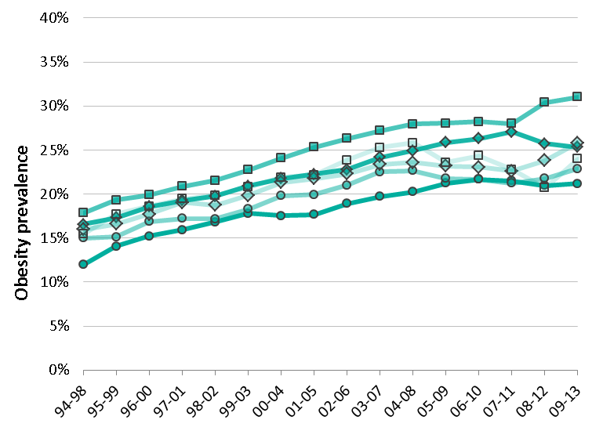
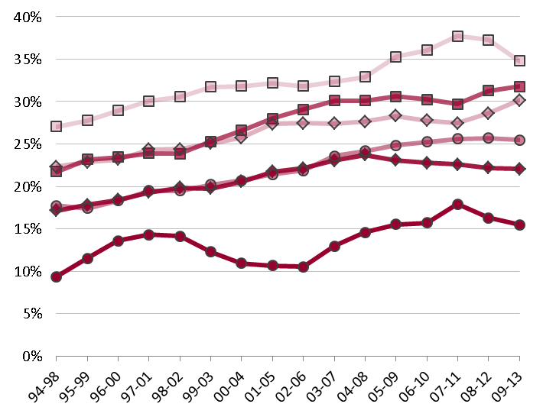
Trend in adult obesity prevalence by social class
Health Survey for England 1994-2013 (5 year moving average*)
Adult (aged 16+) obesity: BMI ≥ 30kg/m²
Men
Women
*No data on social class were collected in 2010 and 2011. Therefore data presented as 06-10 are based on a 4 year average. Data presented for 07-11, 08-12, and 09-13 are based on a 3 year average.
Public Health England (2015)
Notes:
The trend in obesity prevalence by social class differs by sex. For all social classes prevalence of obesity among men has increased between 1994 and 2013; men from the skilled manual class consistently have the highest obesity prevalence and professional men the lowest prevalence.
Women from the professional social class have the lowest prevalence of obesity. The apparent dip in prevalence in this group between 2001 and 2006 could be explained by the small sample size of women in this group during that period. There appear to be larger differences in prevalence in women between social class groups compared to men. Women in the unskilled manual class consistently have the highest prevalence of obesity.
Social class of the survey respondent was not collected in the 2010 HSE or the 2011 HSE. Therefore data presented as 06-10 are based on a 4 year average. Data presented for 07-11, 08-12, and 09-13 are based on a 3 year average.
The analysis for this chart was produced using Health Survey for England data from the UK Data Archive:
http://www.data-archive.ac.uk/

Slide 8
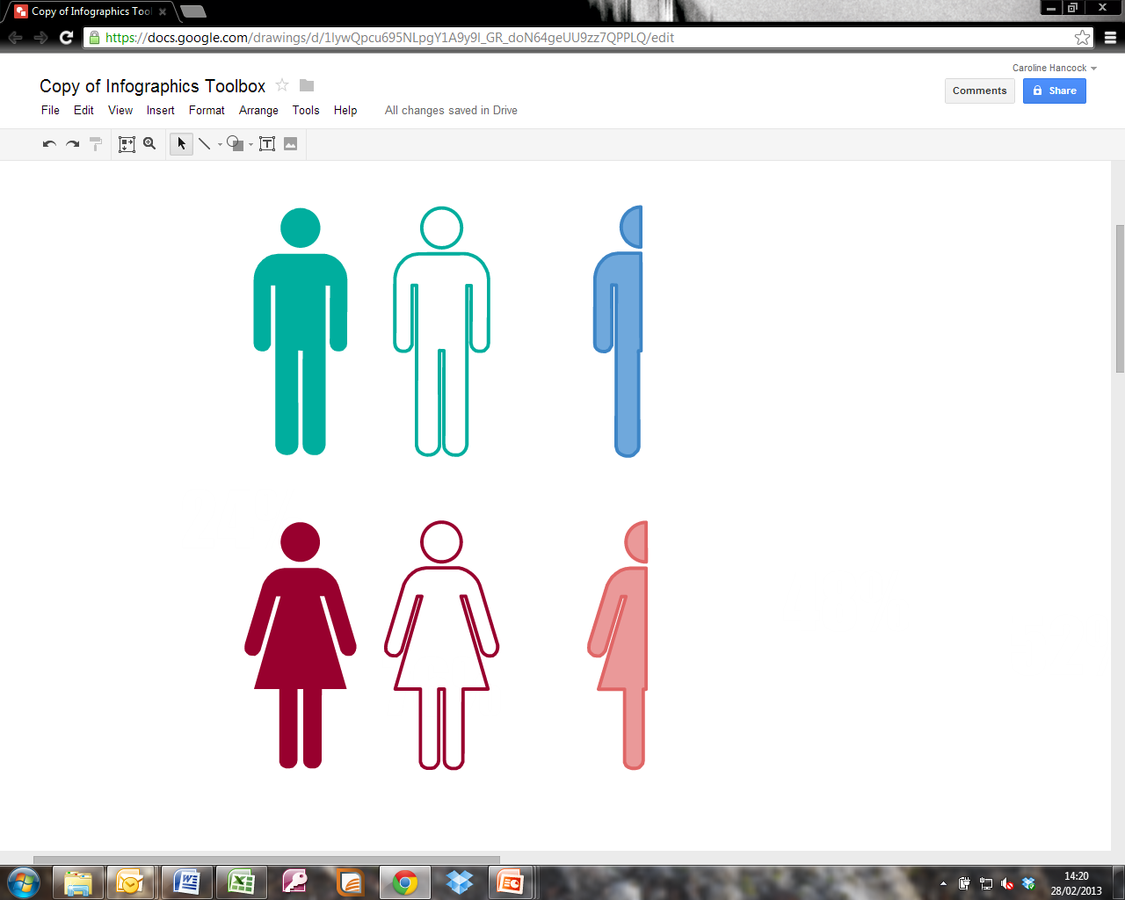
Overweight and obesity among adults
Health Survey for England 2011-2013
More than 6 out of 10 men are overweight or obese (66.2%)
More than 5 out of 10 women are overweight or obese (57.6%)
Adult (aged 16+) overweight and obesity: BMI ≥ 25kg/m²
Public Health England (2015)
Notes:
The published Health Survey for England data used to produce this graphic are available from:
http://www.hscic.gov.uk/catalogue/PUB16077

Slide 9


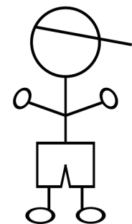

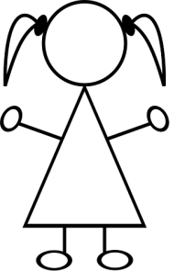
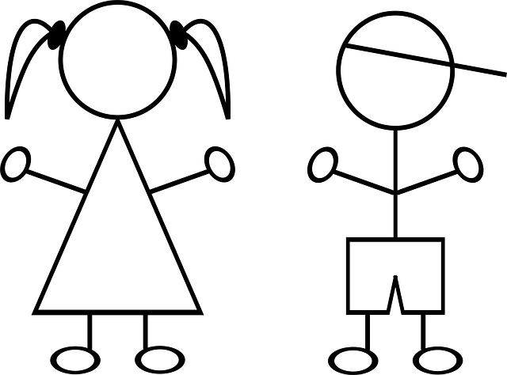
Prevalence of excess weight among children
National Child Measurement Programme 2013/14
One in five children in Reception is overweight or obese (boys 23.4%, girls 21.6%)
One in three children in Year 6 is overweight or obese (boys 35.2%, girls 31.7%)
Child overweight (including obesity)/ excess weight: BMI ≥ 85th centile of the UK90 growth reference
Public Health England (2015)
Notes:
Reception age 4-5 years. Year 6 age 10-11 years.
National Child Measurement Programme data source: Health and Social Care Information Centre
http://www.hscic.gov.uk/ncmp
Child obesity prevalence is strongly correlated with socioeconomic status and is highest in the most deprived Local Authorities.

Slide 10
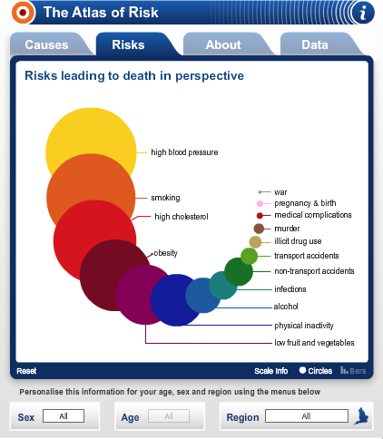
Risks of being obese
Obesity increases the risk of
  Hypertension
  Type II diabetes
  Musculoskeletal disease
  Stroke
  Coronary heart disease
  Asthma
  Many types of cancer
  Leading to significant health and social care costs
Government Office for Science (2007)
Dept of Health (2011)
NHS Choices (2013)

Slide 11
Risks associated with childhood obesity
Childhood obesity increases the risk of type 2 diabetes, asthma, sleep apnoea, musculoskeletal problems, and cardiovascular disease (among many others)
There are also links to psychiatric diagnoses
There is some (limited) evidence to suggest that, on average, children with obesity have poorer educational attainment
Obese children often become obese adults

Slide 12
What does the literature say?
The Foresight Report is the most comprehensive investigation into obesity and its causes and describes obesity as a complex problem that is more than poor choice about diet and exercise but is influenced by social, cultural and environmental factors.
Government Office for Science (2007)

Slide 13
The Foresight Report: – Responding sustainably to obesity
Most adults in the UK are already overweight. Modern living ensures every generation is heavier than the last – ‘passive obesity’
By 2050 60% of men and 50% of women could be clinically obese. Without action obesity related diseases are estimated to cost society £49.9 billion per year.
The obesity epidemic cannot be prevented by individual action alone and demands a societal approach.
Tackling obesity requires far greater change than anything tried so far, and at multiple levels: personal, family, community and national.
Preventing obesity is a societal challenge, similar to climate change. It requires partnership between government, science, business and civil society.
Government Office for Science (2007)

Slide 14
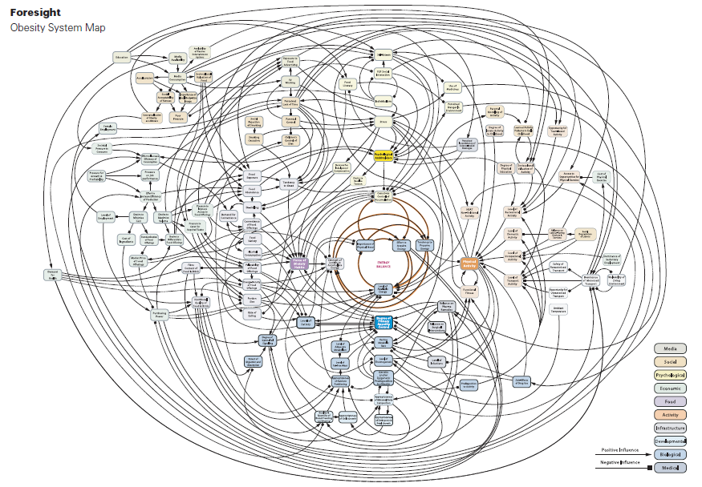
Tackling obesity is complex!
7 Key themes:
Physiology
Individual activity
Physical activity environment
Food consumption
Individual psychology
Social psychology
Government Office for Science (2007)

Slide 15
Focus on Fast Food
Attention has grown to developing action and policy to modify the food environment, with fast food outlets of particular interest.
But
Causal evidence of the link between food availability and obesity is still relatively underdeveloped.
PHE, 2014

Slide 16
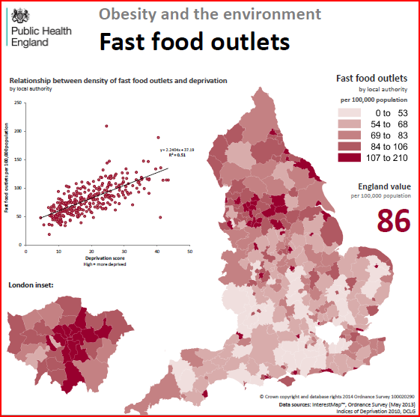
England value is 86 per 100,000
South Tyneside’s value is 103.9 per 100,000 population
Public Health England (2014)
Notes:
Access to cheap, palatable and energy dense food (often of poor nutritional quality)
NOO has produced a national profile of HFTAs per LA showing relationship between the density of HFTAs and deprivation.
Concentration of fast food outlets varies by LA
Strong correlation between deprivation and density of HFTAs
ST has higher levels of obesity and density of fast food outlets.
Evidence of link between food availability and obesity is still relatively underdeveloped.

Slide 17
Examples of Literature on Fast Food
Relationship between location of HFTAs and the impact on food choice and health
Caraher et al (2014)
Connection between the food environment and health inequalities showing an association between the concentration of fast food takeaways and levels of obesity with obesity levels tending to be higher in more deprived areas
Greig et al (2014)
People who live and work near a high number of takeaway food outlets tend to eat more takeaway food and are more likely to be obese than those less exposed
Burgoine et al (2014)
Notes:
Evidence is poor but starting to emerge.
Evidence of this relationship is starting to emerge, for example the location of hot food takeaways (HFTA) and their impact on food choice and health (Caraher et al (2014).
The connection between the food environment and health inequalities has shown an association between the concentration of fast food takeaways and levels of obesity with obesity levels tending to be higher in more deprived areas (Greig et al 2014).
A national profile of hot food takeaways (HFTA) per local authority shows strong correlation between deprivation and density of HFTAs (National Obesity Observatory, 2012)

Slide 18
Literature continued…
Intake of takeaway food has increased & become a regular component of the diet
(Duffy et al., 2007;Poti et al., 2011)
Consumption of fast/takeaway food > once a week increases the risk of being obese by 129%
(Schroder et al., 2007)
Nutritional profile of takeaway food is highly variable - tendency for excessive portion size, energy, macronutrients and salt
(Jaworowska et al., 2014; Caraher et al., 2014; Saunders et al., 2015).

Slide 19
Gateshead Takeaway Study
Sampled popular meals and analysed nutrient data and found:
  wide variation in nutritional content and portion size
  About two-thirds had more than an adult female’s RDA of saturated fat
  About three-quarters had more than 66% of an adult female’s RDA of calories
  Areas where takeaways had proliferated saw serious competition on price and portion size
Notes:
Study included pie and chips, fish and chips, sweet and sour chicken, chicken chow mein, chicken tikka masala, chicken madras, margherita pizza and pepperoni pizza.
Saturated fat worst offenders: pizzas and fish and chips
Calories: best – chicken chow mein

Slide 20
Transfer of Public Health functions
Transition of health improvement functions back to local government in England in 2013.
Provides opportunities for Environmental Health practitioners to contribute to address health inequalities.

Slide 21
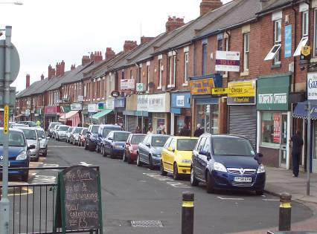
The Project
Understanding food businesses from a public health perspective using existing Environmental Health data.
Notes:
All visits / activities to businesses are recorded on MVM
As all businesses must register they declare what type of business they are eg fish and chips, sandwich shop etc these are held and can be searched
All food visits are held on MVM which is a computer database used to monitor work and generate statutory returns.
Rarely do any form of data interrogation from a public health point of view

Slide 22
The Project
The public health community is responsive to systematic data gathering, evidence based delivery and measuring population level public health outcomes.
The South Tyneside Team:
Julie Connaughton
Andrea King
Claire Nevison
Dene Outerside
Justine Wilkinson

Slide 23
What did we seek to do?
Use existing food business data collected by South Tyneside EH to:
Document the HFTA business profile over a 5 year period
Define the current local HFTA business profile in South Tyneside
Map HFTA business location and compare with deprivation, child and adult obesity data
Use findings to inform public health decision making

Slide 24
Methodology
South Tyneside Council’s Environmental Health database used to extract reliable data on Hot Food Take Aways (HFTAs), including location, type of HFTA and change in profile over time (5 years).
Geographical Information Systems used to map on to local political boundaries and overlaid with child and adult obesity levels, deprivation, town centres and location of schools shown with a radius of 400m.
Notes:
Cost effective and convenient
Comprehensive and systematically collected databases maintained over time can provide valuable information which can form the basis for research studies.
Whilst it is an offence to falsely describe or present food (Food Safety Act, 1990, s.15) takeaways are not required to provide nutritional labelling, therefore consumers may find it difficult to make an informed choice of the nutritional value of meal options.

Slide 25
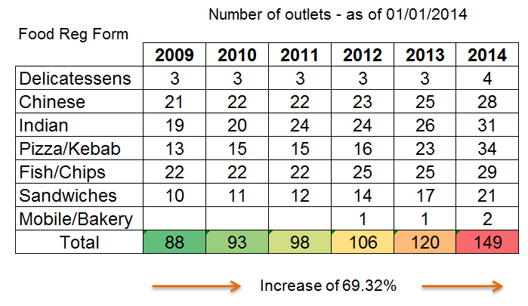
Key Findings: Change over time
Notes:
FBOs are required to register with Env Health and state what type of food business they intend to operate.
Observations by staff are that businesses are diversifying eg sandwich retailers offering a wider selection of hot food / Sunday lunches as take outs.
Over 5 year period we have seen a + 69% increase in businesses

Slide 26
Comparison with planning information
Whilst the overall number of business units in South Tyneside is decreasing the only category to show an increase in growth was A5 (+3% in 2013-14).
In South Tyneside 9% of retail units are defined as business class A5.
Retail units which fall under class A1 such as bakers and sandwich shops may also sell hot food as an ancillary use to their primary purpose without requiring a change of use. In South Tyneside this presents the potential to add a further 268 premises.

Slide 27
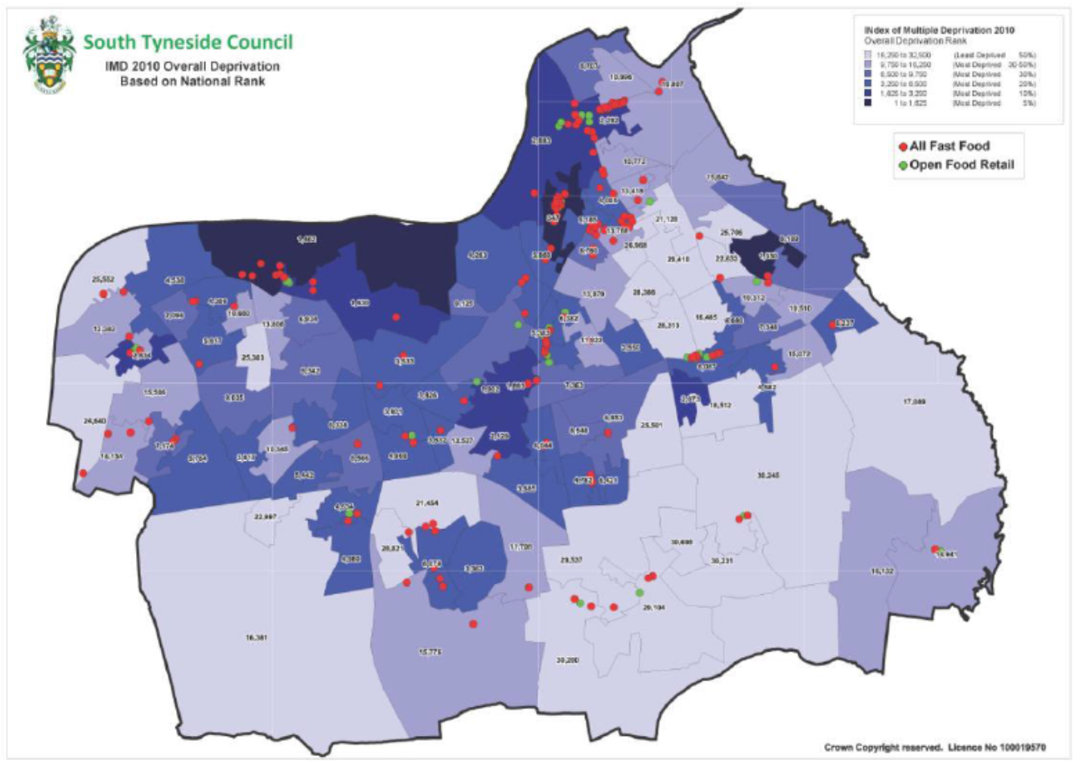

Slide 28
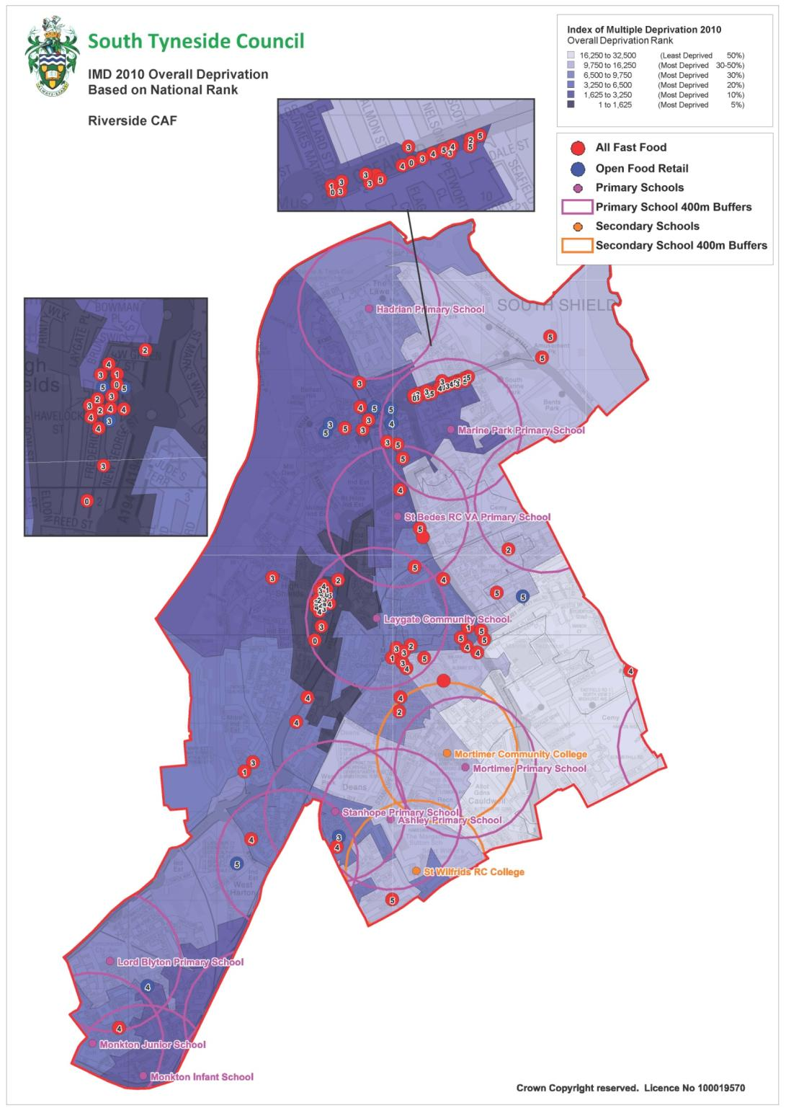
Deprivation and Location of HFTAs
Areas with high levels of deprivation tend to have higher rate per population of HFTAs

Slide 29
Limitations
Differences between planning and Env Health recording of business category
Definitions can lead to missing businesses eg McDonalds is classed as a restaurant.
Doesn’t take account of takeaway delivery
Takeaway outlets are not the only source of poor quality foods with retailers and supermarkets also contributing to the issue.
Focussed on / around the home exposure and doesn’t reflect different types of exposure such as at work or commuting route exposure which may underestimate total exposure

Slide 30
So what next....
The following has been approved by the Health and Wellbeing Board
Planning – Location, Limits and Local Plan
Public Health – Think Family, Healthy Schools
Environmental Health – Businesses
Joint – Regulatory and Educative
Notes:
Commitment from Planning – local plan policy options to control the location of HFTA by establishing limits for max number within Borough’s centres. Continue to monitor applications from A3 & A5 uses including number of applications, decisions and locations. This will help to identify trends and hot spots and review effectiveness of current LDF planning policies.
Public Health – Healthy Schools/Family Lifestyle Programme. Training – all nutrition training – WM, ECHIC etc. includes reference to HFTA. Embed ‘think family’ initiative through a coordinated approach with local partners using the C4Life model.
Env Health, - work with proprietors - nutritional claims investigation, healthy options, educate re levels of obesity.
Joint – targeted educative approach, businesses and consumers, adults and children – to gain insights and attitudes to HFTA – uncover behaviour, cost, accessibility and availability.

Slide 31
So what next…
Licensing restrictions on the location of takeaways doesn’t have an impact on the existing portfolio of businesses.
A more realistic intervention is to challenge and change what is on offer, how much is offered and how it’s been prepared (Saunders et al 2015).
This suggests opportunities to work with independent takeaway businesses particularly in the areas of standardising recipes, improving the nutritional profile and quality of products sold, reviewing cooking techniques as well as portion size reduction.
Public support for healthy lifestyle campaigns and menu labelling rather than taxation of unhealthy foods (Beeken and Wardle,2013)
Notes:
We could work more with shops, supermarkets, restaurants, cafes and voluntary community services to promote
healthy eating choices that are consistent with existing good practice guidance and to provide supporting information.
work more creatively with the catering and retail trades to:
• improve food, drink and menu labelling
• reduce salt and sugar content of menus and portion sizes
• promote and stock healthier alternatives to traditional fast food, takeaways, sweets and sugary drinks
We could further develop planning policies that restrict the number of fast food outlets and vans around schools
and work with schools to reduce vending machines selling salty, sugary food and drinks.

Slide 32
Summary
The proportion of people who are overweight and obese is very large and growing.
We live in an obesogenic environment – the problem is far wider than takeaways alone.
Physical activity, though not mentioned today, has a big role to play.
Obese children often become obese adults. Early intervention can help children and families.
Local authorities are well-placed to intervene.
Notes:
Physical activity – average adult spends TEN TIMES as long watching TV as doing even moderate intensity physical activity e.g. walking

Slide 33
References
Burgoine Thomas, Forouhi Nita G, Griffin Simon J, Wareham Nicholas J, Monsivais Pablo (2014) ‘Associations between exposure to takeaway food outlets, takeaway food consumption, and body weight in Cambridgeshire, UK: population based, cross sectional study’ BMJ 348:g144
Caraher M., Lloyd S.,. Madelin T The “School Foodshed”: schools and fast-food outlets in a London borough British Food Journal2014116:3 , 472-493
Department of Health (2011) Healthy Lives, Healthy People: A call to action on obesity in England Available at: https://www.gov.uk/government/uploads/system/uploads/attachment_data/file/213720/dh_130487.pdf
Government Office for Science (2007): Foresight: Tackling Obesities: Future Choices. 2nd edn London: Stationary Office
Health and Social Care Information Centre (2015) Statistics on Obesity, Physical Activity and Diet - England 2015 Available at: http://www.hscic.gov.uk/catalogue/PUB16988/obes-phys-acti-diet-eng-2015.pdf
Local Govt Association (2015) Tackling the causes of and effects of obesity London: LGA
NHS Choices (2013) Atlas of Risk Available at: http://www.nhs.uk/tools/pages/nhsatlasofrisk.aspx

Slide 34
Poti, J.M. and Popkin, B.M. (2011), “Trends in energy intake among US children by eating location and food source, 1977-2006”, Journal of The American Dietetic Association, Vol. 111 No. 8, pp. 1156-1164.
Public Health England (2014) Obesity and the Environment – Fast Food Outlets Available at: http://www.noo.org.uk/uploads/doc/vid_15683_FastFoodOutletMap2.pdf
Public Health England (2014) Healthy People, healthy Places: Obesity and the environment: regulating the growth of fast food outlets Available at: https://www.gov.uk/government/uploads/system/uploads/attachment_data/file/296248/Obesity_and_environment_March2014.pdf
Public Health England (2015) Obesity Slide sets Available at: https://www.noo.org.uk/slide_sets
Saunders P, Saunders A and Middleton J (2015). Living in a ‘fat swamp’: exposure to multiple sources of accessible, cheap, energy-dense fast foods in a deprived community. British Journal of Nutrition, 113, pp 1828-1834. doi:10.1017/S0007114515001063.
Schröder, H., Fito, M. and Covas, M.I. (2007), “Association of fast food consumption with energy intake, diet quality, body mass index and the risk of obesity in a representative Mediterranean population”, British Journal of Nutrition, Vol. 98 No. 6, pp. 1274-1280.

