Slide 1
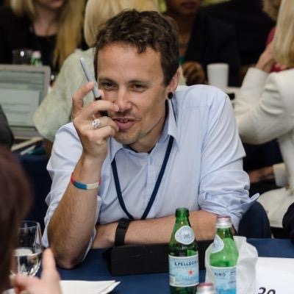
Rethinking Business Models: Lessons from the Quaker approach to responsible business
Dr Nicholas Burton
Dr Alex Hope
Notes:
Good morning. My name is Dr Alex hope and I am Senior lecturer in Business Ethics at Newcastle Business School, Northumbria University.
Today I am presenting on behalf of myself and my colleague Dr Nic Burton who cannot be here today.
We would like to present some work we are currently undertaking on responsible business models and lessons that can be learnt from Quaker business practices.

Slide 2
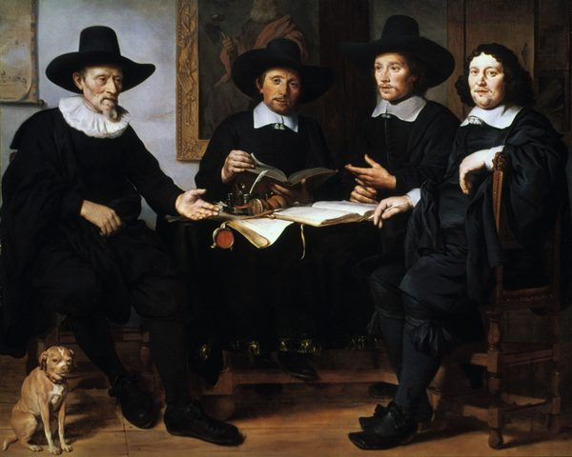
Notes:
But to first, what is a Quaker?
Quakerism, also known as the Religious Society of Friends, is a movement based Christianity. the starting-point of Quakerism is the conviction that everyone can experience God directly in his/her own heart and the movement is known for its values of peace, truth and equality and simplicity and sustainability.

Slide 3
“The real goal for an employer is to seek for others the best life of which they are capable.”
Notes:
The Quakers were persecuted by mainstream Christian groups and barred from many professions, including university lecturing, and the military so they turned to trade and business to make a living.
They translated their values to their business practices believing that the real goal for an employer was to seek for others the best lives of which they are capable.
The 19th century saw rapid growth companies engaging multinational business and Quaker businesspeople were disproportionately present among them.

Slide 4
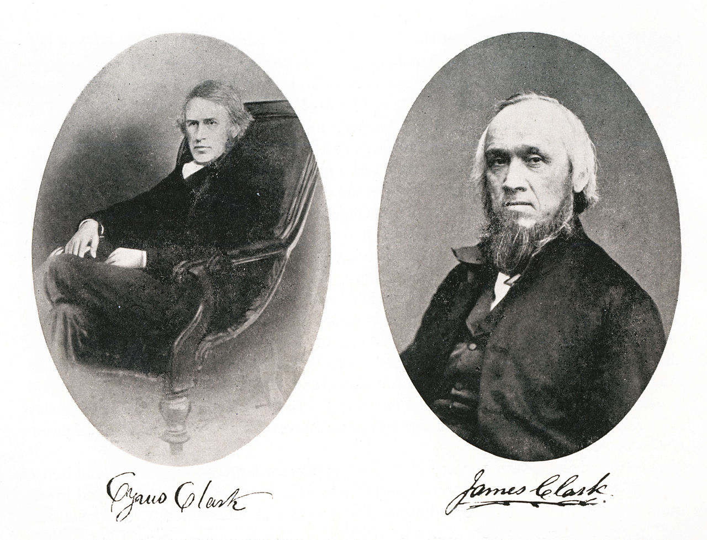
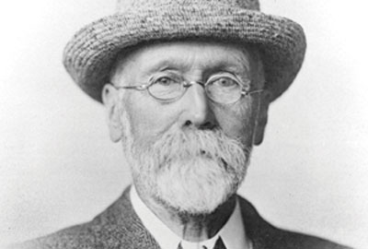
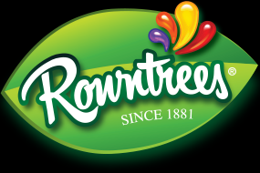
Notes:
Well known Quaker businesses include chocolate makers Cadbury, Terry and Fry ; confectionery manufacturer Rowntree (now Nestle), Clarkes shoes, matchmakers Bryant and even Lloyds and Barclays banks.

Slide 5
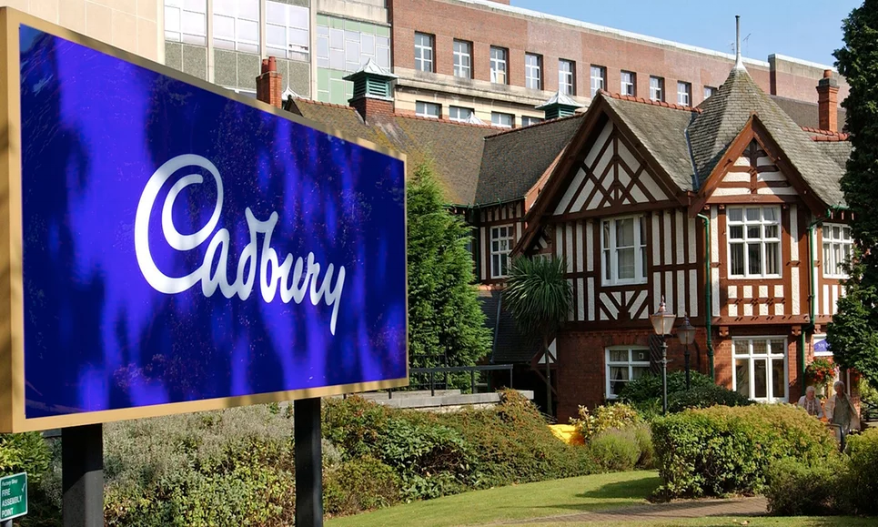
Notes:
The Cadbury family were particularly well known for their Quaker beliefs that all human beings should be treated equally an their commitment to social responsibility and social reform. They built the Bourneville Model village to provide decent housing for their chocolate factory employees.
Many Economic Historians credit Quakerism and its business ethics with shaping the economic environment of early modern England and, consequently, its long term economic growth.

Slide 6
Quaker Business Values
Truth and Integrity
Justice equality and community
Notes:
Quaker Business values today include Truth and Integrity in all business dealings, keeping promises made such on price, delivery or quality.
There is a commitment to Justice equality and community respecting employees and treating them as equals. In the past, this took the form of providing decent housing, education for workers and their families, anti-slavery campaigns, giving pensions and minimum wages.

Slide 7
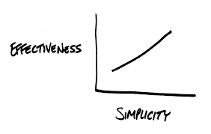
Quaker Business Values
Simplicity
Peace
Notes:
Quaker businesses strive for Simplicity though A simple lifestyle for the organization and its leaders, addressing overuse of the earth's resources, reducing the businesses carbon footprint and working to eradicate poverty.
There is a long tradition of Peace and non-violence with Quaker businesses refusing to engage with the arms trade, or any organizations that profit from conflict. Any form of violence or coercion in business is seen as suspect.

Slide 8
Quaker Business Values
The Light Within
Notes:
Finally there is the belief of The Light Within – which can be translated into the value of authenticity for the organization, and the business leaders who should be courageous in standing up for what they believe to be right.

Slide 9
Notes:
Recent events such as the banking crisis and recession has sparked renewed interest in alternative ways of doing business such as the Quaker business practices of the past.
It could be argued that the “Quaker capitalism” of the 1900’s was far more ethical than the shareholder capitalism of today. The contempt with which the banking industry is now held has led to a search for economic alternatives, both radical and mild

Slide 10
Quaker Capitalism
Notes:
Quaker capitalism' is the term coined by Deborah Cadbury in her 2010 book 'Chocolate Wars From Cadbury to Kraft. It refers to the forging of a new way of doing business that is grounded in faith and ethics. This has been built upon by Mike King as a model for corporate social responsibility in the modern world, exploring Quaker businesses which combine commercial success with philanthropy and social activism.

Slide 11
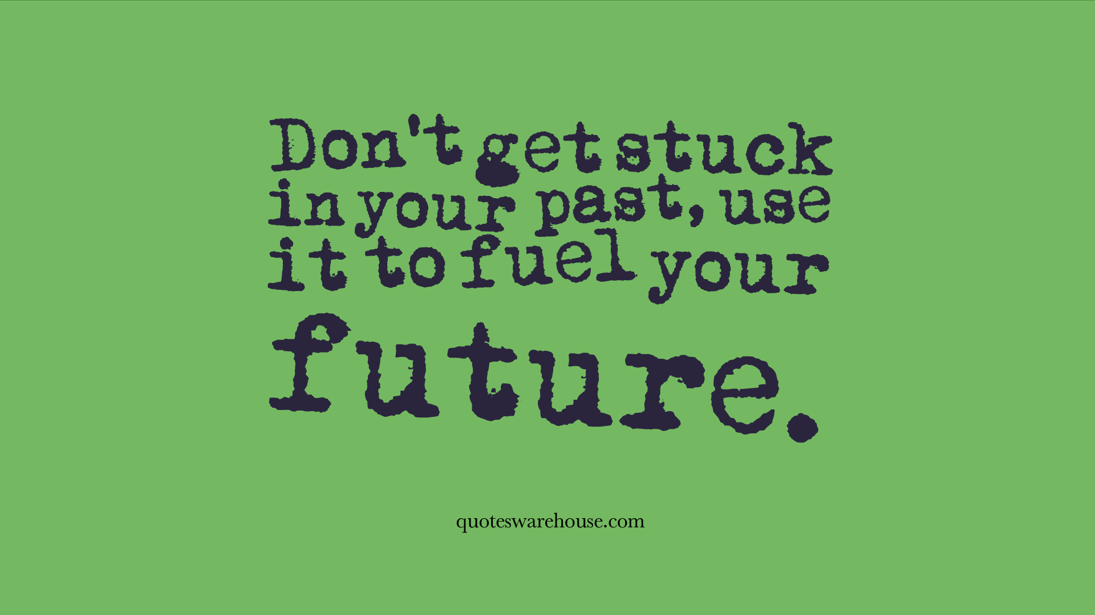
Learning Lessons
Notes:
So, are there lessons to be learnt from the Quaker family businesses of the past for business of today?
Some academics such as Colin Mayer, professor of management studies at Said Business school, Oxford university suggest the answer is yes, but perhaps not in the way in which we might expect.

Slide 12
Responsible Business?
Notes:
It is not that we can or should seek a revival of the types of businesses the Quakers promoted. The world is a very different place now of course.
Indeed, if survival is an indicator of success, the Quaker firms have been a failure. Most went out of business or were taken over and those that have survived, such as Barclays and Lloyds Bank, are not universally regarded as paragons of virtue today.

Slide 13
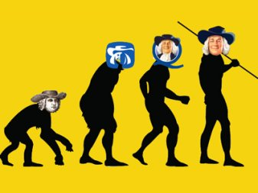
Notes:
In looking for a way forward, we can take inspiration from the more radical Victorian Quakers. They had faith and courage to attempt things which seemed either laughable or shocking such as the model village at Bourneville, or gifting ownership and shares to all employees of the organization.

Slide 14
Innovation
Notes:
This is where the Quaker experience has important lessons for today, because the early Quaker companies operated in a society that was less tolerant and enlightened than today.
What the Quakers did was to engage in commercial innovations, such as fixed price contracts and housing for their employees, that fundamentally altered the conventions and practices of their time.
The Quaker firms became models for business because they demonstrated by example how enlightened business was highly profitable.

Slide 15
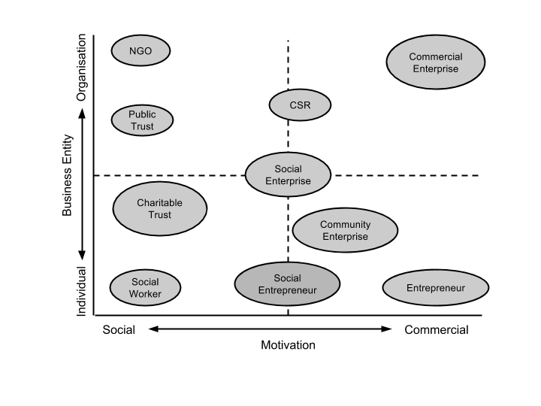
Responsible Business Models
Notes:
It is innovation in business practice today that will ultimately be the catalyst for change and this includes developing and scaling alternative business models, ones that perhaps seek to align social and commercial motivations across individual and organizations scales.

Slide 16
Defining Responsible Business
Responsible Business Model
Innovation: Reconceptualising the role of business in
society.
Dr. Alex Hope and Robert Moehler
Notes:
Work we have been undertaking at Newcastle Business School has resulted in a definition of the responsible business model which we suggest is:
“A plan for the successful operation of a business which identifies sources of revenue and contributions to economic development, products and services that improve the wellbeing of its identified customer base and workforce, contribute to sustainable development, and leverage ethical sources of finance.”

Slide 17
Responsible Business Models
Notes:
Responsible business models already exist and are used across a wide range of organisations.
The cooperative business model is based on a structure pioneered by some early Quaker organisations where the owners are also customers.
Social enterprise models align social objectives with the creation of economic value.

Slide 18
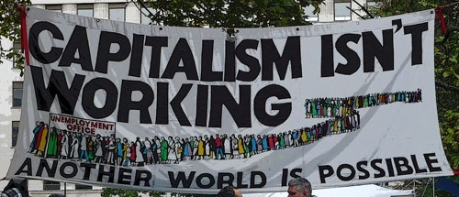
Developing new from old?
Notes:
Ultimately then we suggest that modern business can learn from the responsible businesses of the past.
But A new, enlightened brand of capitalism will of course have to be profitable to flourish. It will have to generate benefits for investors as well as society.
In this respect it could perhaps rekindle the flame that drove the Quakers: that treating people fairly and well is good business.

Slide 19
Future Plans
Notes:
In order to progress this work we have convened a ‘Spirituality in Management and Law’ Special interest group within our Responsible Business research area. Here we are undertaking inter-disciplinary research and scholarship that examines how spirituality, religion or belief influences management, employment and law. We are seeking collaborators if anybody has an interest in these areas.

Slide 20
Thankyou
Dr Nicholas Burton
Dr Alex Hope
n.burton@northumbria.ac.uk
alex.hope@northumbria.ac.uk
@ryesidenic
@drsustainable
Notes:
Finally thankyou for your time, you can contact wither myself or Nic to follow up on anything that you have seen today and I will be happy to try to answer any questions you may have.

