Slide 1
Professional Development Workshop Identity Research: Mapping the terrain, opening frontiers
Kate Black
Caroline Clarke
Sandra Corlett
Ali Rostron
Juliette Summers

Slide 2
Aims of the workshop
To review some of the diverse streams within identity research and to explore some of the distinctions and relationships between them
To discuss and reflect on the ways in which approaches to identity might relate to our own research
To consider possible future “frontiers” of identity research
what particular problems such frontiers might address?
what new problems such frontiers might open up?

Slide 3
Proposed format
Identity: diverse perspectives (c.45mins)
Social identity approach (Juliette)
Identity work (Ali)
Material discursive practices (Sandra and Caroline)
Small group facilitated discussion (c.45mins)
Reconvening and feedback: opening up new frontiers of identity research (c.15mins)

Slide 4
Identity
Potential to advance understanding in almost every aspect of organisational life (Haslam and Reicher, 2006)

Slide 5
Who are we?
Multiple conceptualisations
A “slippery” concept (Alvesson, 2010)
“an explanatory concept … over used and under specified” (Pratt, 2003, p.162)
“a concept which means everything means nothing” (Pratt, 2003, p.162)
The “meanings that individuals attach reflexively to their selves” (Brown 2015, p.2)
Individual … within, and at the interface of, the social and organisational

Slide 6
Who are we? ……
The “meanings that individuals attach reflexively to their selves” (Brown 2015, p.2)
Individual … within, and at the interface of, the social and organisational
Notes:
How we conceptualise identity informs how we research it...

Slide 7
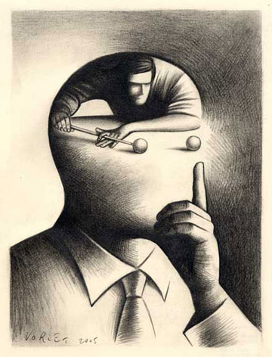
Alvesson (2010)
Agency
Structure
uncertain, precarious and fluid
Robust, integrated and coherent
Notes:
How might we research identity?

Slide 8
Alvesson, M. (2010) Images of self-identities

Slide 9
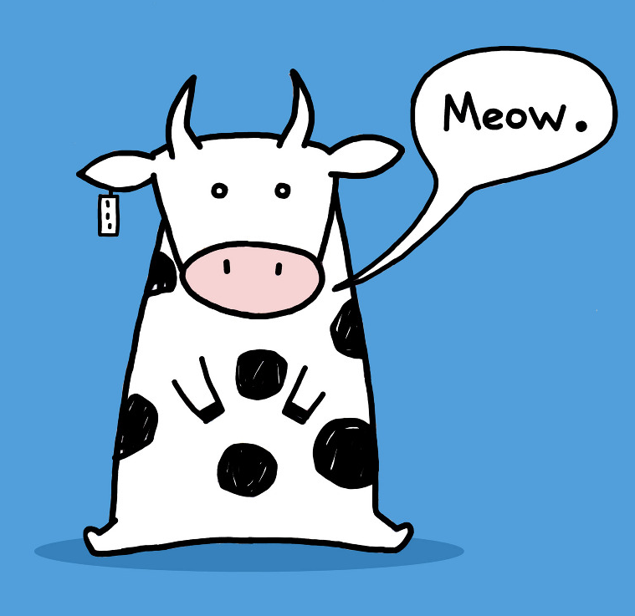
Social identity approach
Identity work
Material discursive
May not be regarded as “hermetically sealed” but as related, complementary and/or overlapping (Brown, 2015, p. 23)
Notes:
Exploring identity

Slide 10
Social Identity Approach
BAM 2016

Slide 11
What is SIA? – Underpinning Concepts
SIA combines
Social Identity Theory Tajfel 1978, Tajfel & Turner 1979
2. Self-Categorisation Theory Turner 1982, Turner et al. 1987, Turner et al. 1994
SIT introduces the concept of social identity in the context of an analysis of intergroup relations, SCT clarifies the concept and its relationship to other levels of identity.
SIT
Tajfel’s studies (which allocated participants to ostensibly meaningless groups) indicated that people come to define themselves in terms of group membership.
This influences group behaviour (in-group favouritism)
Social identities have value and emotional significance: our sense of esteem attaches to the fate of our group (and to the fate of fellow group members)
SCT
links social identity and self
group psychology underpinned by a cognitive act of self-categorisation
Focuses on: depersonalization, self-stereotyping and social influence
Notes:
11

Slide 12
What is SIA? - Underlying Assumptions
Membership of groups is significant for self-identity
A group needs to meet members’ expectations and beliefs (normative fit) and be distinctive (comparative fit)
Group membership/social identity is linked to self-esteem
Numerous and changing social identities
Change is key to SIT: As the social context alters, the salient social identity changes too
As the environment changes, so too do social identities develop
Notes:
12

Slide 13
Relational Nature of SIA
Self-esteem occurs when the in-group is perceived as superior to relevant out-groups.
But, defining the in-group as inferior would be a threat to self-esteem.
e.g. the socially constructed low status and skill of the work done by women.
(see Goffman 1963, Major & O’Brian 2005)
A number of possible responses to a threat to self-esteem may occur ….

Slide 14
Change is key to SIA
Exit the low status group.
But exit is not always possible
Social competition,
a collective challenge to the status/validity of a higher status group.
e.g. attempting to advance the status of women at work by challenging (within that environment) the wisdom and truth of gendered work inequalities.
Social creativity
find a new positive dimension to compare the ingroup with the relevant outgroup
compare the in-group with equivalent or subordinate groups to enhance its status (see Haslam, 2004).

Slide 15
SIA use in Management Debates
Theory: H. Tajfel; J.Turner and S.A. Haslam
Work & Organisations
Teamwork & group performance, change management, conflict, fairness, discrimination, & bullying
Decision-making
How journal ranking decisions are based on the social identities of the panel (Peters, Daniels, Hodgkinson, Haslam 2012)
Leadership
Leadership as a group process; prototypicality and influence
Identity entrepreneurs (Mols)
Notes:
15

Slide 16
Where is it going?
Environmental identities and behaviour:
Persuasion and nudging
Examples: Ethical behaviours (Bratanova et al., 2012: Moral Circle) Persuasive governance (Mols, 2012 & 2015: Nudging; Framing)
Health & Wellbeing: How does group identification promote welfare?
In religious gatherings / care homes / mental health support groups / pain management groups / social care
Example:
Crowd Behaviour: How are cohesive and empowered groups formed?
How does social change occur?
How does communication initiate the formation of new norms, values and social identities?
Example: Football (Guilianotti 2013)
SIT is increasingly studied using qualitative, social constructivist, inductivist, interpretivist, and critical realism approaches.
Notes:
16

Slide 17
References
Guilianotti, R. (Ed.). (2013). Football, violence and social identity. Routledge.
Haslam, S. A., van Knippenberg, D., Platow, M. J., & Ellemers, N. (Eds.). (2014). Social identity at work: Developing theory for organizational practice. Psychology Press.
Ellemers, N., Pagliaro, S., & Barreto, M. (2013). Morality and behavioural regulation in groups: A social identity approach. European Review of Social Psychology, 24(1), 160-193.
Hogg, M. A., & Terry, D. J. (Eds.). (2014). Social identity processes in organizational contexts. Psychology Press.
Mols, F., Haslam, S. A., Jetten, J., & Steffens, N. K. (2015). Why a nudge is not enough: A social identity critique of governance by stealth. European Journal of Political Research, 54(1), 81-98.
Mols, F. (2012). What makes a frame persuasive? Lessons from social identity theory. Evidence & Policy: A Journal of Research, Debate and Practice, 8(3), 329-345.
Bratanova, B., Loughnan, S., & Gatersleben, B. (2012). The moral circle as a common motivational cause of cross‐situational pro‐environmentalism. European Journal of Social Psychology, 42(5), 539-545.
Tee, E. Y., Paulsen, N., & Ashkanasy, N. M. (2013). Revisiting followership through a social identity perspective: The role of collective follower emotion and action. The Leadership Quarterly, 24(6), 902-918
Tajfel, H. (Ed.) (1978). Differentiation between social groups: Studies in the social psychology of intergroup relations. London: Academic Press.
Tajfel, H., Flament, C., Billig, M. G., & Bundy, R. F. (1971). Social categorization and intergroup behaviour. European Journal of Social Psychology, 1, 149-177.
Tajfel, H., & Turner, J. (1979). An integrative theory of intergroup conflict. In W. G. Austin & S. Worchel (Eds.), The social psychology of intergroup relations (pp. 33-48). Monterey, CA: Brooks/Cole.
Turner, J. C. (1982). Towards a cognitive redefinition of the social group. In H. Tajfel (Ed.) Social identity and intergroup relations (pp. 15-40). Cambridge: Cambridge University Press.
Turner, J.C. (1991). Social influence. Milton Keynes: Open University Press.
Turner, J. C., Hogg, M. A., Oakes, P. J. Reicher, S. D. & Wetherell, M. S. (1987). Rediscovering the social group: A Self-Categorization Theory. Oxford & New York: Blackwell
Goffman E. (1963). Stigma: Notes on the management of spoiled identity
Major, B., & O'Brien, L. T. (2005). The social psychology of stigma. Annu. Rev. Psychol., 56, 393-42
Bratanova, B., Loughnan, S., & Gatersleben, B. (2012). The moral circle as a common motivational cause of cross‐situational pro‐environmentalism. European Journal of Social Psychology, 42(5), 539-545.

Slide 18
Identity Work
So who are you again?

Slide 19
Identity work: what is it?
Interest in the continuous dynamic (struggle) between the self and the social
...the mutually constitutive processes whereby people strive to shape a relatively coherent and distinctive notion of personal self-identity and struggle to come to terms with and, within limits, to influence the various social-identities which pertain to them in the various milieu in which they live their lives. (Watson, 2008, p.129)

Slide 20
Identity work: what is it?
Interest in the continuous dynamic (struggle) between the self and the social
...the mutually constitutive processes whereby people strive to shape a relatively coherent and distinctive notion of personal self-identity and struggle to come to terms with and, within limits, to influence the various social-identities which pertain to them in the various milieu in which they live their lives. (Watson, 2008, p.129)
Mutually constitutive - degree of agency

Slide 21
Identity work: what is it?
Interest in the continuous dynamic (struggle) between the self and the social
...the mutually constitutive processes whereby people strive to shape a relatively coherent and distinctive notion of personal self-identity and struggle to come to terms with and, within limits, to influence the various social-identities which pertain to them in the various milieu in which they live their lives. (Watson, 2008, p.129)
Mutually constitutive - degree of agency
Individuals seek to establish coherence - but unfinished and changing project

Slide 22
Identity work: what is it?
Interest in the continuous dynamic (struggle) between the self and the social
...the mutually constitutive processes whereby people strive to shape a relatively coherent and distinctive notion of personal self-identity and struggle to come to terms with and, within limits, to influence the various social-identities which pertain to them in the various milieu in which they live their lives. (Watson, 2008, p.129)
Mutually constitutive - degree of agency
Individuals seek to establish coherence - but unfinished and changing project
Making sense of one’s place in the world at any one time

Slide 23
Identity work: what makes it distinctive?
Attends to the "work" undertaken to create, sustain, repair, revise self-concepts – the individual in their context(s)
Processes of struggle and meaning-making
The range of strategies/tactics employed
Incorporates both inward and outward processes and degree of consistency and fluidity - but degree of emphasis may vary e.g.
Narrative approaches – commonly* focus on inward, self-reflection, nature of self-identity and processes for creating, maintaining, repairing, revising
Performative approaches – focus on responses to outward context, selective associations – the relational self
*but...

Slide 24
Identity work: how is it being used (and where might it be going?)
How individuals make meaning from context and experience e.g. Beech et al, 2016; Brown and Coupland, 2015
Identity transitions (demanding/extreme forms of identity work) e.g. Ibarra and Barbulescu, 2010; Hay, 2014; Mallett and Wapshop, 2015
Negotiating organisational roles and relationships e.g. DeRue and Ashford, 2010; Wright et al, 2012; McInnes and Corlett, 2012
Hybrid roles e.g. McGivern et al, 2015; Currie and Croft, 2015
The legitimisation of organisations (reproducing, resisting, accommodating organisational logics) e.g. Brown and Toyoki, 2013; Mangan and Brivit, 2015; Kreiner et al, 2015

Slide 25
References
Beech, N., Gilmore, C., Hibbert, P., & Ybema, S. (2016). Identity-in-the-work and musicians' struggles: the production of self-questioning identity work. Work, Employment and Society, 30(3), 506-522.
Brown, A. D., & Coupland, C. (2015). Identity threats, identity work and elite professionals. Organization Studies, 36(10), 1315-1336.
Brown, A. D., & Toyoki, S. (2013). Identity work and legitimacy. Organization Studies, 34(7), 875-896.
Currie, G., & Croft, C. (2015). Examining hybrid nurse managers as a case of identity transition in healthcare: developing a balanced research agenda. Work, Employment and Society, 29(5), 855-865.
DeRue, D. S., & Ashford, S. J. (2010). Who will lead and who will follow? A social process of leadership identity construction in organizations. Academy of Management Review, 35(4), 627-647.
Hay, A. (2015). 'I don;t know what I'm doing!': Surfacing struggles of managerial identity work. Management Learning, 45(5), 509-524.
Ibarra, H., & Barbulescu, R. (2010). Identity as narrative: Prevalence, effectiveness and consequences of narrative identity work in macro work transitions. Academy of Management Review, 35(1), 135-154.
Kreiner, G. E., Hollensbe, E. C., Sheep, M. L., Smith, B. R., & Kataria, N. (2015). Elasticity and the dialectic tensions of organizational identity: How can we hold together while we are pulling apart? Academy of Management Journal, 58(4), 981-1011.
Mallett, O., & Wapshott, R. (2015). Making sense of self-employment in late career: understanding the identity work of olderpreneurs. Work, Employment and Society, 29(2), 250-266.
Mangan, C., & Brivot, M. (2015). The challenge of sustaining organizational hybridity: The role of power and agency. Human Relations, 68(4), 659-684.
McGivern, G., Currie, G., Ferlie, E., Fitzgerald, L., & Waring, J. (2015). Hybrid manager-professionals' identity work: The maintenance and hybridization of medical professionalism in managerial contexts. Public Administration, 93(2), 412-432.
McInnes, P., & Corlett, S. (2012). Conversational identity work in everyday interaction. Scandinavian Journal of Management, 28(4), 27-38.
Watson, T. J. (2008). Managing identity: Identity work, personal predicaments and structural circumstances. Organization 15(1), 121-143.
Wright, C., Nyberg, D., & Grant, D. (2012). "Hippies on the third floor": Climate change, narrative identity and the micro-politics of corporate environmentalism. Organization Studies, 33(11), 1451-1475.

Slide 26
Material-Discursive Practices
British Academy of Management, Newcastle
September 6th 2016
Dr. Sandra Corlett, Northumbria University
Dr. Caroline Clarke, Open University Business School

Slide 27
Alan Watts
Just as no one in his senses would look for the morning news in a dictionary, no one should use speaking and thinking to find out what cannot be spoken or thought (1966, p.141)

Slide 28
Material-Discursive practice: meaning what?
Draws on post-humanist performative feminism (Barad, Butler ). Earlier anti-humanist Alan Watts helpful, ahead of his time (1951)
Focuses on the performative nature of identity formation, within and through material-discursive practices, and challenges representationalist beliefs in words as representing pre-existing things.
Performativity: ‘a contestation of the excessive power granted to language to determine what is real…shifting to matters of practice/doings/actions’’ (Barad, 2003: 802)
‘The term intra-action as opposed to interaction is crucial because …it captures an engagement of internally related yet unbounded elements that are in the process of becoming through their intra-action’ (Knights, 2015:208)
Notes:
Point 1 – much of the work of Barad for example, resonates with earlier writings of Alan Watts, although she may not have read him or quoted him – we will show some similarities – Watts is also far more accessible. Definition of humanism [insert here]
Point 3 – performativity then in is ‘not an invitation to turn everything (including material bodies) into words but brings to the forefront questions of ontology, materiality, and agency
OTHER STUFF WE MIGHT WANT TO SAY

Slide 29
So, what’s distinctive?
Brings materiality to the forefront of organizational power relations and identity formation (Bardon et al, 2012)
Contests the notion of self/subject and identity as a stable entity
Has implications for understanding agency:
‘not something someone or something has’
but a matter of enacting
‘iterative changes to particular practices…
through the dynamics of intra-activity’ (Barad, 2007:178)
Notes:
Point 2 – we can no longer secure identity through resources that are external to the self because there is no separation of humans from materials, self from other (Knights, 2015, p.209)

Slide 30
Possibilities for pushing the frontiers of identity research
Challenging humanistic ideas of identity being a central concern
Attending to absent body in identity studies
Embodied beings entangled with surrounding relations (others/non-human materiality/nature etc)
A focus on material-discursive practices – ethically engaged in an embodied way with what we are doing

Slide 31
Identity as a Central Concern
Challenges taken-for-granted imperative to work on the self
as a means to elevate and secure oneself, to escape from the present, and deny our own finitude (Becker, 1973)
Move towards knowing and being, rather than seeking and becoming (Watts) to abandon the idee fixee of self-fulfilment for:
‘to pursue it is to pursue a constantly retreating phantom, and the faster you chase it, the faster it runs ahead’
Later modernity has brought problems of ‘changing focus from what we are doing to the fascination of being the one doing it’ so we can ‘hide in the limitless concerns of identity’ (Ekman, 2013)
Notes:
Definition of humanism is required
Ekman’s point is arguably exacerbated by neo-liberal ideologies

Slide 32
The absent body – almost always erased
Identity studies tend to ignore the body of the researcher (Clarke et al, 2014) and researched, it is absent but present (Slutskaya & De Cook, 2008)
The social agent is ‘embodied and embedded’ … ‘we should use our bodies to become better acquainted with the world we are studying’ (Wacquant, 2015:4)
Glesne in doing fieldwork ‘you conduct two research projects at the same time: one into your topic and one into yourself’ (2006: 126)
Decisions ‘can serve to keep people or events at a distance’ (Maile, 2014: 112)
Disembodied research = subject/object as seemingly separate, but research is practice based = the ‘doing’ and ‘performing’ make the subject and object difficult to disentangle from mutually constituted practices of enactment (Mol, 2002)
Notes:
Just being there changes everything
Wacquant talks about diving into the stream of action, or entering the theatre of action
What about us? As researchers? How are we changed by what we do, bodily inscriptions, engagement in new possibilities? The’ body’ we bring to bear research is never be apolitical

Slide 33
Embodied beings are entangled with and inseparable from surrounding relations
In the act of putting everything at a distance so as to describe and control it, we have orphaned ourselves from the surrounding world and from our own bodies (Watts)
The relationship between self and society is rather an ‘unrelenting, inter and intra-dependent, co-constituting phenomenon (Barad, 2007)
Identity often reinforces its hierarchical/political construction involving normative assumptions – marked identities (Laclau) Man/Woman, White/Black, Human-animal/animal
Materiality is embedded within self/identity as ‘a complex web of entanglements, the boundaries of which are fluid and fragile’ (Barad, 2007) rather than ‘distinct and comparatively “fixed” identities’ (Knights, 2015)

Slide 34
Focus on material-discursive practices = ethically/embodied engagement
Spinoza invites us to ‘really be there’ in the social (Negri, 2013). This implies a fully embodied and engaged presence, without detached/narrow/ cognitive/controlled ‘hoax of egocentricity’
Post-humanism opposes individualism and ideals of enlightenment autonomy/rationality/anthropocentricism without abandoning or dismissing all humanistic values
Opens up possibilities for ethically engaged embodied experiences with ‘our responsibility to the other who is different from us but to whom we cannot be indifferent’ (Levinas, 1985: 95)
Antidote to legitimising tendencies to ‘trample all over other people’ (Harding 2016: 75)

Slide 35
References
Barad, K. (2003) Posthumanist performativity: Toward an understanding of how matter comes to matter, Signs, 28(3), 801-831.
Barad, K. (2007) Meeting the universe halfway: Quantum physics and the entanglement of matter and meaning, Durham, NC: Duke University Press.
Bardon, T., Clegg, S., & Josserand, E. (2012) Exploring identity construction from a critical management perspective: a research agenda, M@n@gement, 15(4), 351-366.
Becker, E. (1973) The Denial of Death. New York: Free Press.
Clarke, C., Broussine, M., & Watts, L. (Eds.). (2014). Researching with Feeling: The Emotional Aspects of Social and Organizational Research. Routledge.
Ekman, S. (2013). Work as Limitless Potential − how managers and employees seduce each other through dynamics of mutual recognition. Human Relations, 66, 9, pp.1159-1181.
Glesne, C. (2016) Becoming Qualitative Researchers An Introduction
Kleinman, A (2012), Intra-actions – An interview of Karen Barad, Mousse, 34
Knights, David (2015) Binaries need to shatter for bodies to matter: Do disembodied masculinities undermine organizational ethics? Organization, 22(2), 200-216
Levinas, E. (1985) Ethics and Infinity
Maile, S. (2014) Not researching where we grew up. Researching with Feeling: The Emotional Aspects of Social and Organizational Research, p.111.
Mol, A (2002) The Body Multiple: Ontology in Medical Practice, Duke University Press Books.
Negri, A (2013) Spinoza for Our Time, New York: Columbia Univ. Press, Kindle.
Slutskaya, N and De Cock, C(2008) The body dances: Carnival dance and organization, Organization, 15(6), 851-868
Wacquant, L (2015) For a sociology of flesh and blood. Qualitative Sociology, 38(1), 1-11
Watts, A. (1966) The Book: On the taboo against knowing who you are. Pantheon Books.

Slide 36
Individually …..
Position yourself and your research in relation to one of these approaches/streams discussed
… or consider which approach/stream might be most beneficial to you … or has struck you as interesting, different ……
Forms groups based around these approaches/streams

Slide 37
In groups
Discuss this chosen identity approach/stream within the context of your own past, current or future research
Within the group, are you able to identify fruitful dialogues that might be had between this identity stream and different subjects and disciplines
Consider:
what the future “frontiers” of identity research might be?
what particular problems such frontiers might address?
what new problems such frontiers might open up?

Slide 38
Drawing conclusions
Not the only ways ….
Different conversations - making sure you are clear which you are entering

