Slide 1
‘Civis Romanus Sum’ and the Legal Protection of Nationals Abroad
Dr Conall Mallory
School of Law, Northumbria University, Newcastle upon Tyne

Slide 2
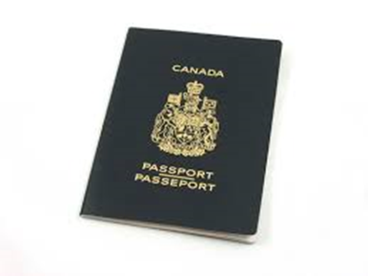
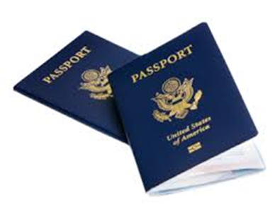
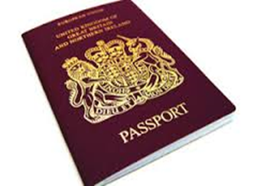
United Kingdom
Canada
United States of America

Slide 3
Positive Obligations
Diplomatic Protection
Consular Assistance

Slide 4
Positive Obligations
United Kingdom
No legal right to consular assistance or diplomatic protection.
Assistance is provided at the discretion of the State.
Enforceable only through principles of judicial review.
Canada
Also no legal right to consular assistance or diplomatic protection.
Assistance is provided at the discretion of the State.
Enforceable only through principles of judicial review.
USA
A legal right extended to the bearer of a US passport.
A codified legal obligation.
Very rarely litigated.

Slide 5
Negative Obligations
Here we consider the extent to which a state is prohibited from harming citizens.

Slide 6
Negative Obligations
United Kingdom
Guided by European Convention on Human Rights 1950 implemented into UK law by Human Rights Act 1998.
Human rights owed to anyone within a state’s ‘jurisdiction’.
Neither regional nor domestic judges award added protection to citizens.
Canada
Guided by Canadian Charter of Rights and Freedoms.
Citizenship also not a relevant factor.
Interpretation instead concerned with principles of public international law and international human rights law.
USA
Guided by Constitutional Protection.
Citizenship as a shield, a ‘high privilege and ‘priceless treasure’.
Legal protection for the citizen ‘against the arbitrary action of their own government’.
DoJ White Paper – Lawfulness of Lethal Operation Directed Against US citizens

Slide 7
Potential Explanations for Differing Approaches
Financial explanations
Historical distinctions in approach to citizenship
Synergy with international law

