Slide 1
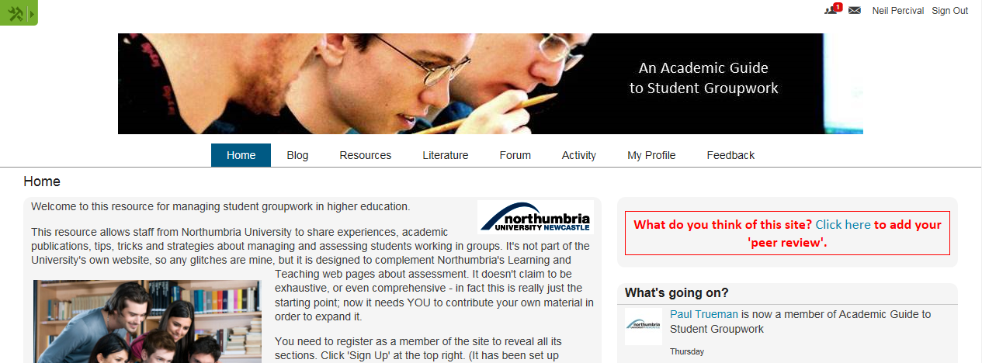
Scholarship, or just social media?
Creating an online community to support academics in the use of student group work
Neil Percival - neil.percival@northumbria.ac.uk
Group work – a tool for student engagement
The pros: great benefit for student engagement, in terms of the valuable interpersonal and organisational skills it develops, and the quality of collaborative work which it enables them to produce (Boud, Cohen, & Sampson, 1999)
The cons: can be a cause of dissatisfaction for students (Davies, 2009), especially if skills required for successful group work are not taught, enabled and supported within the module or programme (McAllister, 1995; Vik, 2001).
Does this website contribute to a ‘scholarship of teaching and learning’? These suggest ‘yes’…
Boyer, in coining the term ‘scholarship of teaching’, looked towards a ‘community of scholars’ and “a campus-wide, collaborative effort around teaching” (1990).
Trigwell et al commented that the aim of scholarly teaching was “to make transparent how we have made learning possible…university teachers must… be able to collect and present rigorous evidence of their effectiveness… as teachers.” (Trigwell, Martin, Benjamin, & Prosser, 2000).
Shulman saw teachers as “members of active communities: communities of conversation, communities of evaluation, communities in which we gather with others… to exchange our findings, our methods, and our excuses” (1993)
Weston & McAlpine saw the scholarship of teaching as “characterized by an intention to share expertise and develop scholarly knowledge about teaching that has a significant impact on the institution and the field” (2001)
Huber & Hutchings proposed “the teaching commons, an emergent conceptual space for exchange and community among faculty, students, administrators, and all others committed to learning” (2005)
While these suggest ‘maybe not’…
Witman & Richlin (2007) remind us that ‘teaching tips’ are not the same as the scholarship of teaching (2007).
For Weston & McAlpine – it has to have impact outside the institution (2001)
Shulman reminds of the need for peer review: “We develop a scholarship of teaching when our work as teachers becomes public, peer-reviewed and critiqued”. (2001)
Healey is also explicit on the subject: “…if the scholarship of teaching is to match that of research there needs to be a comparability of rigour, standards and esteem” (2000)
Kanuka comments that publication must “make a significant contribution to knowledge... as theory allows you to make public the intellectual basis of findings” (Kanuka, 2011)
Discussion
Online moderation and discussion are genuine and potentially rigorous forms of peer review
If scholarship requires ‘making public’- a website could be more genuinely public than a conference paper or journal
As Kreber comments: “…the scholarship of teaching… is represented not just in formal studies informed by the empirical analytical, interpretive or critical sciences, but also in the public dialogue that ensues from posing these questions in the first place… We might do better to think of research findings as the start of our conversations into teaching and learning rather than as the conclusion.” (2013)
An online community by this definition makes a valid contribution to the scholarship of teaching and learning
An online community to support academics using group work
I created an online community offering colleagues:
academic literature resource on student group work
a means of sharing experiences/case studies
guidelines and advice resources for good practice
space for discussion through a forum
blog for reflective thoughts from participants
groupwork.ning.com
Boyer, E. L. (1990). Scholarship reconsidered: priorities of the professoriate. Princeton, NJ: The Carnegie Foundation for the Advancement of Teaching.
Healey, M. (2000). Developing the Scholarship of Teaching in Higher Education: A discipline-based approach. Higher Education Research & Development, 19(2), 169-189. doi: 10.1080/072943600445637
Huber, M. T., & Hutchings, P. (2005). The Advancement of Learning. Building the Teaching Commons. A Carnegie Foundation Report on the Scholarship of Teaching and Learning in Higher Education. The Carnegie Foundation For The Advancement Of Teaching. San Francisco: Jossey-Bass.
Kanuka, H. (2011). Keeping the scholarship in the scholarship of teaching and learning. International Journal for the Scholarship of Teaching and Learning, 5(1), 3.
Shulman, L. (1993). Teaching as community property (Vol. 25, pp. 6). Philadelphia: Taylor & Francis Inc.
Shulman, L. (2001). From Minsk to Pinsk: Why a scholarship of teaching and learning? Journal of the Scholarship of Teaching and Learning, 1(1), 48-53.
Trigwell, K., Martin, E., Benjamin, J., & Prosser, M. (2000). Scholarship of Teaching: A model. Higher Education Research & Development, 19(2), 155-168. doi: 10.1080/072943600445628
Weston, C. B., & McAlpine, L. (2001). Making Explicit the Development Toward the Scholarship of Teaching. New Directions for Teaching and Learning, 2001(86), 89-97. doi: 10.1002/tl.19
Witman, P. D., & Richlin, L. (2007). The Status of the Scholarship of Teaching and Learning in the Discipline. International Journal for the Scholarship of Teaching and Learning, 1(1), 14.

