Slide 1

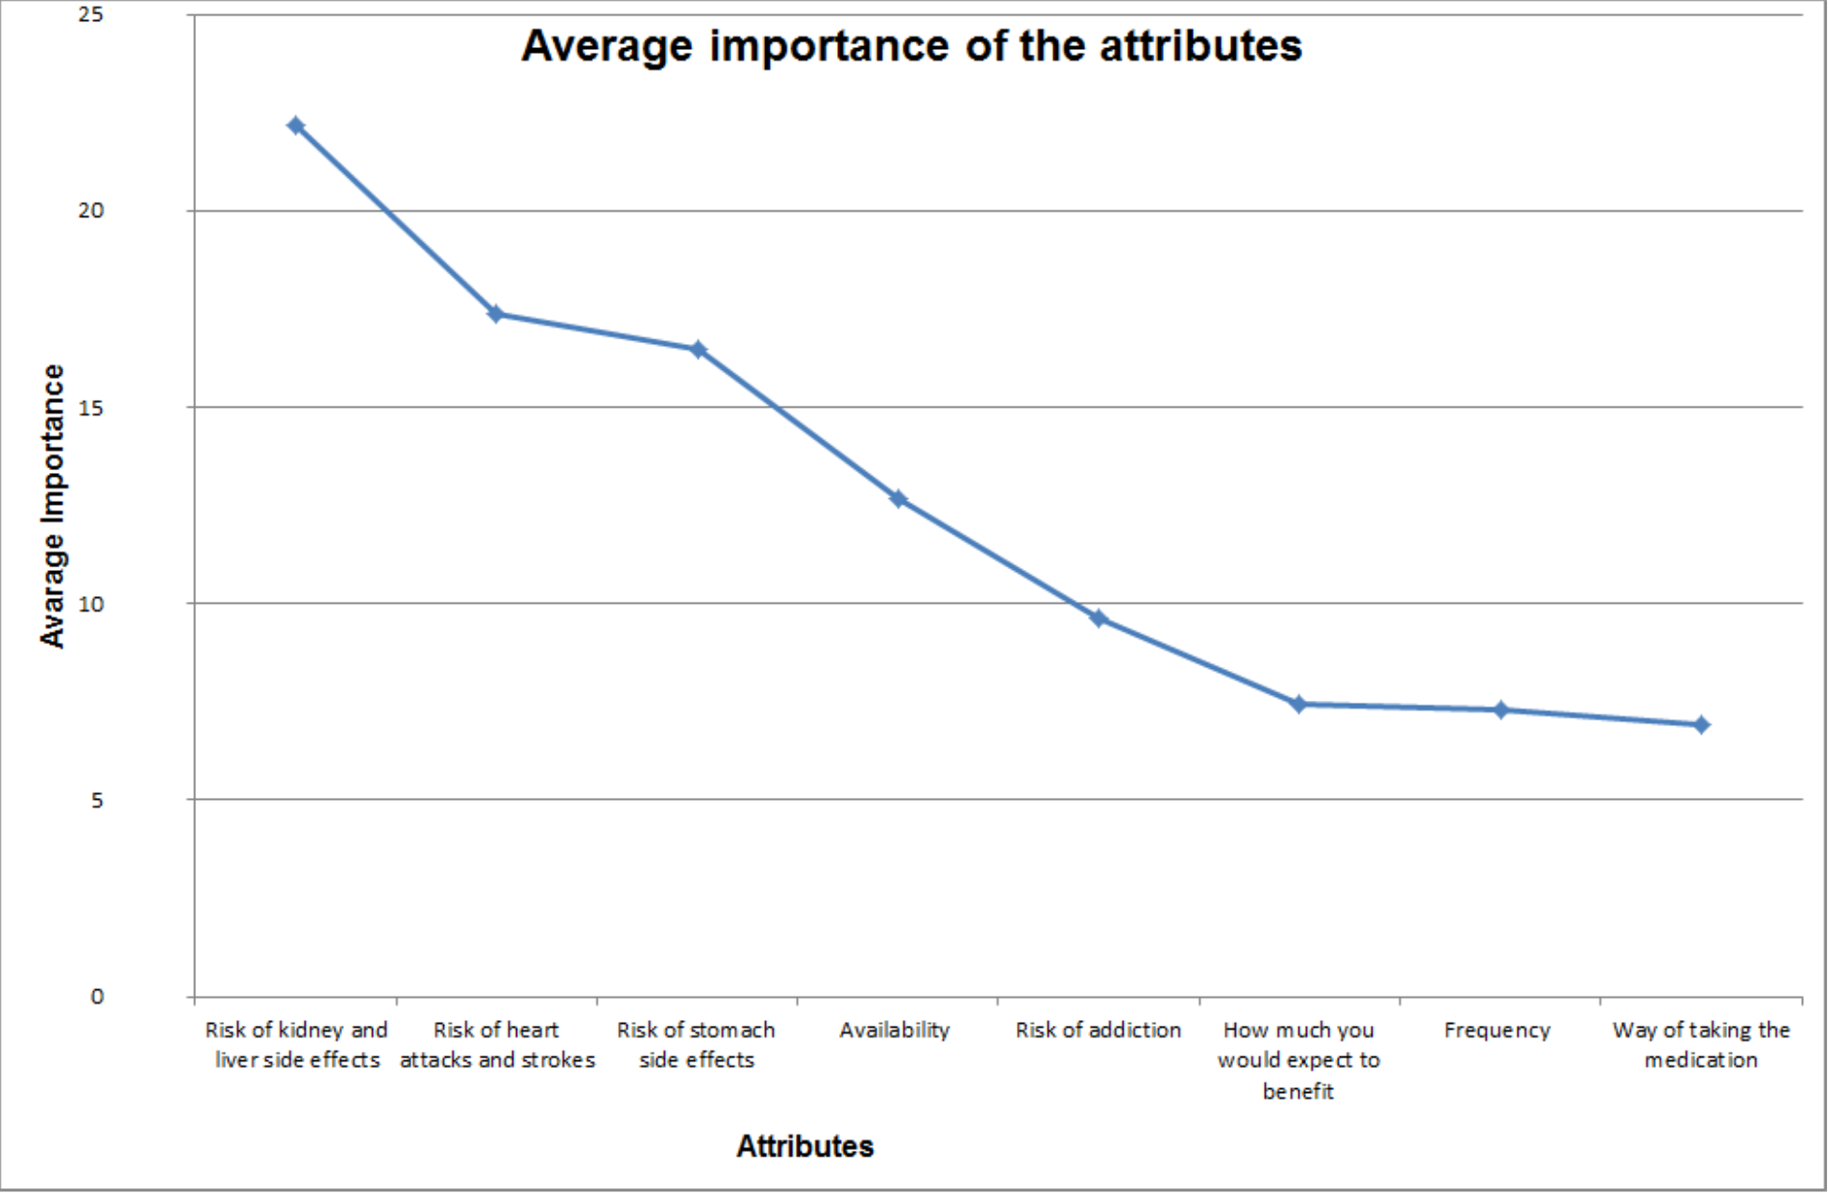
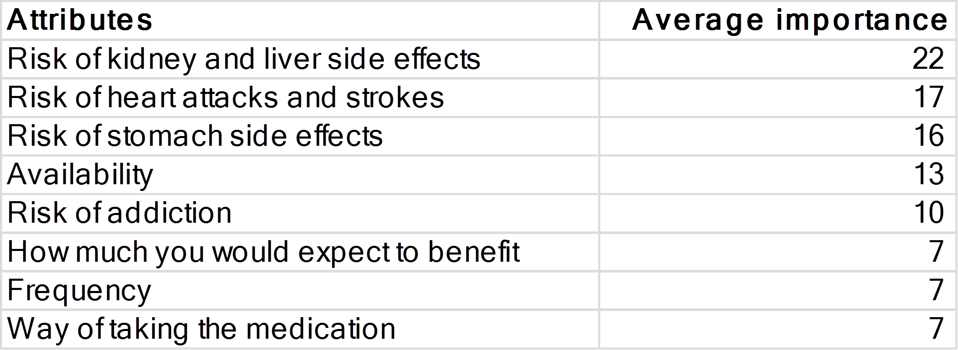


Using adaptive choice-based conjoint analysis (ACBC) to study patients’ preferences regarding pharmaceutical treatment for osteoarthritis (OA)
Revealing hidden preferences?
Basem Al-Omari, Martin Frisher, Peter Croft, Julius Sim
Arthritis Research UK Primary Care & Health Sciences, Keele University, Keele, Staffordshire, ST5 5BG, UK
School of Pharmacy and Medicines Management, Keele University, Keele, Staffordshire, ST5 5BG, UK
Background
Adaptive choice-based conjoint analysis (ACBC) is a technique for eliciting and quantifying people’s preferences. This is the first application of ACBC in rheumatology research. The advantage of this method is that it adapts to patients’ responses to different scenarios characterised by a range of medication attributes.
Results
Rather than medication benefits being the top priority, the greatest impact on patients’ preference regarding medication was the risk of kidney and liver side effects.
Conclusion
ACBC reveals patients’ preferences and the precise trade-offs that patients are willing to make.
Patients with OA are willing to trade off the benefits of medication for low risks of adverse effects.
In trade-off against kidney and liver side effects, the benefits that patients expect from the medication are less important.
This raises questions about identifying and discussing patients priorities regarding the risks and benefits of OA medications.
Aim
This research is concerned with the extent to which the benefits of medication are traded off against serious adverse effects such as kidney impairment and stroke.
Acknowledgements
We are extremely grateful to Carol Rhodes and Adele Higginbottom at the Arthritis Research UK Primary Care Centre for their efforts in facilitating the involvement of the Research User Group.
Special thanks to the Research User Group at the Arthritis Research UK Primary Care Centre, Keele University, UK, as this research work would not have been possible without their participation.
Methods
Eleven participants were recruited from the Research User Group at the Arthritis Research UK Primary Care Centre, to evaluate a newly developed ACBC questionnaire involving 8 attributes.
Participants were over 50 years of age, with OA in at least one joint.
The relative importance of the 8 attributes, which sum to 100%, was calculated using hierarchical Bayes estimation.
1
2
3
4
Contact: b.al-omari@keele.ac.uk

