Slide 1
Key note presentation to International Urban Regeneration Symposium, Suwon City,
6-7 December 2017
U.K. Urban Regeneration: sharing 50 years of experience & lessons learned
Dr Paul Greenhalgh MRICS
Professor (Associate) of Real Estate & Regeneration
Head of Built Environment
Department of Architecture and Built Environment
Northumbria University
Notes:
Firstly, thank you for inviting me to visit the beautiful City of Suwon to talk with you. It is both a pleasure and a privilege to be here.
I am a Surveyor (Member of the Royal Institution of Chartered Surveyors) and Associate Professor of Real Estate and Regeneration.
I am head of the Built Environment in the Department of Architecture and Built Environment, in the Faculty of Engineering and Environment at University of Northumbria
I co-founded the URBaNE Research Group and R3intelligence (real estate analysis) consultancy service

Slide 2
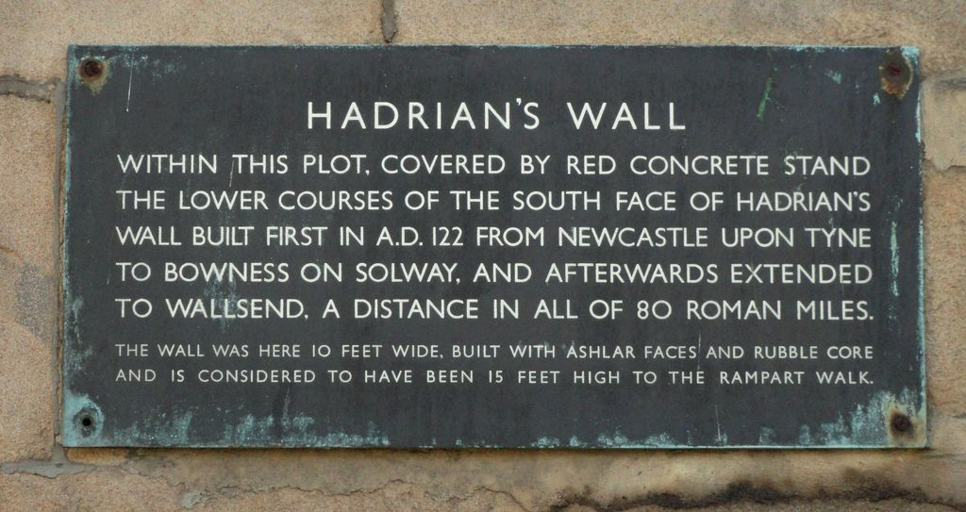
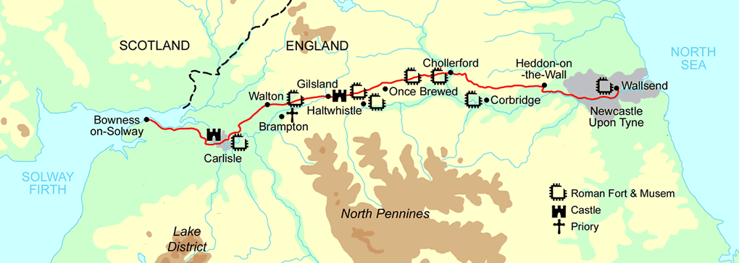
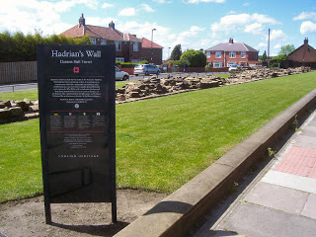
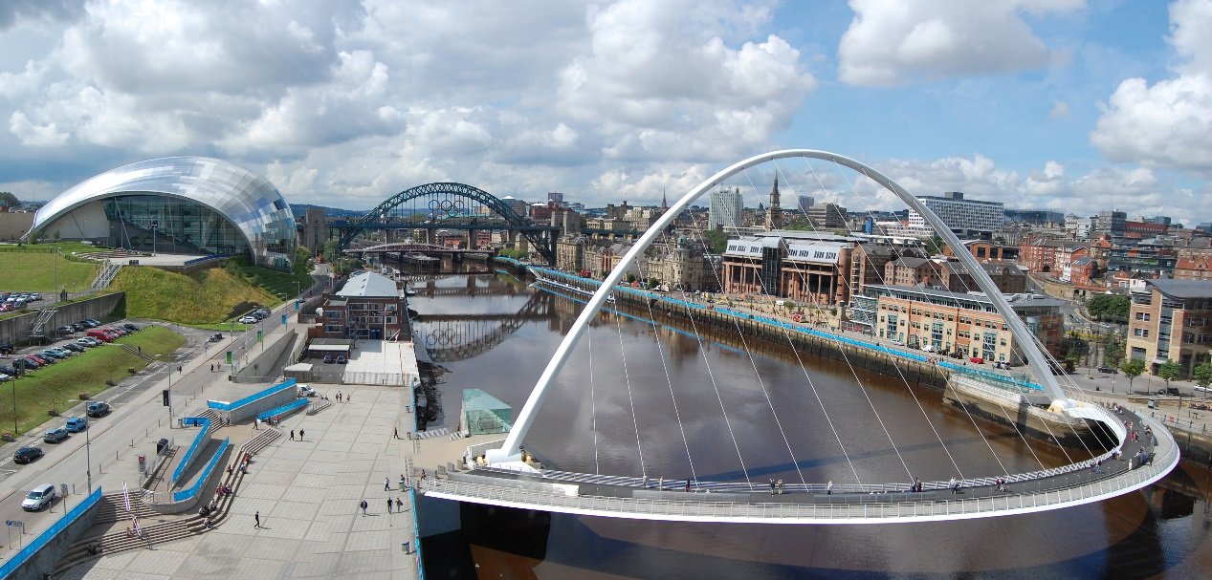
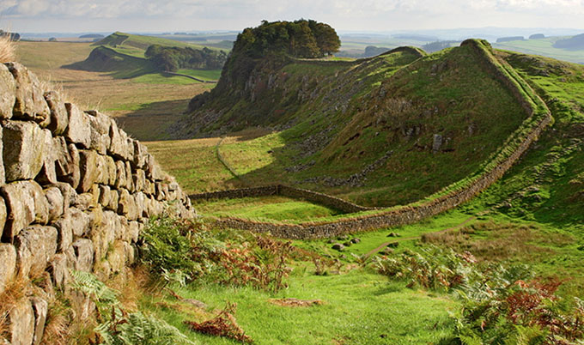
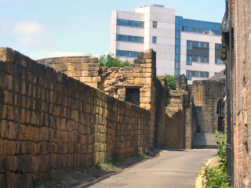
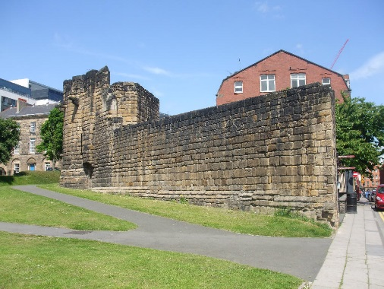
Walls and Bridges: Newcastle & Northumberland
Notes:
In the spirit of building bridges between Newcastle upon Tyne and Suwon, I would like to share some of our walls with you:
Hadrian’s wall from the East coast of Northumbria to the West coast of Cumbria in the North of England
For further information see:
Hadrian’s Wall official visitor: http://hadrianswallcountry.co.uk/
English Heritage: http://www.english-heritage.org.uk/visit/places/hadrians-wall/
Visit Northumberland: http://www.visitnorthumberland.com/hadrians-wall
National Trust: https://www.nationaltrust.org.uk/hadrians-wall-and-housesteads-fort
Hadrian’s wall in Newcastle: http://newcastlephotos.blogspot.co.uk/2008/12/hadrians-wall-in-newcastle.html
Town walls: http://newcastlephotos.blogspot.co.uk/2008/06/town-walls.html
http://newcastlewalks.co.uk/walkwalls.html

Slide 3
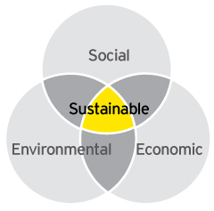
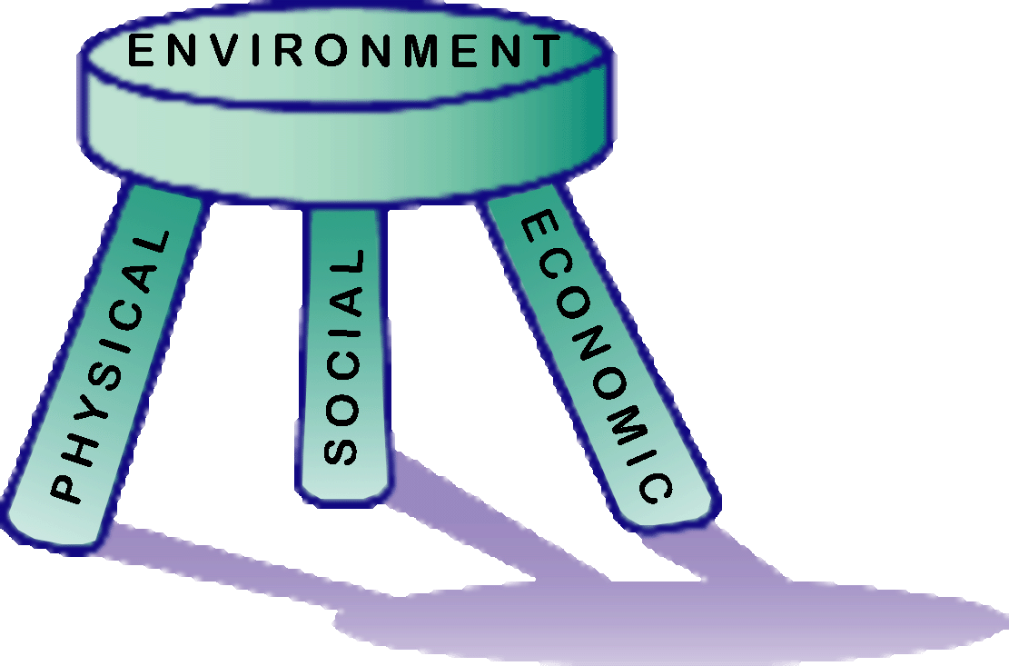
Triple bottom line of sustainable development and regeneration
Sustainability Sweet spot
If one of the legs on the stool is missing it will fall over
Notes:
The model on the left should be familiar and represents the triple bottom line of sustainability/sustainable development
The model on the right is one that I conceived and represents the three pillars or legs or holistic urban regeneration (environment sits across all three); all 4 terms (physical; social; economic; environment) are contained in authoritative definitions of urban regeneration.
Holistic regeneration projects and programmes should seek to balance all three otherwise the stool will fall over

Slide 4
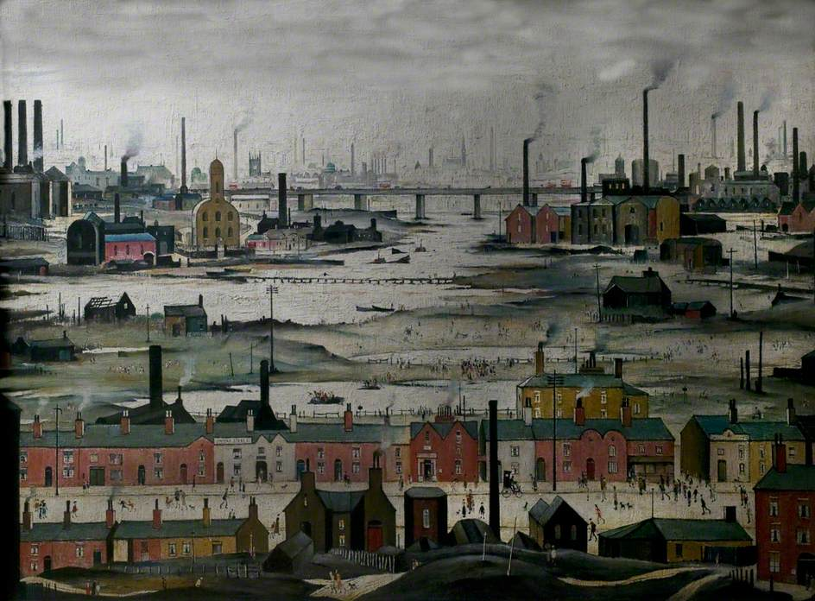
Notes:
LS Lowry (1887-1976)
Industrial Landscape, River Scene (1950) oil on canvas
New Walk Museum & Art Gallery, Leicester

Slide 5
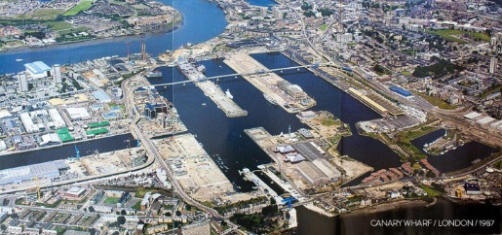
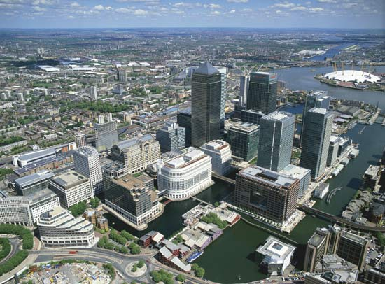
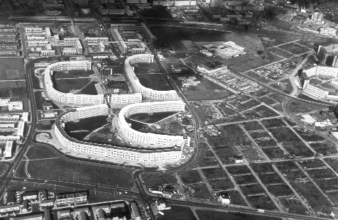
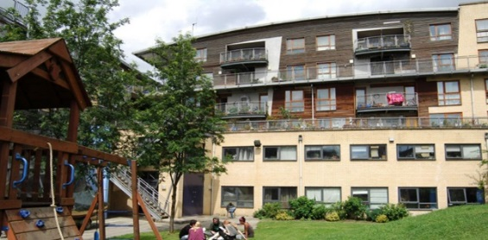

5 Decades of UK urban policy
1960s: Revitalisation - Urban Programme
1970s: Renewal – Inner Cities Programme
1980s: Redevelopment - Property-led regeneration
Enterprise Zones
Urban Development Corporations: pump priming
Grant based regimes: market led gap funding
Reclamation of derelict land
1990s: Regeneration - Partnership Based Approach
Holistic area based regeneration
City Challenge & Single Regeneration Budget
English Partnerships
2000s: Renaissance - Neighbourhood & Community
New Deal for Communities & Neighbourhood Renewal
Housing Market Renewal (North & Midlands)
Sustainable Communities (South East)
Compact city & mixed use development
Notes:
With acknowledgement to Roberts, P. (2017) The Evolution of Urban Regeneration. Chapter 2, Table 2.1 p19 of Roberts, P., Sykes, H. & Granger, R. (eds) (2017) Urban Regeneration 2nd ed. Sage. London
See also Brown, C. (2006) Urban Regeneration Toolbox, Chronology of U.K. Regeneration Funding,
1970s 100% public funding via Urban Programme
Early 1980’s EZ tax allowances; UDC pump priming
Mid 1980’s market-led gap funding; gearing target 1:4
Early 1990’s holistic area based partnership model; City Challenge/SRB/grants via EP
Mid 1990’s increasing focus on brownfield land; emerging housing driven funding model
Late 1990’s greater focus on economic development via RDAs & social focus via NRU
Early 2000’s polarisation between housing growth in SE and housing market failure in North
Further reading see:
Jones, P. & Evans J. (2013) Urban Regeneration in the U.K. London. 2nd edition. Sage. London Chapter 2
Tallon, A. (2013) Urban Regeneration in the UK. 2nd edition. London. Routledge, Chapters 2-5
Images:
Canary Wharf (London Docklands) aerial images before (1987) and after (2017)
Hulme (Manchester) before demolition; Homes for Change (1996) cooperative; 18 hours a day building see: http://mbla.net/projects/homes-for-change/
Batty et al (2010) New Deal for Communities Experience: a final assessment. The New Deal for Communities Evaulation Final Report Volume 7. DCLG. London. available at: http://extra.shu.ac.uk/ndc/downloads/general/A%20final%20assessment.pdf

Slide 6
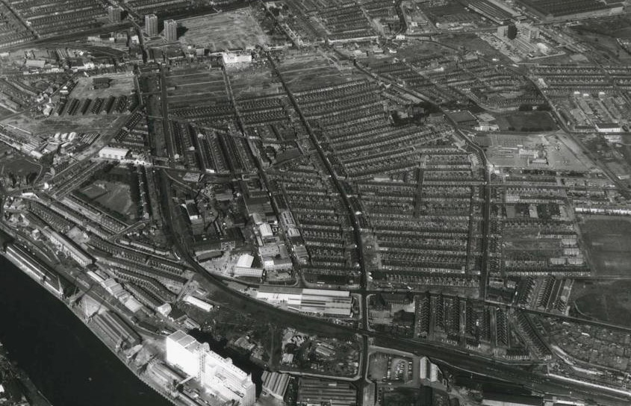
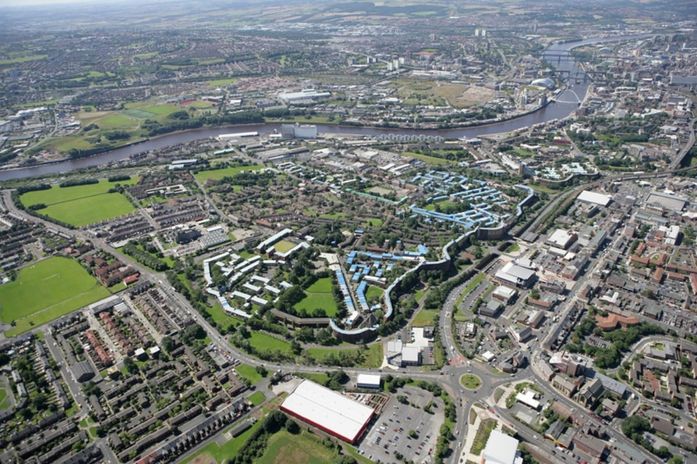
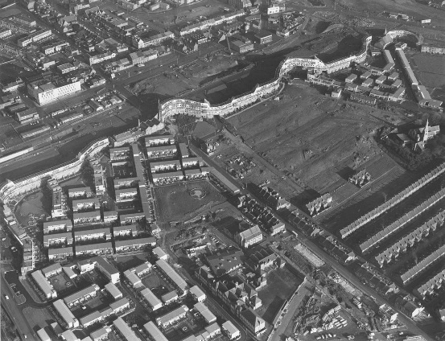
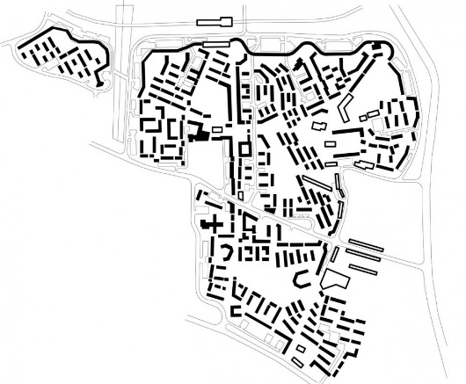
Byker Estate, Newcastle East End (1960-70s)
Demolition of terraces housing 12000 people
Comprehensive redevelopment for 9000
Architect Ralph Erskine appointed (also did Greenwich Millennium Village)
Traffic free enclaves created
Community retention strategy deemed to have failed (see Peter Malpass’ study)
Decline; protection; renaissance
Notes:
See literature available on the Byker Estate and Byker Wall:
Minton, A. (2015) Byker Wall: Newcastle’s noble failure of an estate. The Guardian: Cities. Available online at: https://www.theguardian.com/cities/2015/may/21/byker-wall-newcastles-noble-failure-of-an-estate-a-history-of-cities-in-50-buildings-day-41
Pendlebury et al (2009) Social Housing as Heritage: the case of Byker, Newcastle upon Tyne in Valuing Historic Environments eds Gibson, L. & Pendlebury, J. . Ashgate. Farnham
Malpass, P. (1990) The architect and the community. Housing. January. P1-5
Glyn, S. (2011) Good Homes: lessons in successful public housing from Newcastle’s Byker Estate. Paper presented to colloquium on the Housing Crisis: experience, analysis and response, Birkbeck Institute, London 18 November 2011, available at: https://www.theguardian.com/cities/2015/may/21/byker-wall-newcastles-noble-failure-of-an-estate-a-history-of-cities-in-50-buildings-day-41
Abrams, R (2003) Byker Revisited. Built Enviroronment 29(1) 117-131
Mann, W. (2016). Newcastle in the sky. Modus. London, RICS: 32-33.

Slide 7
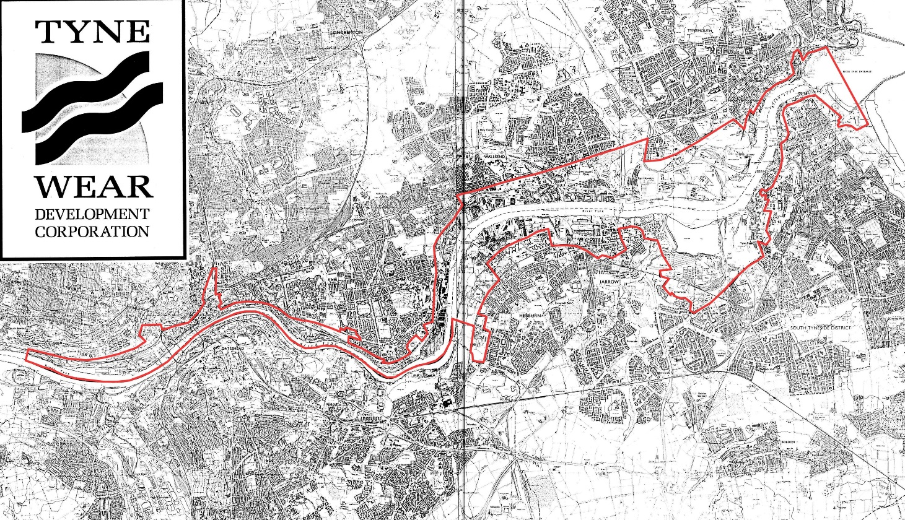
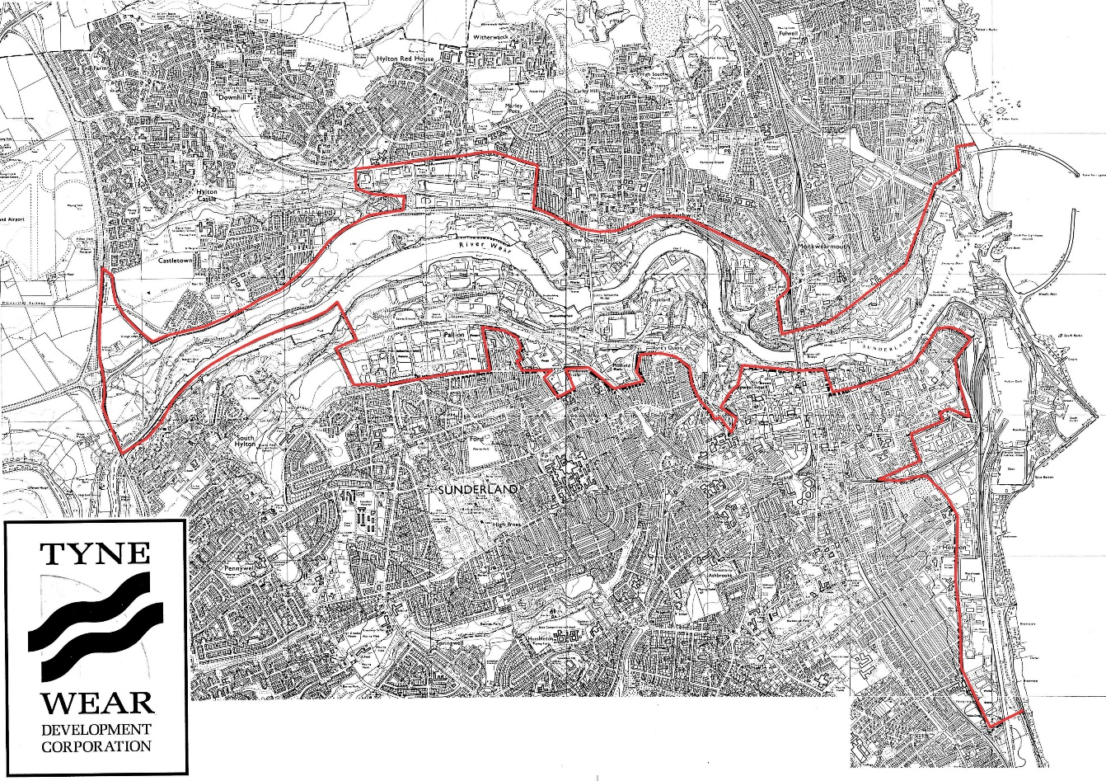
1980-90s
TWDC 1987-1998
Urban Development Area (UDA) delineated by red line
Community Liaison Panels for all flagship development projects
Industrial legacy of Rivers Tyne & Wear
Transition to post industrial economy
Economic restructuring; flagship projects
physical redevelopment & regeneration
Notes:
Tyne and Wear conurbation; population ~1 million people built around the 2 of the 3 great industrial rivers of the North East of England, the Rivers Tyne & Wear (the other is the River Tees in Tees Valley)
First comprehensive attempt to address industrial legacy was by Tyne & Wear Development Corporation (TWDC) established in 1987 which operated for just over 10 years.
TWDC pioneered the use of community liaison panels associated with its major ‘flagship’ regeneration project. The panels were made up of local stakeholders from the business community as well as community representatives.
For more information see North East Regeneration Archive (NERA) currently hosted on URBaNE web site: www.urbaneweb.org.uk sign up for free
New domain being created for NERA at www.neregenarchive.online

Slide 8
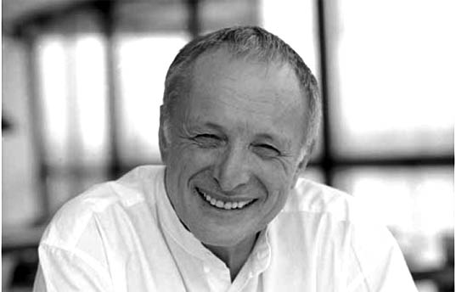
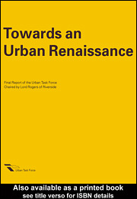
Towards an Urban Renaissance
‘England’s urban legacy as one of the most urbanised countries in Europe and one of the highest population densities in the world but declining populations in the big cities, environmental degradation & lack of housing.’
Urban Task Force chaired by Richard Rogers
Report published 1999 (Spon)
Key principles:
  Compact city
  Urban densification
  Mixed use
  Sustainability
Notes:
In 1998 the then Deputy Prime Minister, John Prescott, appointed Sir Richard Rogers (architect; now Lord Rogers of Riverside) to head an Urban Task Force to look at the reasons why many urban areas in the U.K. were in decline, particularly population, and make recommendations as to how to reverse the trend and achieve an urban renaissance.
‘Towards an Urban Renaissance’ published by Department of the Environment Transport & the Regions in 1999 (publisher: Spon)
See extensive literature on this topic
Executive Summary available at: http://dclg.ptfs-europe.com/AWData/Library1/Departmental%20Publications/Department%20of%20the%20Environment,%20Transport%20and%20the%20Regions/1999/Towards%20an%20Urban%20Renaissance.pdf
Electronic copy of Urban Task Force Report (1999) available at: http://lib.myilibrary.com/Open.aspx?id=2367&loc=&srch=undefined&src=0
Abbott, C., et al. (2000). "Towards and Urban Renaissance." American Planning Association 66(4): 357-358.
Lees, L. (2003). Visions of 'urban renaissance': the Urban Task Force Report and the Urban White Paper. Urban Renaissance? New Labour, community and urban policy. R. Imrie and M. Raco. Bristol, Policy Press.
TCPA (2003). Urban Renaissance in England. London, TCPA.

Slide 9
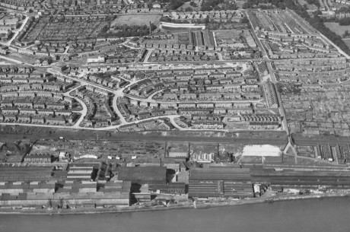
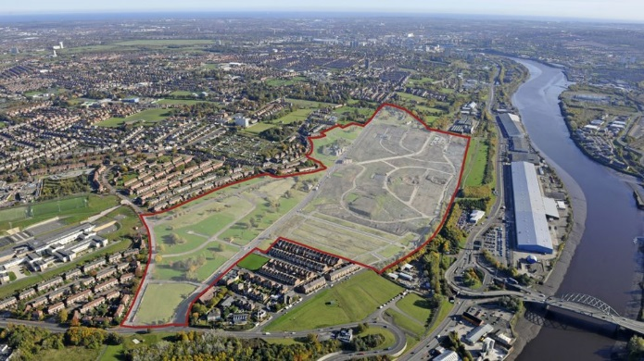
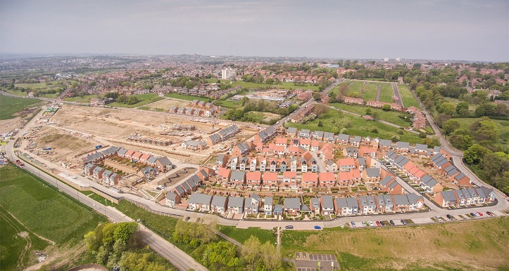
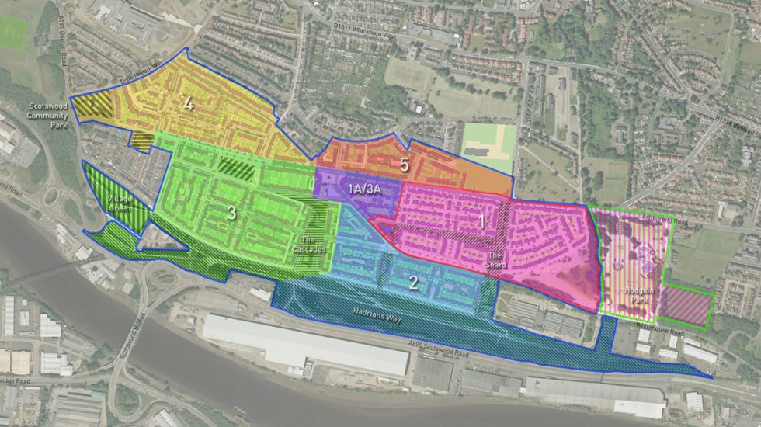
The Rise, Scotswood, Newcastle West End
Joint Venture Public Private Partnership between Barrett Keepmoat Homes & Newcastle City Council
Site assembly and preparation
Multi-phase
Long term
Mixed tenure
Place making
Notes:
The west end of Newcastle comprises the 3 areas of Elswick (in the east), Benwell and Scotswood (in the west). Following closure of factories and shipyards the economic underpinning of the west end collapsed and the population declined and the area suffered from blight and stigma. A series of urban regeneration initiatives were pursued including Newcastle West End City Challenge in early nineties which was a comprehensive 5 year programme to reverse the decline – it had modest success in slowing the rate of decline but was too short term and lacked resources (comprehensive holistic regeneration can’t be done in 5 years; it usually takes 15-20 years to deliver sustainable regeneration). This was followed by Reviving the Heart of the West End which was a Single Regeneration Budget funded initiative focussed on Benwell which lasted 6 years and again was just ‘sticking plaster’ to a wound. The latest endeavour is a Joint Venture Public Private Partnership between Barrett & Keepmoat Homes (volume house builders based in the North East) and Newcastle City Council. The City council owned much of the land and compulsorily purchased what it did not; the private sector partners have invested finance and their house building and place making expertise.
See:
Films & archive for West End of Newcastle: http://archiveforchange.org/
Insert additional information on project.

Slide 10
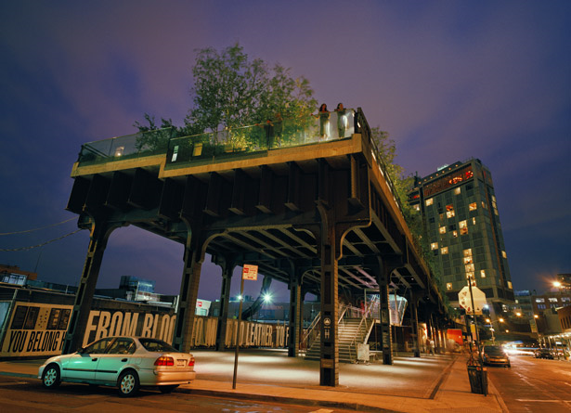
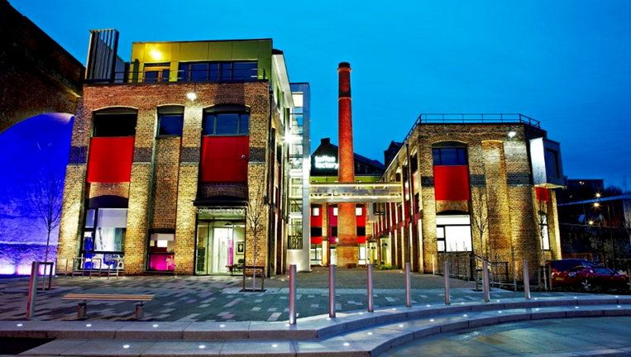
Back to the future
~2% real estate stock replaced per annum; even less for infrastructure.
In much of the ‘West’ the future city has already been built
High Line, New York USA
How we retrofit and adapt the present, will define the evolution of the future city
Toffee Factory, Ouseburn, Newcastle UK
Notes:
Opportunities for adaptive re-use and re-purposing of buildings and infrastructure to celebrate the past (industrial heritage) whilst looking to the future.
Potentially more sustainable when take account of embedded carbon in all the materials used in original construction.
R3intelligence has done research around obsolescence and potential adaptive re-use of commercial buildings.
NYC - The Low Line, Lower East Side, NYC
After the High Line, here is the next up-and-coming green space regeneration in former industrial underground space. Substantive public engagement efforts, including this online portal
https://courbanize.com/projects/lowline/information
More info about the Low Line project itself:
http://thelowline.org/about/project/
NYC - 247 Cherry Street, NYC - controversial real estate development, apparently less successful community participation because of nature of the project
https://courbanize.com/projects/247cherry/information

Slide 11
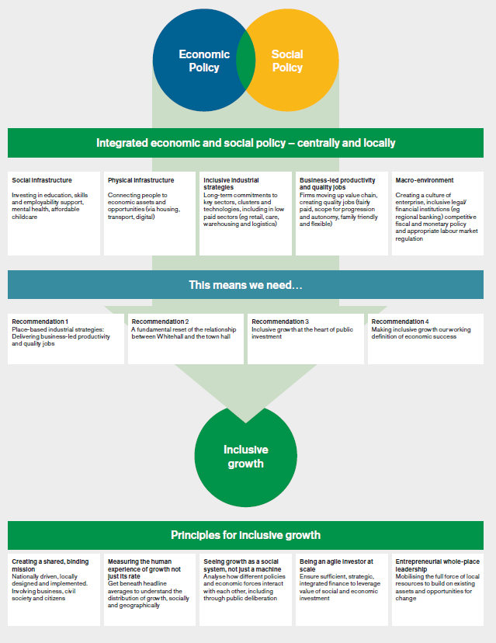
Contemporary
Challenges
Rapid urbanisation v shrinking cities
Increasing inequality of wealth & income
Social exclusion & social injustice
Access to affordable housing & services
How to achieve inclusive growth for people & places?
  Promote economic inclusion across wider geography
  Public service reform to overcome barriers to inclusive growth
  Role of communities
See report of Inclusive Growth Commission (2017)
Notes:
Challenges facing cities around the world are not uniform
Developing countries facing rapid urbanisation similar to that which ‘western’ countries experienced in 19th and 20th centuries
Some towns and cities in developed countries experiencing population loss – ‘Shrinking cities’
Increasing inequality on global economies leading to social exclusion an injustice
In the UK the challenge to this has been framed around ‘Inclusive Growth’ including setting up of ‘Inclusive Growth Commission’ by RSA, see: https://www.thersa.org/action-and-research/rsa-projects/public-services-and-communities-folder/inclusive-growth-commission
Final report of Inclusive Growth Commission available at: https://www.thersa.org/globalassets/pdfs/reports/rsa_inclusive-growth-commission-final-report-march-2017.pdf

Slide 12
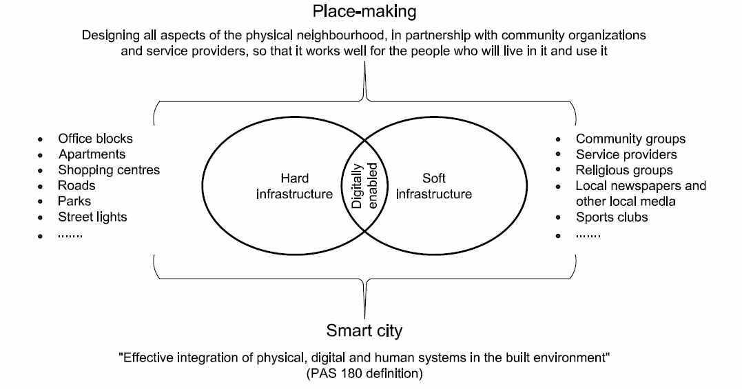
Post Industrial Urban Legacy
Place making in places that already exist
Links: Participation, Smart Cities, Digital Living,
Notes:
Most towns and cities in developed countries may now be described as post-industrial but most were built on manufacturing industry. As their economies have restructured they have been forced to confront their industrial legacy through processes of redevelopment and regeneration. Such processes are often ‘top-down’ and impose plans on local areas with little consultation; more contemporary approaches have pursued ‘bottom-up’ initiatives where local communities and stakeholders participate in the preparation of plans and strategies for their future.. In the UK this is commonly termed ‘place making’. It is most challenging in locations that have resident communities. There is now opportunity to deploy emerging ‘smart’ digitally enabled technology to support participation as neighbourhoods and urban areas transition to smart futures.
Link for Northumbria University Digital Living multi-disciplinary research theme and Newcastle City Futures (see later in presentation)

Slide 13
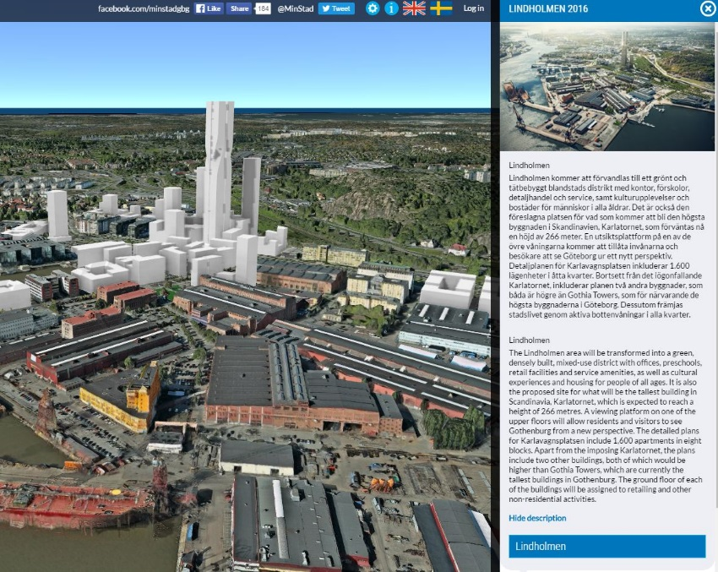
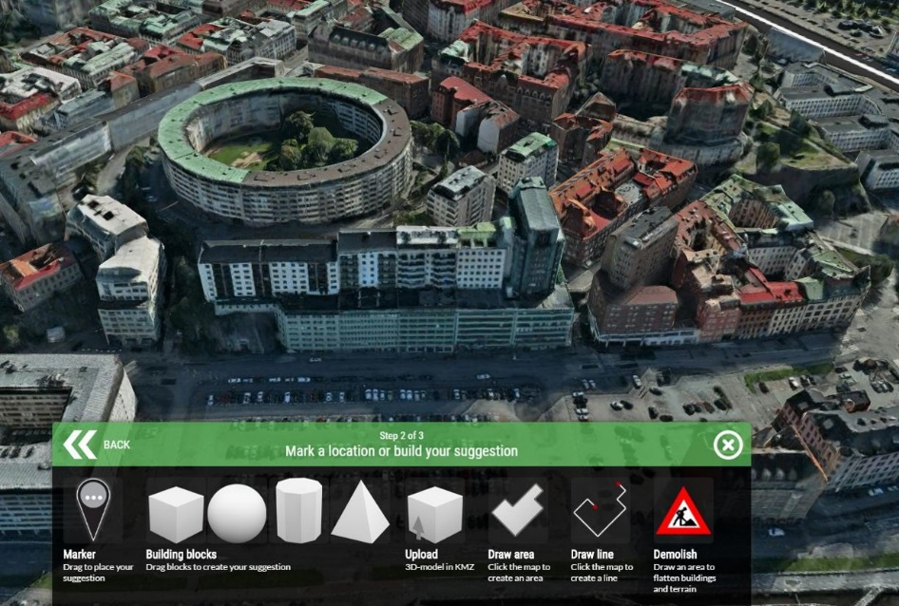
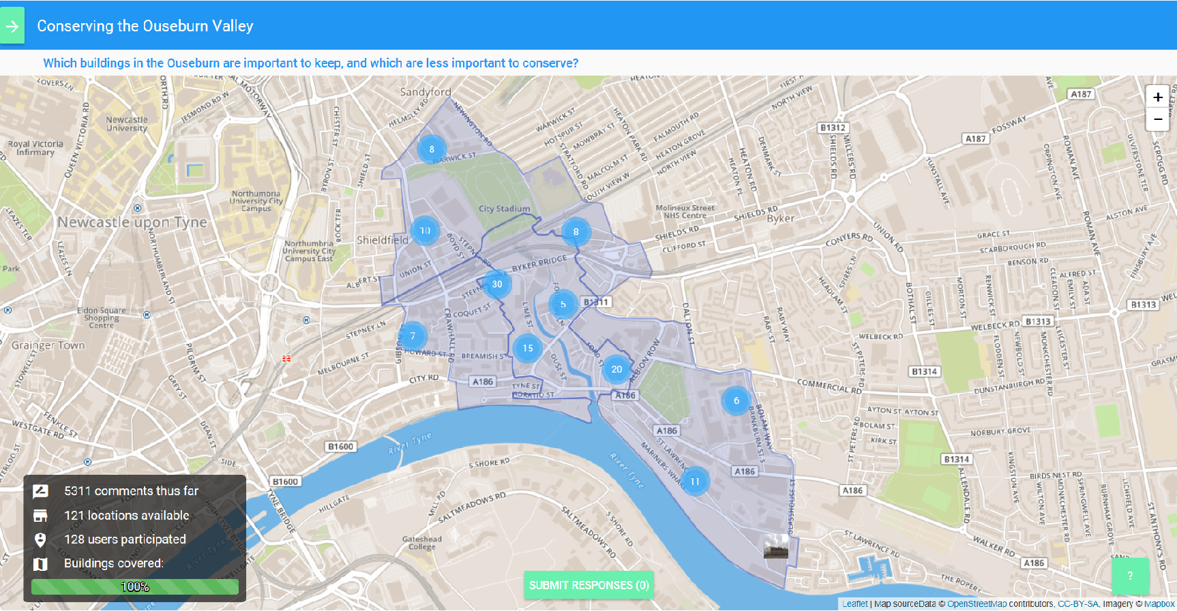
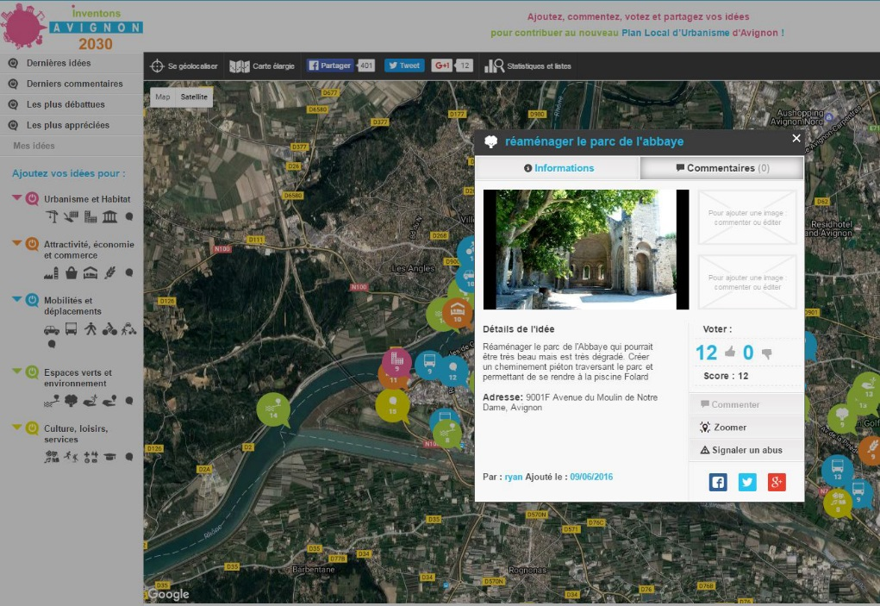
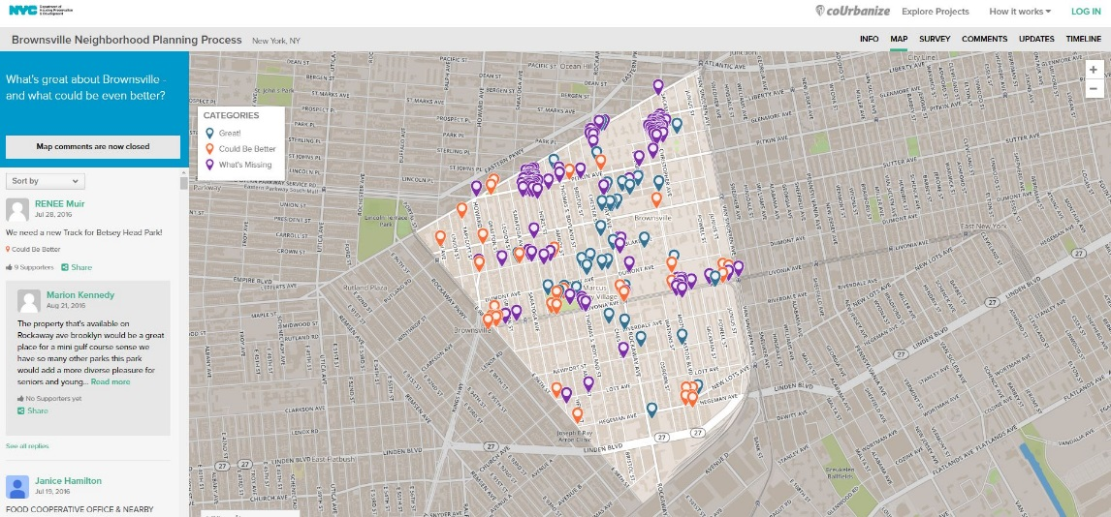
International examples of citizen & community participation using on-line 3D/2D maps & models from Sweden, France, U.S. & U.K.
Notes:
International examples of community participation in regeneration:
Sweden - MinStad, 3D city portal for public engagement in Gothenburg, Sweden. Now available as an app (but maybe just in 2D)
Used largely as geospatial social media, to discuss local heritage as well as planned local developments, such as brownfield development.
http://minstad.goteborg.se/minstad/index.do
Plan London Bridge - CommonPlace, map-based public engagement in 2014 which helped to inform the Plan for London Bridge, led by business consortium Team for London Bridge.
https://londonbridge.commonplace.is/
Info about the Plan for London Bridge: http://www.teamlondonbridge.co.uk/gfx/uploads/pres_11022016120850.pdf
Cambridge, MA. Kendral Square Urban Renewal Plan in Cambridge, Massachusetts.
Regeneration / Revitalisation with lots of offices and significant portion of housing below market value.
https://courbanize.com/projects/kendall-sq-urban-renewal/information
City of Lille, France - public engagement by "Carticipe" for comprehensive planning, including regeneration. 2000+ registered users, and almost 3000 ideas provided on the map.
http://jecarticipe.lillemetropole.fr/#
Ouseburn - PlaceChangers, used by Ouseburn Futures.
A new participatory map used by Ouseburn Futures, to comment on individual buildings, as part of regeneration / neighbourhood planning. The map software was developed very recently at Newcastle Uni (co-initiated by Sebastian Weise)
https://www.app.placechangers.uk/#!/2/map

Slide 14
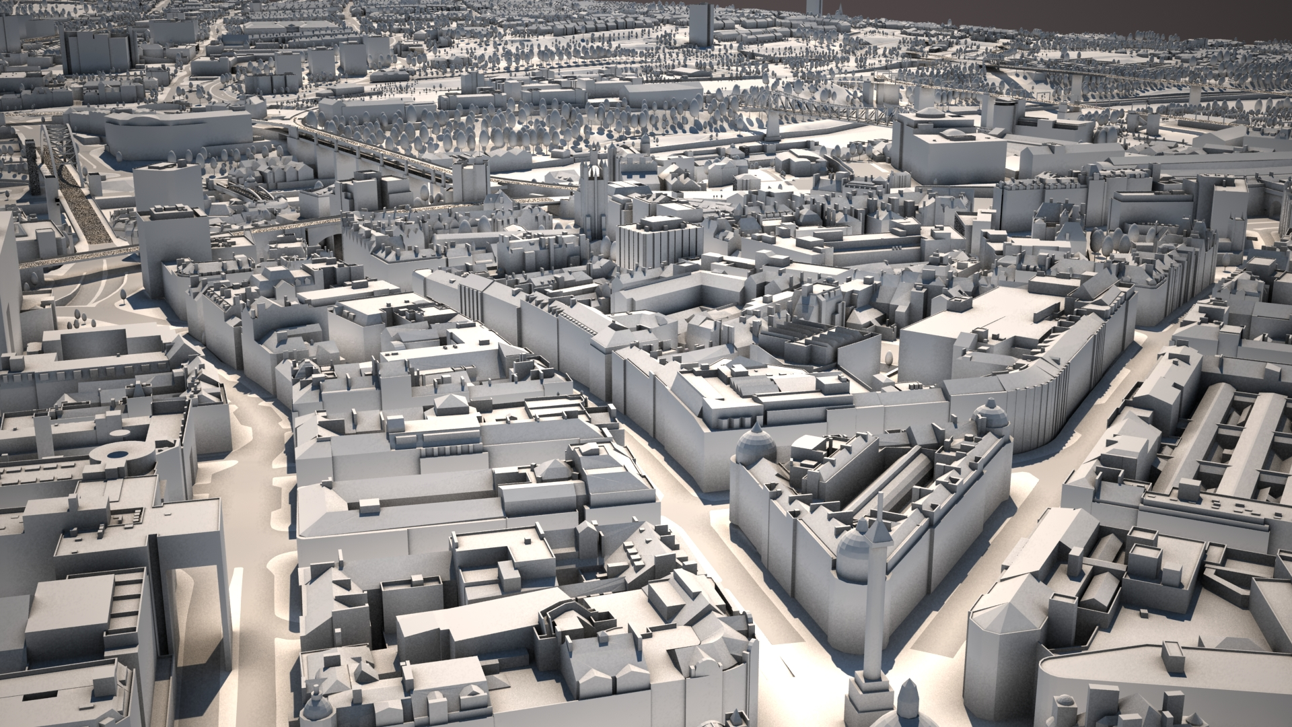
Notes:
Virtual Newcastle Gateshead 3D city model created, developed and operated by Northumbria University in partnership with Newcastle City and Gateshead Councils.
This screen shot is of Newcastle city centre looking south towards the river with Gateshead beyond.

Slide 15
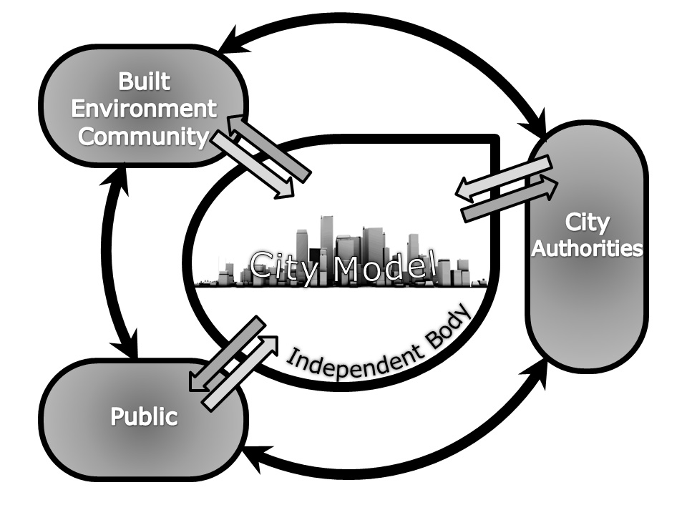
Virtual Newcastle Gateshead (VNG)
Established 2008
Joint venture between:
  Northumbria University
  Newcastle City Council
  Gateshead Council
seeks ways to create one virtual, definitive, accurate, 3D, interactive model with the potential to be sustained and used for a range of applications
https://www.youtube.com/watch?v=nJ7fDjpSYwY (3min 31sec no audio)
Notes:
10 years ago the University entered into a joint venture with City of Newcastle and Metropolitan Borough of Gateshead to create a virtual 3D city model of the city/conurbation
See videos on Youtube https://www.youtube.com/watch?v=nJ7fDjpSYwY (3min 31sec, no audio)
Follow on Twitter @NorthunbriaVRV
Reference: Horne, Margaret, Thompson, Emine Mine and Charlton, James (2014) Towards a Multifunctional Virtual City Model. In: Technologies for Urban and Spatial Planning: Virtual Cities and Territories. Advances in Civil and Industrial Engineering (ACIE) . IGI Global Book, Hershey, PA, pp. 154-142.

Slide 16
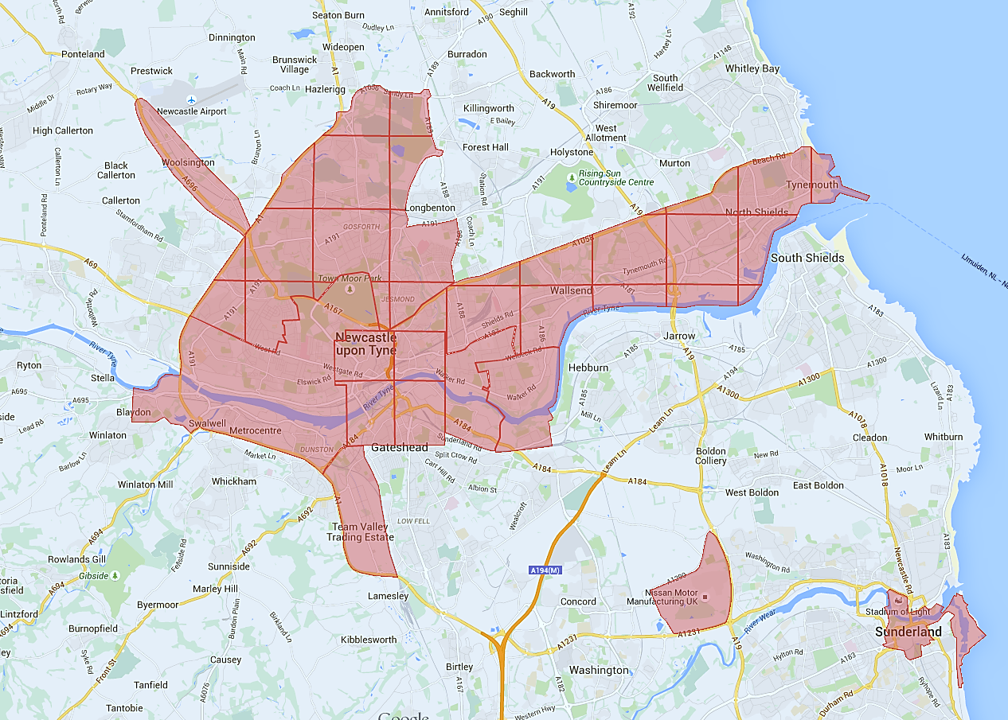
100km²
1
2
Terrain accuracy: 0cm-25cm for 70% of points
Data capture aerial photogrammetry and laser scanning survey techniques
NewcastleGateshead Urban Core Area Action Plan, Sept 2011 acknowledges and encourages the utilization of VNG.
Notes:
Coverage of 3D City model – now includes City of Sunderland and land around Nissan.
1 = Byker Wall
2 = Staiths South Bank
3 = the Rise

Slide 17
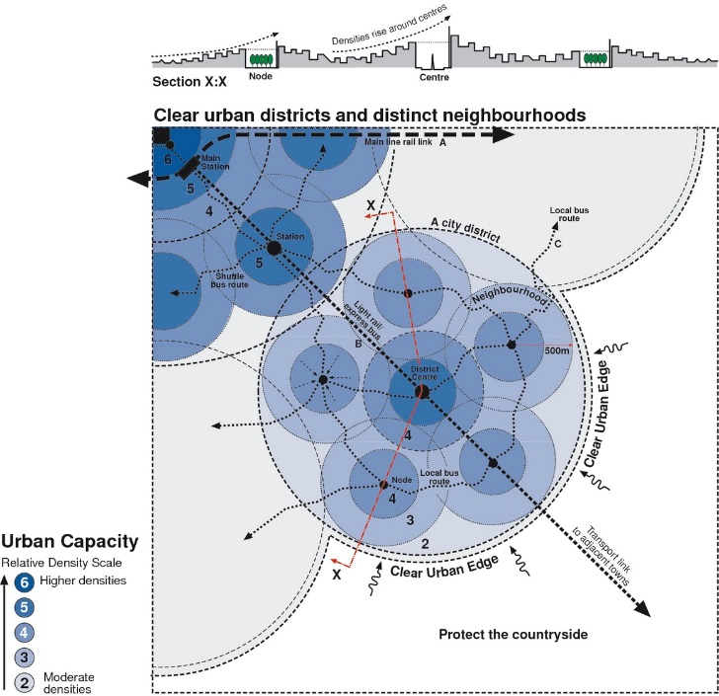
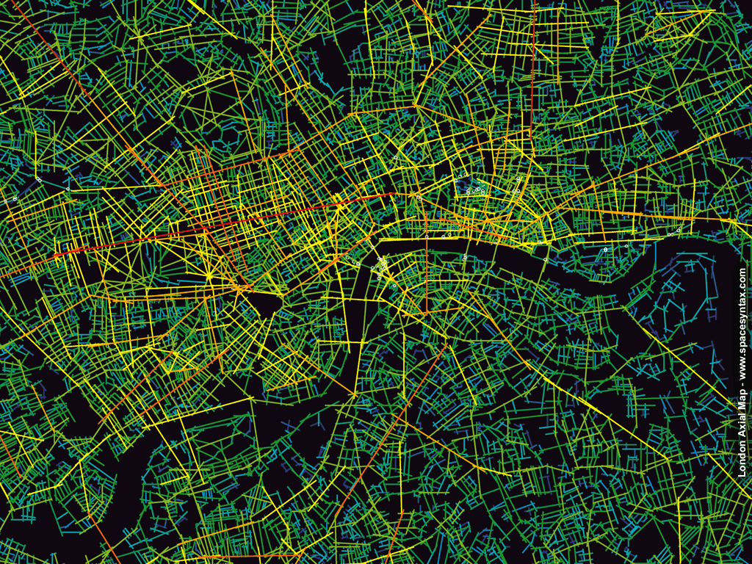
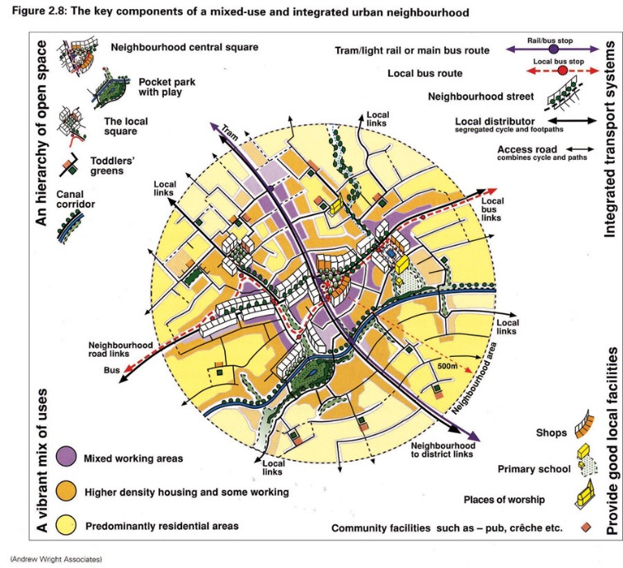
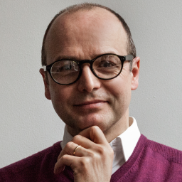
City Networks
Understanding city networks
Syntax/Connectivity/Integration
Notes:
Models from Towards an Urban Renaissance (1999)
Visiting Professor Tim Stonor: http://www.spacesyntax.com/staff/tim-stonor/
Space Syntax at the Bartlett, UCL: http://spacesyntax.org/
Space Syntax Network: http://www.spacesyntax.net/
Space Syntax at Northumbria University: Professor Ruth Dalton, Department of Architecture and Built Environment

Slide 18
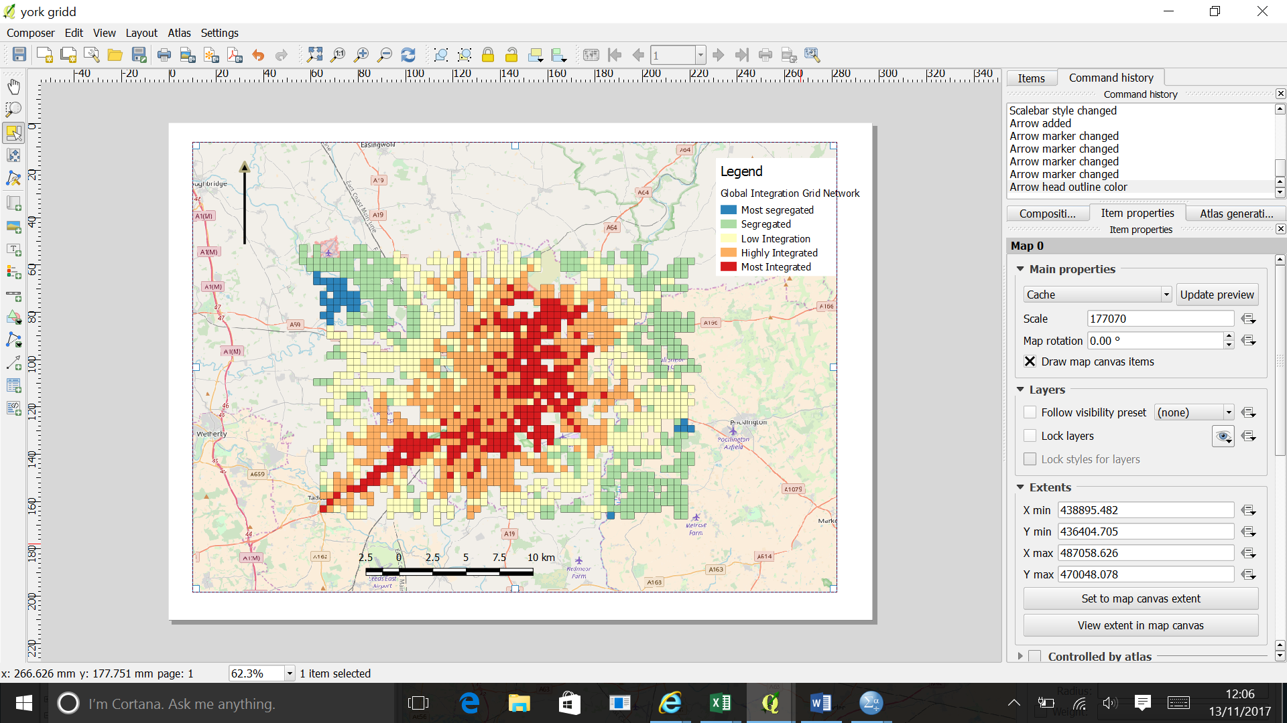
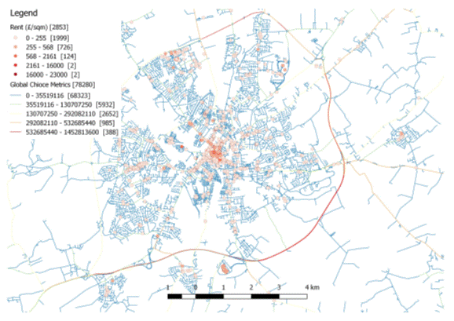
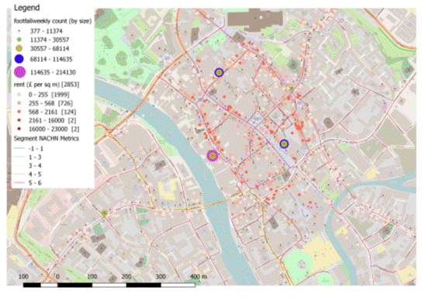
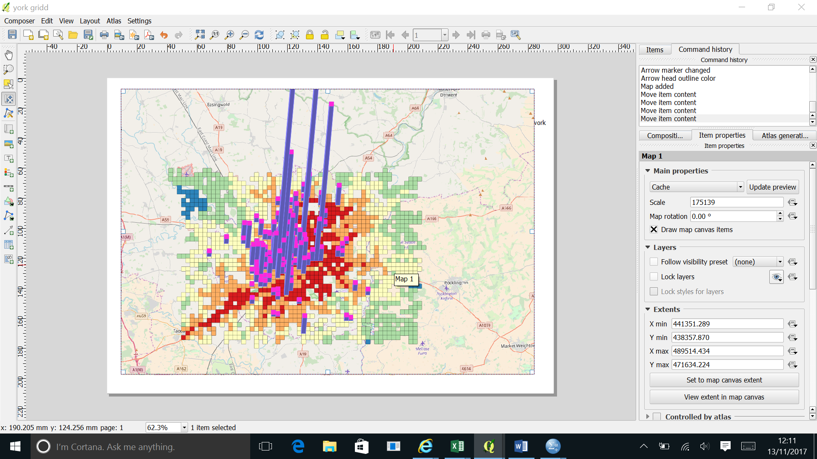
Data Modelling: York Retail Syntax
Notes:
York is another walled city in Northern England; it has one of the most complete City Walls in Europe: see: http://www.yorkwalls.org.uk/?page_id=3690
Experimental retail stock, value, integration modelling by R3intelligence at Northumbria University

Slide 19
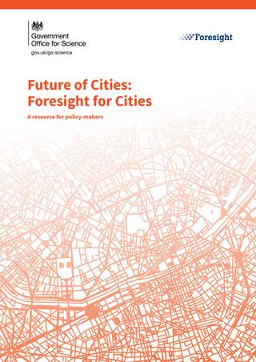
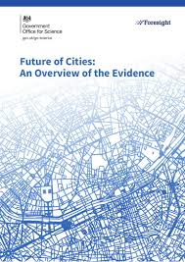
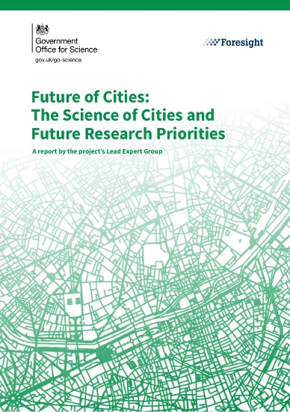
Foresight: Future of Cities (gov.uk/go-science)
Bringing together expertise in design, planning, construction, operations, funding, technology and risk management will enable the UK to capitalise on the essential need to provide infrastructure and its services to our citizens and across the world
Notes:
UK Government Initiative led by Government Office for Science
Foresight programme

Slide 20
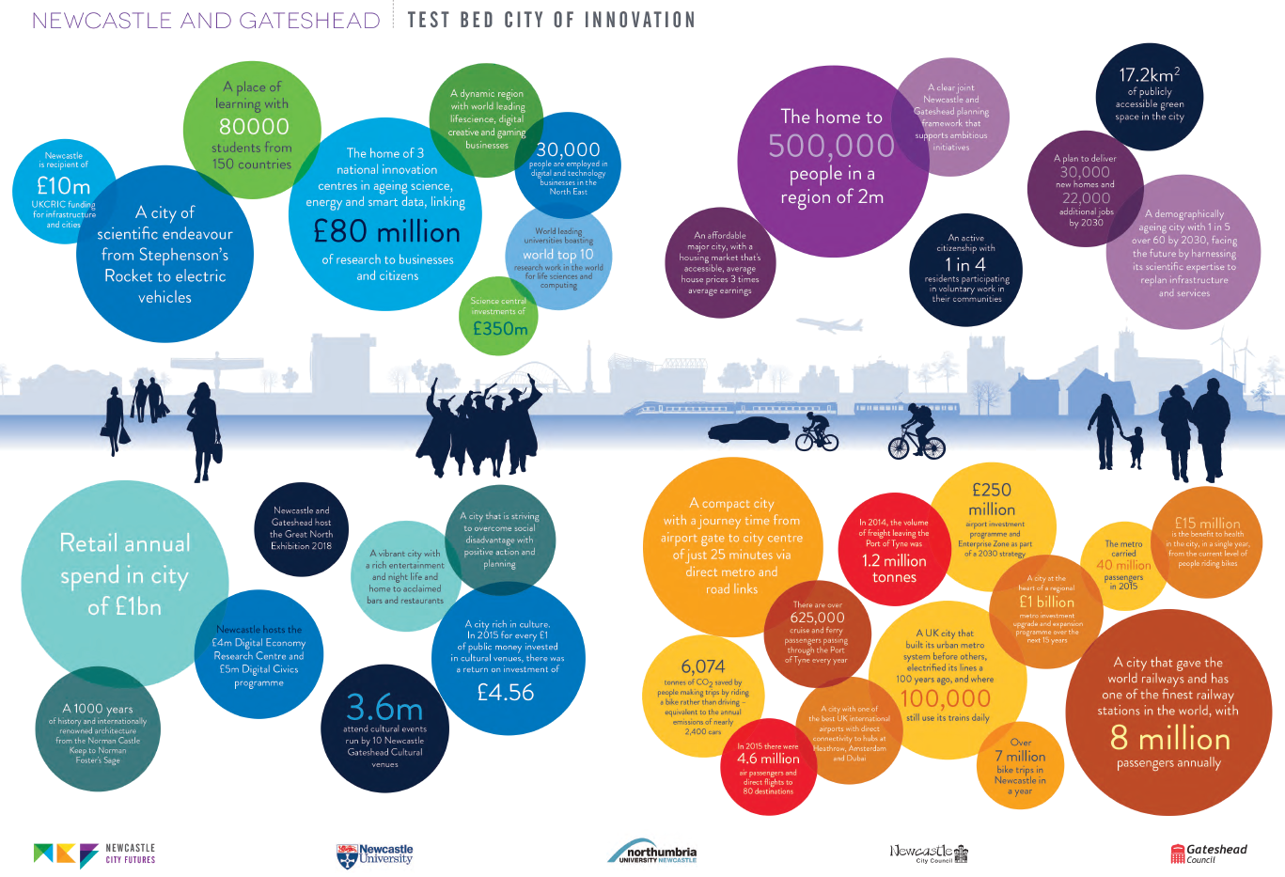
Newcastle City Futures 2065 https://www.youtube.com/watch?v=i4l26RsDzoU
Notes:
Promoting engagement with communities and stakeholders before planning what to do = find out first
Quadruple helix of Civic Government, private sector, community and Universities
See Newcastle City Futures 2065: anchoring Universities in urban regions through city Foresight; funded by Government Office for Science
http://www.newcastlecityfutures.org/
Visualising Newcastle City Futures 2065 (5min13sec): https://www.youtube.com/watch?v=i4l26RsDzoU
Children’s version: https://www.youtube.com/watch?v=5FOXf3SgQUY

Slide 21



Learning Lessons from the past: NERA
Helping shape urban futures: URBaNE
Sign up to NERA for free at www.urbaneweb.org.uk
Register your details to get free access to our collection
>250 documents archived; 100 documents available online
New web site being created at www.NEregenarchive.online
Collection comprises:
  Bridging Newcastle Gateshead Housing Market Renewal Pathfinder
  Grainger Town Partnership
  Sustainable Cities Research Institute
  Sunderland ARC Urban Regeneration Company
  Tyne and Wear Development Corporation
  Project Genesis Consett
  Newcastle/Gateshead Quays
Notes:
Who is URBaNE?
URBaNE is a multi-disciplinary group of academics and practitioners with a background in, experience of, and passion for urban matters.
What do we do?
conduct both funded and unfunded academic research projects and offer a consultancy service to external clients in the field of urban regeneration and renewal.
host the North East Regeneration Archive (NERA) of material produced by both the group, external partners and organisations that have been active in the North East of England.
Website: www.urbaneweb.org.uk
Twitter: @URBaNEregen
Institutional home page: www.northumbria.ac.uk/about-us/academic-departments/architecture-and-built-environment/research/sustainability-society-urbane/
The need for URBaNE:
During periods of economic austerity and public sector cuts, the need for urban regeneration rises exponentially
Paradoxically, most bespoke (area-based) regeneration programmes have been wound-up and dedicated agencies have closed as the Government has sought to recalibrate the role of the state.
The consequence is a sector facing growing demands in parallel to shrinking resources.
The URB@NE Research Group was established to offer impartial advice and support to place-based communities, social enterprises and the voluntary sector, business bodies and sectoral interests, and public sector organisations.
North East Regeneration Archive (NERA) – the concept:
Most regeneration agencies that operated in the North East have been wound-up; their legacy, as recorded in documents published during their lifetime, is dispersed, unprotected and is not often in the public domain.
The North East Regeneration Archive Project (NERA) sought funding to upload a collection of documents that had already been collated and archived, to make them freely available in the public domain to anyone who registers their details on the URB@NE web site.
The archive is a synergy of on-line technology, current expertise and historic documents, which have been combined to create a unique new product/tool available for free to all who register with our web site.
The proposal to create a regeneration archive aligns with the core purpose of the URB@NE research group, which is to further our knowledge of regeneration policies and programmes and contribute to wider understanding of best practice e.g. what works and what doesn’t, to better inform future policy development.
The making available of a valuable archive of historic documents, which are of specific relevance to the North East region, not only contributes to knowledge exchange and engagement but will also attract potential partners, clients, academic and community/third sector users and stakeholders to URB@NE
Collection comprises:
Bridging Newcastle Gateshead (BNG) Housing Market Renewal Pathfinder(2003-2010)
Grainger Town Partnership (GTP) heritage-led regeneration of Newcastle’s historic core(1997-2003)
Sustainable Cities Research Institute (SCRI) at Northumbria University(2001-2012)
Sunderland ARC Urban Regeneration Company(2002-2010)
Tyne and Wear Development Corporation – Urban Development Corporation for banks of Rivers Tyne and Wear (1988-1998)
Project Genesis (Public Private Partnership) in Consett, County Durham
Sustainable Cities Research Institute at Northumbria University (2000-2012)
Newcastle/Gateshead Quays by Morgan, E. (2009) STD Publishing, Newcastle upon Tyne

Slide 22



Links to Northumbria University Research & Consultancy Groups
Web: www.urbaneweb.org.uk
Twitter: @urbaneregen
Mail: paul.greenhalgh@northumbria.ac.uk
Linkedin: https://uk.linkedin.com/in/paul-greenhalgh-80029018
Sign up via: www.urbaneweb.org.uk
New dedicated web site being created at: www.NEregenarchive.online
Web: www.R3Intelligence.co.uk
Twitter: @r3intelligence
Web: https://www.northumbria.ac.uk/about-us/academic-departments/architecture-and-built-environment/research/virtual-reality-visualisation/
Twitter: @NorthumbriaVRV
Showreel: https://www.youtube.com/watch?v=7tiXqqb26Wo
Web: http://www.bimacademy.global/
Twitter: @bimacademy
Web: https://www.northumbria.ac.uk/research/changing-challenging-world/shaping-cities-with-digital-technology/
URBaNE
NERA
R3intelligence
Virtual Reality & Visualisation
including VNG
BIM Academy
Digital Living
Notes:
Please contact is via Twitter or visit our websites.

Slide 23
Thank you
Notes:
Thank you for inviting me to speak to you. It has been an honour and pleasure.
I look forward to working with your City in the future and hope that I can share some of my experience and expertise of urban regeneration in the UK to inform the work you are doing here in Suwon and I look forward to learning ‘best practice’ lessons from you to take back to the UK.
I am happy to answer questions as long as they are translated into English.

