Slide 1
Is the Increase in Disaster Occurrence Driving a need for more SAR?

Slide 2
Dr Geoff O’Brien
Senior Lecturer
October 23, 2017

Slide 3
Disaster
A serious disruption of the functioning of a community or a society involving widespread human, material, economic or environmental losses and impacts, which exceeds the ability of the affected community or society to cope using its own resources.
UNISDR Terminology 2009: http://www.unisdr.org/files/7817_UNISDRTerminologyEnglish.pdf

Slide 4
Disaster
We generally associate disasters with high energy rapid onset events such as earthquakes in Pakistan (2005), China (2008), Japan (2011) and New Zealand (2011), tsunami in Japan (2011), floods in Thailand (2011) and cyclones on Myanmar (2014) and The Philippines (2014)
Hurricanes Harvey, Maria and Irma (2017)

Slide 5
Disaster
We know that disasters often lead to loss of life.
Between 1970-2015 there were almost 4 million deaths from disasters (EMDAT)
But between 1970 – 2010 almost 900, 000 die from drought - mainly Africa (WB 2010).
But drought is a slow onset disaster and rarely reported.

Slide 6
Disaster
But is a high energy rapid onset event to narrow a view of disasters?
1.25m road traffic deaths in 2013 (WHO, 2015)
Continued conflict in Afghanistan, Iraq, Syria and Africa.
Increasing numbers of refugees with many dying as they try to reach Europe.
Could these be considered as slow onset disasters?

Slide 7
Disaster
Accelerated climate change and increasing variability is one of the greatest.
threats we face. GHG concentration – 400ppm and rising.
It presents both rapid (storms, etc.) and slow (sea-level rise, etc.) onset events.
There is considerable uncertainty about the kinds of impacts we will experience.

Slide 8
Disaster
Two things are driving us toward increasing disasters:-
Population growth – 9-10bn by 2050
Urbanisation – 70% by 2050
(UN Habitat 2016)

Slide 9
Disaster
UNISDR reports that climate disasters have increased by 14% over last 20 years (The Human Costs of Weather Related Disasters 1995-2015).
The costs of hurricane Irma are high – some US$150-180billion (Stiglitz, 2017).
Some 75 people were killed.

Slide 10
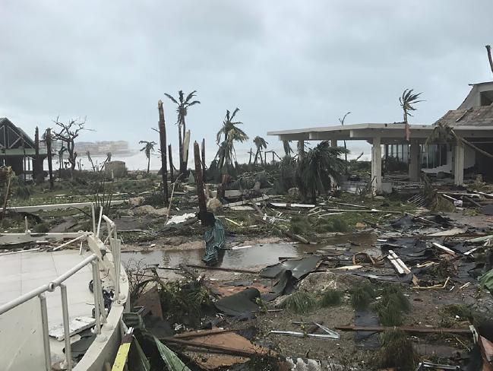
Hurricane damage to buildings – people can often be trapped inside damaged property

Slide 11
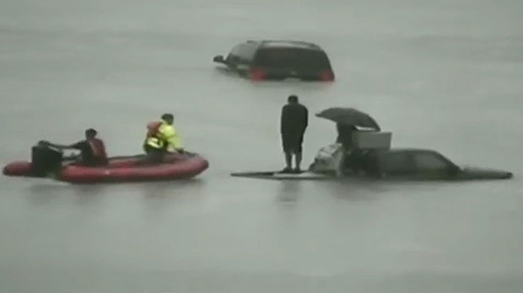
People can also be trapped on their vehicles.
The need for SAR is clear!

Slide 12
What is SAR?
SAR is defined as:-
Search and rescue operations involve looking for people who are lost or in danger, for example, after a war or a natural disaster, and bringing them back safely.
Collins English Dictionary, undated.

Slide 13
What is SAR?
Includes many specialty sub-fields, typically determined by the type of terrain where the search is being carried out.
These include mountain rescue; ground search and rescue, including the use of search and rescue dogs; urban search and rescue in
search and rescue dogs; urban search and rescue in cities; combat search and rescue on the battlefield and air-sea rescue over water

Slide 14
Operational Levels of SAR
Internationally – in response to what perceived as poorly organised interventions, the
International Search and Rescue Advisory Group (INSARAG) (1991) was set up.
Comprise some 100 member states – is focused on Urban Search and Rescue (USAR) activities.
INSARAG sets minimum standards for international operations.
It now is supported by UN OCHA and based in Geneva.

Slide 15
Operational Levels of SAR
National Level (using UK as an example) SAR is undertaken by a range of bodies such as the Military, Police, Fire and Rescue Service, Health Service, coastguard, lifeboat service, mountain, cave and low ground rescue teams, dog rescue teams - there are a number of voluntary organisations.

Slide 16
Operational Levels of SAR
SAR Teams - Operational members meet and train very regularly, take fitness tests once or twice a year and possess several versions of uniform and kit. These are deploy to events, searches, rescues and international disasters.
Non operational (support) member – help with administration, logistics, etc.

Slide 17
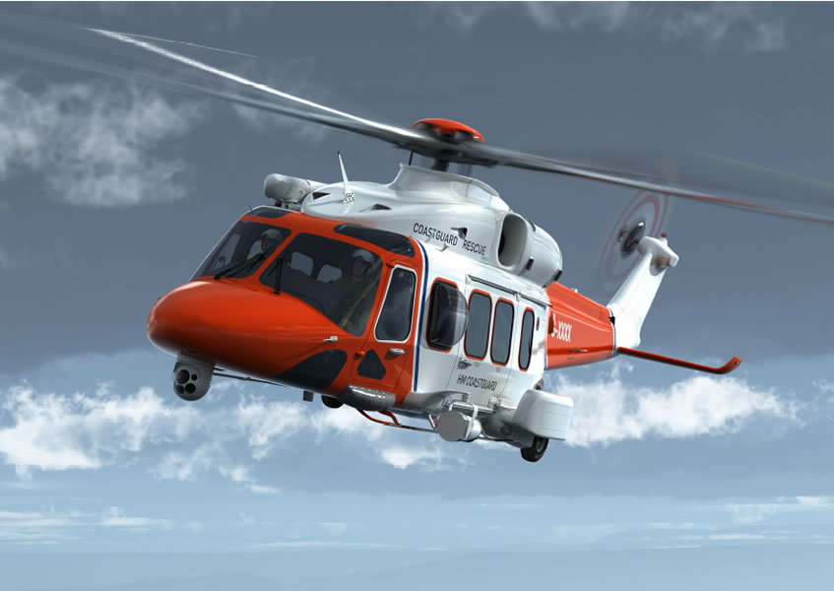
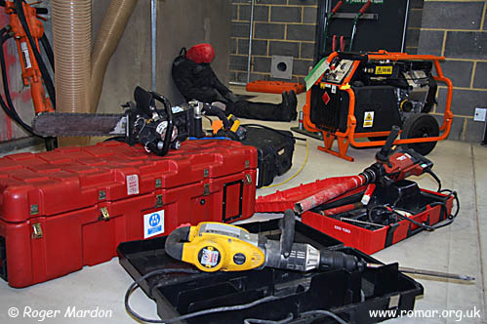
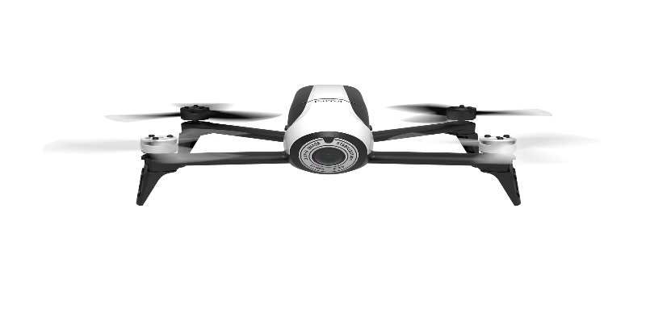
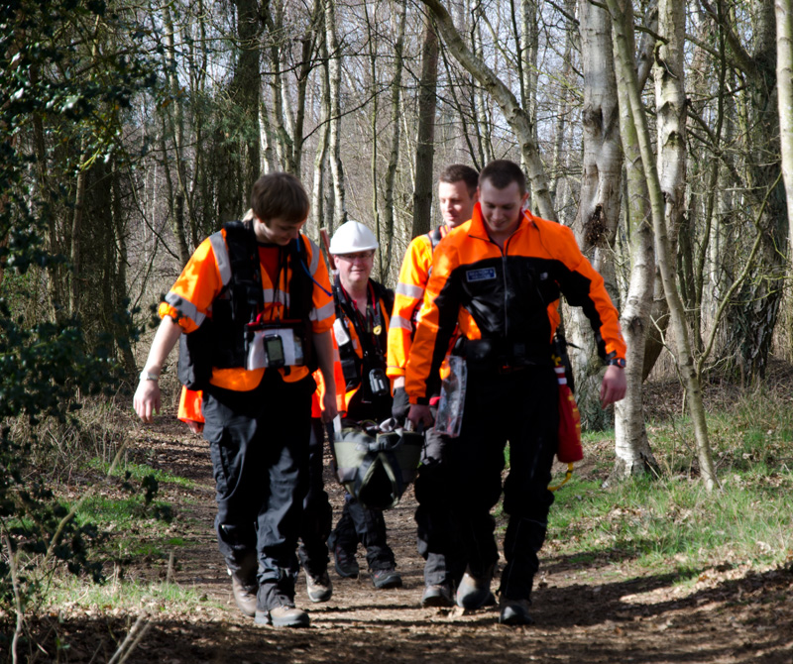
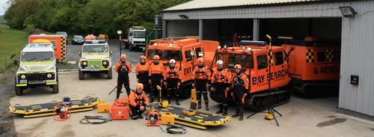

Slide 18
Use of SAR Increasing?
According to Nichols et al 2014 and Glomseth et al 2016 there is clear evidence of an ongoing increase in demand for SAR.
This is highly likely to remain the case as the population grows and becomes more urbanised and climate events become more extreme.
The implications are that will require more resources: human, financial, technical

Slide 19
Use of SAR Increasing?
Conflict (Algeria, Libya, Egypt, Yemen, Somalia, Palestine, Iraq, Syria and Afghanistan) is leading to more refugees.
0.5 million conflict refugees in 2015 reach Europe from Syria, Sudan and Afghanistan.
There is considerable effort in Mediterranean to rescue refugees.
As climate change worsens many more will be heading north!

Slide 20
Summary
Disasters, particularly weather related, are becoming more severe and frequent.
Urban areas are being affected by disasters and this driving an increase in the needs for SAR.
Technology is an integral part of SAR.
In many places SAR relies on volunteers.
Is this something that is likely to continue

Slide 21
References
Collins English Dictionary, undated. Collins. Online at:- https://www.collinsdictionary.com/dictionary/english/search-and-rescue
Ragnar Glomseth Fritz I. Gulbrandsen and Knut Fredriksen, 2016, Ambulance helicopter contribution to search and rescue in North Norway, Scandinavian Journal of Trauma, Resuscitation and Emergency Medicine2016 24:109
Nichols, Geoffrey; Goel, Rohan; Nichols, Tom; Jones, Will, 2014 Volunteers in British mountain rescue: responding to increasing demand for rescues and a changed relationship with the state, Voluntary Sector Review, Volume 5, Number 2, July 2014, pp. 213-229(17)
Stiglitz, J., 2017, After the Hurricanes, Project Syndicate. Online at: https://www.project-syndicate.org/commentary/learning-from-harvey-government-role-by-joseph-e--stiglitz-2017-09?gclid=CjwKCAjwmefOBRBJEiwAf7DstKb5WhUHSzGYaE5onqBMpYgj8mp8nr4LLK_woCh_Ik5rg3eUXoDh2RoCwB0QAvD_BwE
The World Bank 2010 Natural hazards, unnatural disasters : the economics of effective prevention, Washington DC, USA. Online at:- https://www.gfdrr.org/sites/gfdrr/files/publication/NHUD-Report_Full.pdf
UNISDR Terminology 2009: UNISDR. http://www.unisdr.org/files/7817_UNISDRTerminologyEnglish.pdf

Slide 22
Thank You
geoff.obrien@northumbria.ac.uk

