Slide 1

Exploring Digital Careers, Stereotypes and Diversity with Young People through Game Design and Implementation
Rebecca Strachan, Opeyemi Dele-Ajayi
Itoro Emembolu, Joe Shimwell, Matthew Peers

Slide 2
Digital Sector and Diversity
People working in the digital and games industry:
* Less than 1 in 5 people are female in the UK
* Only 1 in 20 (5%) are from a Black, Asian and Minority Ethnic (BAME) background yet BAME account for 1 in 8 (13%) of the UK population
Does it matter?

Slide 3
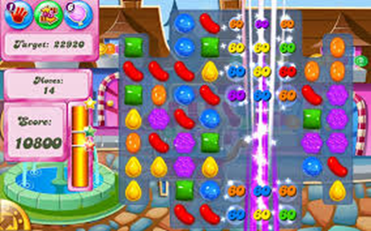

The Research
Objectives
Create more awareness of careers in the gaming industry
Generate interest and engagement
Explore diversity and stereotypes

Slide 4
Relevance of the research
Address Culture Stereotypes in Computer Science
Attract more young people to the computing discipline and wider STEM Disciplines
Reduce the Gender gap in STEM disciplines
Encourage Diversity
Notes:
Improving the image of the culture of the discipline (Culture Stereotypes in Computer Science): The discipline has been stereotyped as tedious and abstract with little practical application [10-13]. Individuals that major in the discipline have been stereotyped as antisocial or socially awkward, very smart and/or excellent at mathematics [14
Attracting more young people to the computing discipline and wider STEM Disciplines: Computer science is one of the STEM subjects that has not shown a growth in the numbers of people studying it at university. Between 2006-7 and 2015-16, the number of computer science students at university in the UK shows a decline of 7.3% [6].
Reducing the Gender gap in STEM disciplines: (Addressing Gender stereotypes)The figures on gender in the UK are similarly stark; females made up 18% of engineering, technology and computer science undergraduates in 2015-2016 [8] and less than 10% of professional engineers are female [9]. perception among females that the careers within computing are not for ‘people like me’ and strengthens the view that the field is generally associated with masculine stereotypes
Encourage Diversity: Currently the majority of young people entering the sector are male. How can we encourage more young people, particularly females and other under-represented groups to consider studying computer science and digital technologies at university and beyond?

Slide 5
Methodology
Action research approach
Pre and Post quasi experimental design
Done in two phases (Pilot and main intervention)
Pilot (2 sessions, 40 young people)
Main intervention (5 sessions, 20 young people)
Game Engine (Gamefroot)

Slide 6
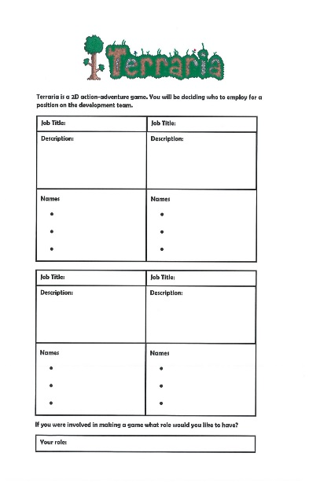
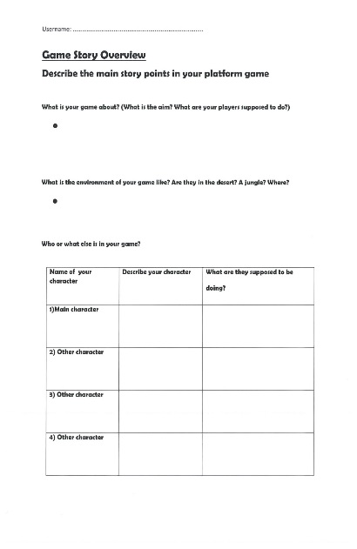
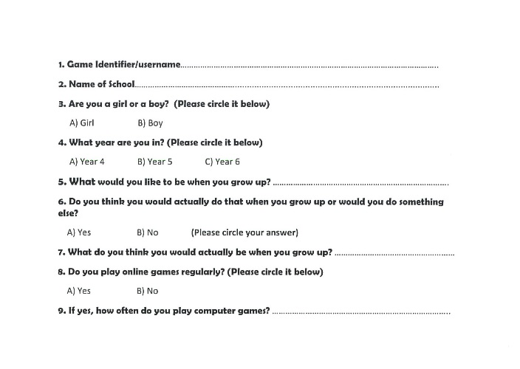
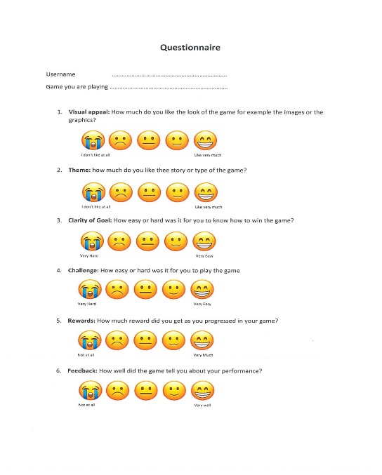
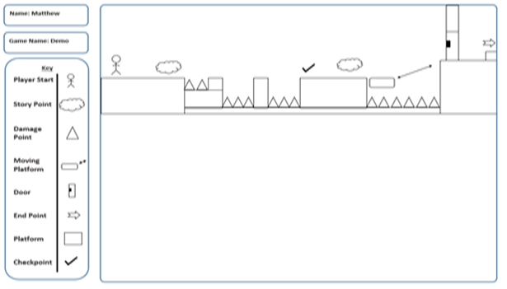
Evaluation
Sorting activity
Questionnaire
Game overview
Game Design Planning Sheet
Child’s game
Engagement Factors

Slide 7
Findings…
Limited understanding of career roles in the Industry
Males created male characters, females created characters of mixed gender
Females aspired to jobs in health sciences while males aspired to a wider range
Shift in STEM aspirations from 25% (Pre) to about 40% (Post)

Slide 8
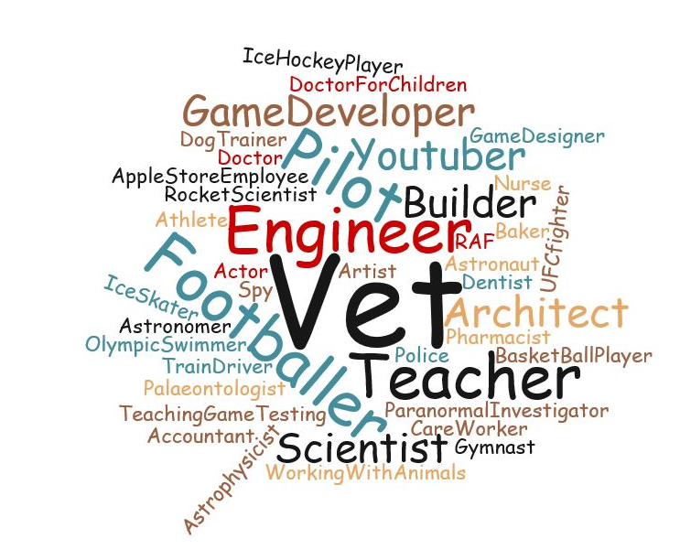
The Young People’s Aspirations

Slide 9
Findings Continued…
Most identified Jobs (Game Designer, Programmer, Game Artist and Game Tester)
Sorting activity: Top three characters assigned job roles were predominantly males, those assigned least roles were all females
The young people were able to use the engagement factors to evaluate each others games
Notes:
Job roles mostly identified in the gaming Industry were Game Designer, Programmer, Game Artist and Game Tester
In the job roles given to characters, the three characters selected the most for a job role in the gaming industry were mostly males while the three characters selected the least for a job role were all female

Slide 10
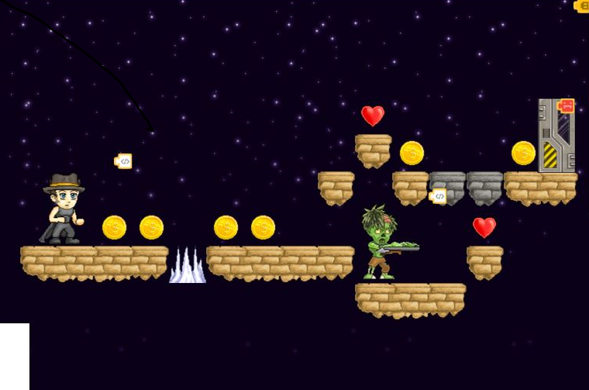
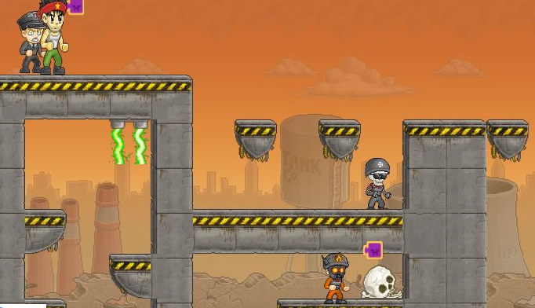
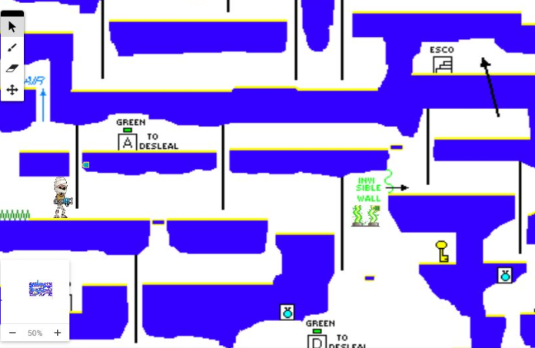

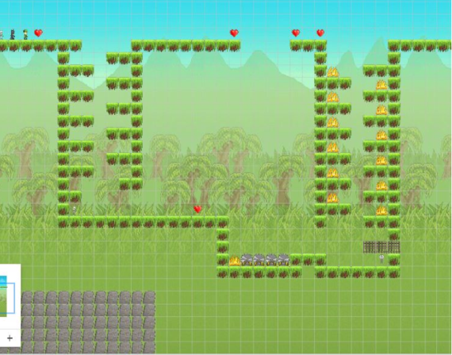
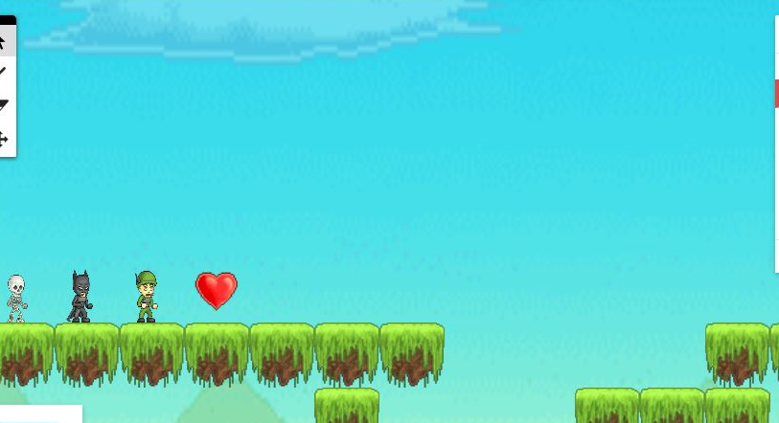

Some of the children’s games….

Slide 11
What Next?
Finding a suitable game development platform
Training for Teachers
Equality and Diversity with young people
Notes:
• The game engine worked better using chrome rather than internet explorer
• The story sheets required a lot of explaining and prompts for participants to expatiate of their intended game story

Slide 12
Thank you!

