Slide 1
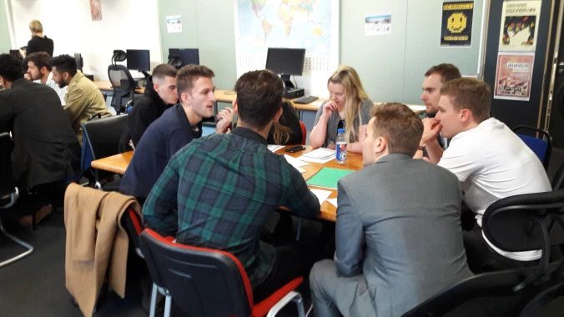
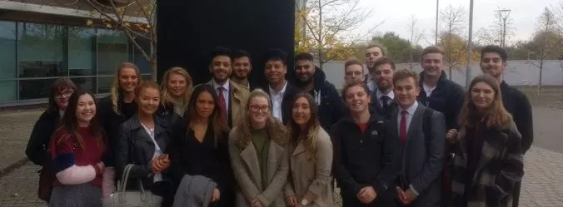
Interdisciplinary clinics – the next step in the evolution of clinical legal education?
Victoria Roper
Notes:
Introduce ourselves briefly and explain SLO module and EBM programme

Slide 2
About me
Joined university from practice where I worked as a solicitor at a commercial law firm
Supervise students in our clinic and teach a range of other commercial modules in the Law School
External examiner for clinical legal education module at external university
Trustee/Treasurer of the UK Clinical Legal Education Organisation (CLEO) -www.cleo-uk.org/
Member of the Law Society for England and Wales national Education and Training Committee

Slide 3
Cast your mind back to IJCLE 2017…
In his keynote speech at IJCLE 2017, Kevin Kerrigan (Pro Vice Chancellor, Sheffield Hallam University) discussed the potential to develop a live client clinical approach right across the undergraduate curriculum.
At the same conference, I co-presented a paper about a multi-disciplinary clinical teaching project at Northumbria University which was then in its pilot year - Roper V and Hatt L “Breaking down boundaries – the case for clinic collaboration with other disciplines” International Journal of Clinical Legal Education Conference 2017, Newcastle upon Tyne, England.

Slide 4
Cast your mind back to IJCLE 2017…
This paper will build upon my 2017 paper, presenting the results of a recently conducted research survey on the now expanded teaching project which is currently in its third year.
The project involves students of the Student Law Office (SLO) and Entrepreneurial Business Management (EBM) students working together to identify legal issues and solve business problems.

Slide 5



The Student Law Office (SLO)
The Student Law Office is a long established, in house, live client, university law clinic – compulsory assessed module
Law students provide legal advice and representation to clients - approx. 300 students this year
The service is run like a firm of solicitors, save for being free
Students work in ‘firms’, each firm has a specialist area e.g. employment, business, civil disputes etc.
Practising lawyers closely supervise the students' work and have overall responsibility for ensuring that clients receive a professional service
https://www.northumbria.ac.uk/about-us/academic-departments/northumbria-law-school/study/student-law-office/

Slide 6
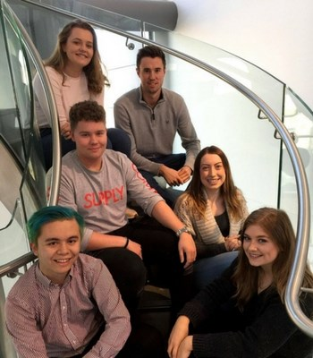
Entrepreneurial Business Management Programme (EBM)
EBM programme is a degree offered by Newcastle Business School, Northumbria
The EBM programme is one of a small number of undergraduate programmes in the UK with venture creation as the core of the curriculum
Students learn business by setting up and running their own businesses
https://www.northumbria.ac.uk/study-at-northumbria/courses/entrepreneurial-business-management-ba-ft-uufebz1/

Slide 7
What does our project involve?
“Alone we are smart, together we are brilliant”
(Steven Anderson, Educator)
75 SLO and EBM students
7 business and law lecturers
Multiple collaborative sessions over the course of each academic year:
  Presentations on legal issues by SLO students
  Presentations by EBM students where they have to ‘pitch’ their business idea to the SLO students
  Small group sessions – EBM and SLO students work in small groups to identify legal issues and solve business problems
  Drop-in sessions

Slide 8
Methodology of research
Internal ethical approval was obtained to obtain data from the students who took part in the project
An online survey was prepared using Online Survey (formerly called Bristol Online Survey) and sent to students by email
The survey asked students a series of questions using likert scale (strongly agree, agree, etc.) and also included some open text boxes allowing for additional qualitative comments
The survey was anonymous and students has to confirm they had read information about the research and consented to providing the data
Responses are automatically collated by Online Survey saving time

Slide 9
Overview of Research Survey Results
92.3% of students said they enjoyed the project
84.6% said they learnt something from the other students
92.3% said it helped them improve communication/pitching skills
92.3% said it helped them understand the issues facing businesses

Slide 10
Overview of Research Survey Results
53.9% said it helped improve their understanding of the law
46.2% said it helped improve their ability to work as part of a team
84.7% said it was good experience for meeting clients
92.4% said they would like more opportunities to work with students in other disciplines

Slide 11
“everyone seemed to benefit from this session, both business and law students”
“Today was really fun as well as informative. I feel like I learnt a lot from the external people that came in, as well as learning more about each other.”
“It allowed us to practice our speaking and communication skills”
Student Feedback
“it allowed [me] to consider different issues which may arise when dealing with a business”.
“It made my understanding even stronger as I made links between practical and theory”
Notes:
LH to discuss
Specifically
Implications of beer in hamper of local products
Questions about liability when retailing 3rd party products
Issues around intellectual property

Slide 12
Tips and best practice
Consider a pilot/starting small before scaling
Consider at the outset your aims/how you are going to measure success
Remember to share/disseminate as widely as possible (staff presentations, conferences, journal articles, university news pages, prize submissions, funding submissions, blog posts, social media etc.)
Online survey tools are very useful, but have limitations – ideally we would have wanted a higher response rate.

Slide 13
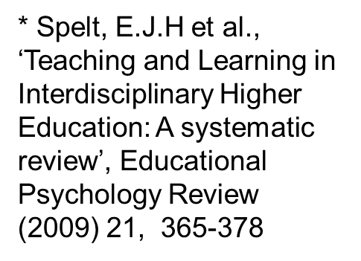
Pedagogical benefits of interdisciplinary working
In the real world there is often a lot of overlap between disciplines, this is especially true for business/business management and law
Professionals are ‘increasingly confronted with complex issues’ and higher education is therefore increasingly called on to train students to deal with complex issues in professional environments.*

Slide 14
Pedagogical benefits of interdisciplinary working
Students don’t often have the chance to work with students in other disciplines at university – additional experiential opportunities
Develops an emerging professional identity in students – important for a professional university like Northumbria
Students are exposed to notions of professional ethics and professional obligations

Slide 15
Interdisciplinary clinics – the next step in the evolution of clinical legal education?
Small scale study, but our findings suggest there may be a value in considering working with other disciplines in legal clinic more
Think about your own clinic – are there areas of overlap with other degree subjects potentially?

Slide 16
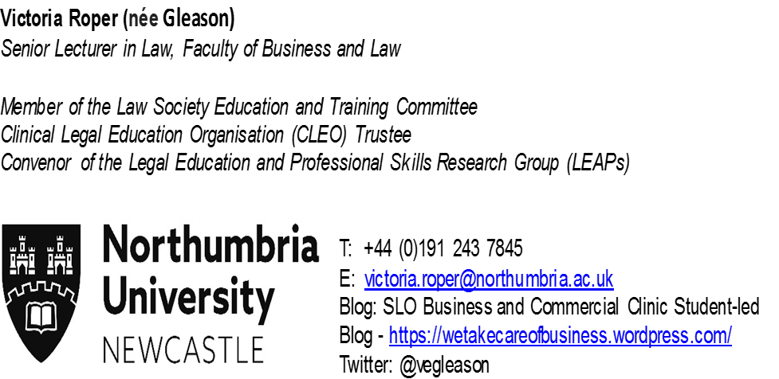
Questions/thoughts/comments?
Publications:
Notes:
I have just cut and paste my email signature into here. Are you able to do the same?

