Slide 1
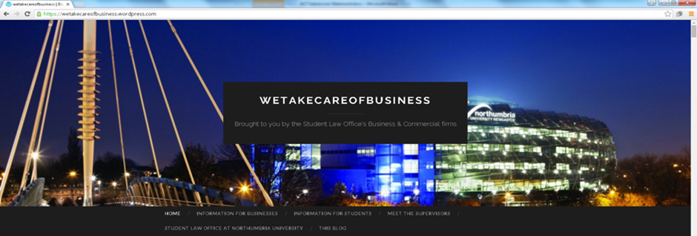
Using Blogs in Legal Education – A Case Study Analysis
Find our blog at: https://wetakecareofbusiness.wordpress.com
Victoria Roper, Senior Lecturer, Northumbria University
Notes:
Introduce ourselves briefly and explain SLO module and EBM programme

Slide 2
Introduction
Joined university from practice where I worked as a solicitor at a commercial law firm
Supervise students in our clinic, the Student Law Office, and teach a range of other commercial modules in the Law School
Member of the Law Society for England and Wales national Education and Training Committee
Trustee/Treasurer of the UK Clinical Legal Education Organisation (CLEO) -www.cleo-uk.org/
External examiner for clinical legal education module at external university
Lead Northumbria’s Legal Education and Professional Skills (LEAPS) Research Group

Slide 3
Why should legal educators be thinking about social media in legal ed?
Law Society Practice Note on Social Media (https://www.lawsociety.org.uk/support-services/advice/practice-notes/social-media/):
“Social media continues to be a popular and growing area. As such, it is important for the profession to keep up to date with developments in social media which present real opportunities if harnessed effectively”

Slide 4
About Northumbria’s Student Law Office
The Student Law Office (SLO) at Northumbria is one of the longest running live client law clinics in the UK
This year 350 students work in the SLO under the supervision of over 20 solicitors and barristers
In 2007, the SLO established a specialist Business and Commercial Law Clinic
In 2014 we decided we wanted to maximise the experiential learning opportunities afforded within the Business and Commercial Law Clinic and setting up a student-led blog

Slide 5
The “We Take Care of Business” Blog
https://wetakecareofbusiness.wordpress.com
Business and Commercial Clinic students produce and drive the content
Students write some blurb about themselves and include a photo
Voluntary
Lecturers act as editors
We have disabled the comment function

Slide 6
What were our aims in setting up the blog?
Pedagogic value - encourage collaborative and constructivist learning as students are responsible for choosing the topics they want to write about and for developing their own learning
Employability and commercial awareness –
Wanted to help students to appreciate the importance that social media plays in law firm marketing
Help students understand the importance of having a good social media image
Give students to demonstrate a commercial awareness of legal changes affecting law firms and businesses
Something to help students stand out from the crowd in the competitive graduate law market

Slide 7
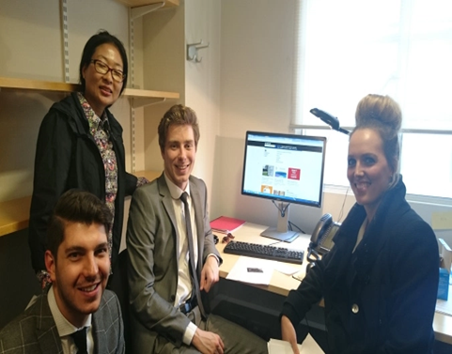
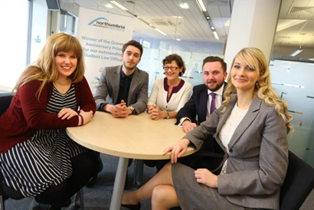
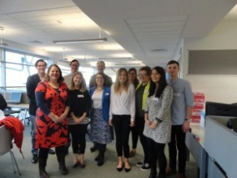
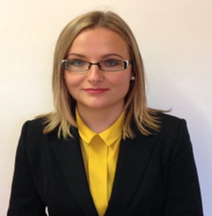
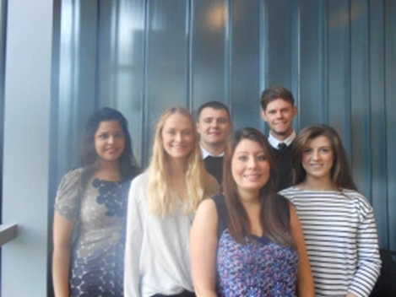
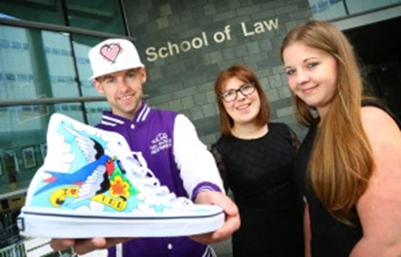
Readers in over
100 countries
Over 9,500 blog views
Over 50 students involved
Over 50 students involved

Slide 8
Content of Blog Posts – (1) Substantive law examples
“400 years later: a legal structure designed specifically for registered charities” 7 May 2019
“The New Consumer Rights Act: Some Key Issues” 19 January 2016
“Are you ready for the General Data Protection Regulation?” 12 March 2018

Slide 9
Content of Blog Posts – (2) Commercial awareness and advice for students examples
“Do law students need to network?” 2 May 2017
“10 TED talks to make you commercially aware” 13 April 2015
“How is Artificial Intelligence affecting the legal sector?” 23 March 2017

Slide 10
Content of Blog Posts – (3) Marketing for the Student Law Office examples
“Sole trading!” 12 August 2014
“FIRST class legal advice” 29 April 2015
“Sky’s the limit for OpenWorks!” 12 August 2014

Slide 11
Student Feedback
Let my students tell you about the blog in their own words…

Slide 12
Student Feedback
“My blog posts showed firms that I was able to nurture client relationships, whilst providing added value and marketing services in an effective and client-focused manner”
“My experience with the blog helped me get some work experience with a local firm writing legal updates for their website”
“Someone from a law firm contacted me after reading one of my blog posts…”
“It was the impressions made from the creation of blog posts upon my two interviewers which really ‘sealed the deal’ of a paralegal job”

Slide 13
Challenges of using blogs in this way
Are we “digital immigrants”?
Encouraging bad habits?
Student engagement
Student discomfort/ethical considerations
Time and cost
Lack of institutional guidance

Slide 14
Lessons learnt
Think about what your aims are and how you are going to measure you success at outset
Aim to gather feedback formally e.g. short online survey etc.
Shout about what you do and write about it if you can – blog was one of only 3 projects shortlisted for the national Routledge/ALT Teaching Law with Technology Prize 2016
Success with one type of social media does not mean success is guaranteed with all types of social media – our attempt to use Twitter with our students was a failure!

Slide 15
Want to know more?
Visit our blog
Have a look at the ‘sister’ blog that was set up by our family law colleagues in 2017 - https://afamilyaffairsite.wordpress.com/
Victoria Roper, ‘Blogs as a Teaching Tool and Method of Public Legal Education: A Case Study’ (2018) 2(1) International Journal of Public Legal Education 46 - http://www.northumbriajournals.co.uk/index.php/ijple/article/view/707

Slide 16
Final thoughts
“Academics should commit to their own life-long learning and try to adapt to a world saturated with social technologies”
Kukulska-Hulme, ‘How should the higher education workforce adapt to advancements in technology for teaching and learning?’ (2012) 15 The Internet and Higher Education 247 at p. 253.
“Teaching with technologies requires ‘a spirit of experimentation’ and a ‘tolerance of failure”
G. Siemens and P. Tittenberger, Handbook of emerging technologies for learning. (University of Manitoba, 2009) at p. 15

Slide 17
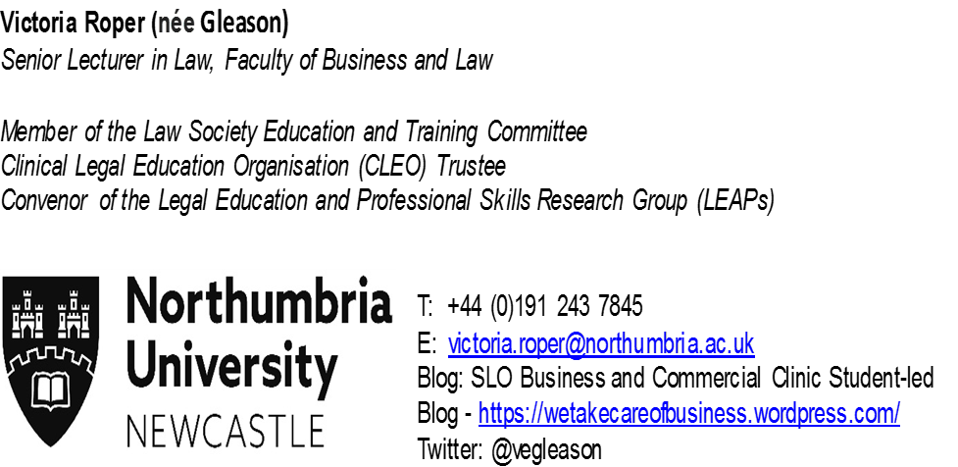
Questions/thoughts/comments?
Publications:
Victoria Roper, ‘Blogs as a Teaching Tool and Method of Public Legal Education: A Case Study’ (2018) 2(1) International Journal of Public Legal Education 46
Rachel Dunn, Victoria Roper and Vinny Kennedy, ‘Clinical Legal Education as Qualifying Work Experience for Solicitors’, (2018) 52(4) The Law Teacher 439
Victoria Roper, Elaine Campbell, Assaf Ben-David, Dov Greenbaum and Jonathan Askin, ‘Understanding the Scope of Business Law Clinics: Perspectives from the United Kingdom, Israel and the United States’ (2018) 5(1) Journal of International and Comparative Law 217
Victoria Roper, ‘Reflecting on Reflective Practices in Clinical Legal Education’ (2019) 26(1) International Journal of Clinical Legal Education 216
Victoria Roper, ‘Round Up of the 2nd Commercial Law Clinics Round Table – 9th March 2018’ (2018) 25(2) International Journal of Clinical Legal Education 248
Victoria Roper and Elaine Campbell, ‘Cultivating 21st Century Law Graduates through Creativity in the Curriculum’ (2015) 10(1) Journal of Commonwealth Law and Legal Education 4

