Slide 1


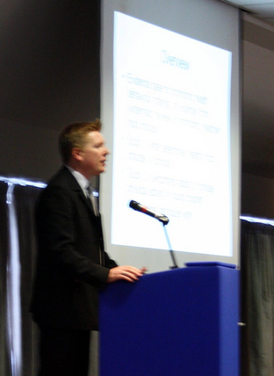
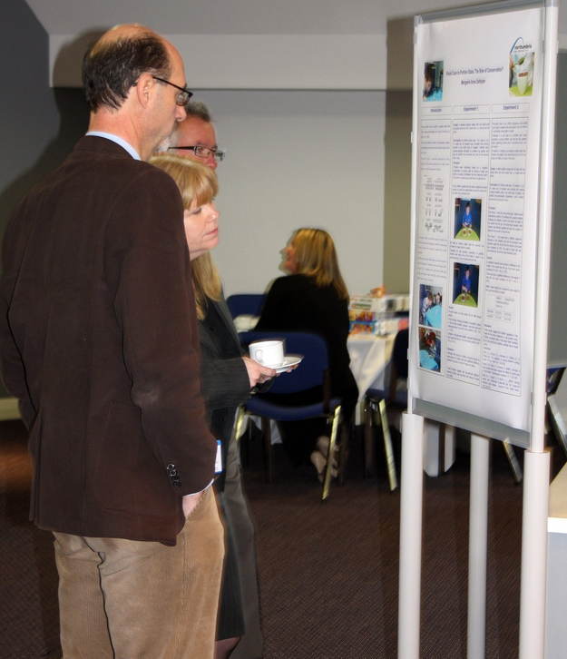
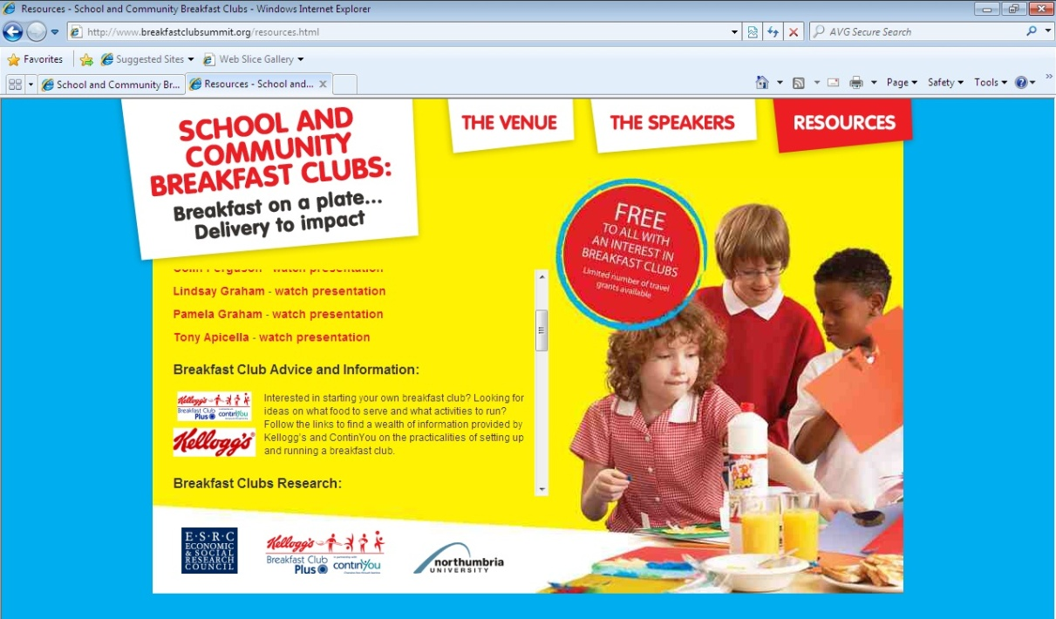
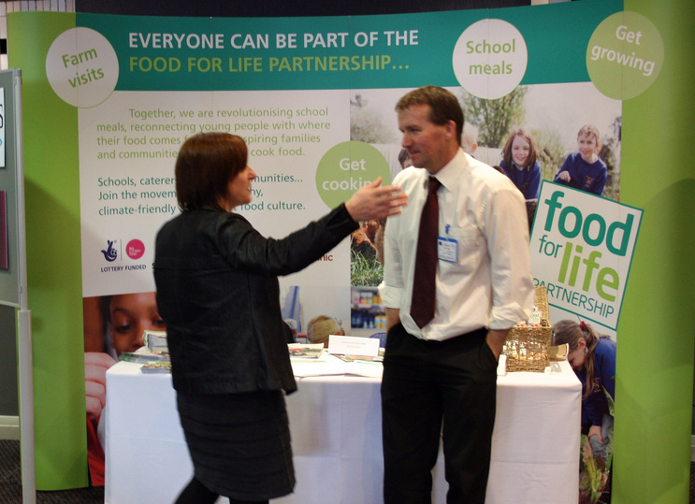
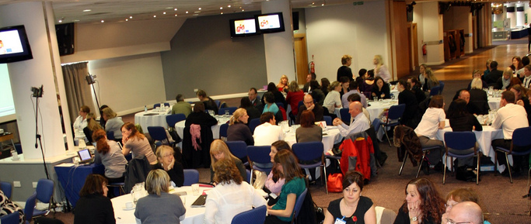
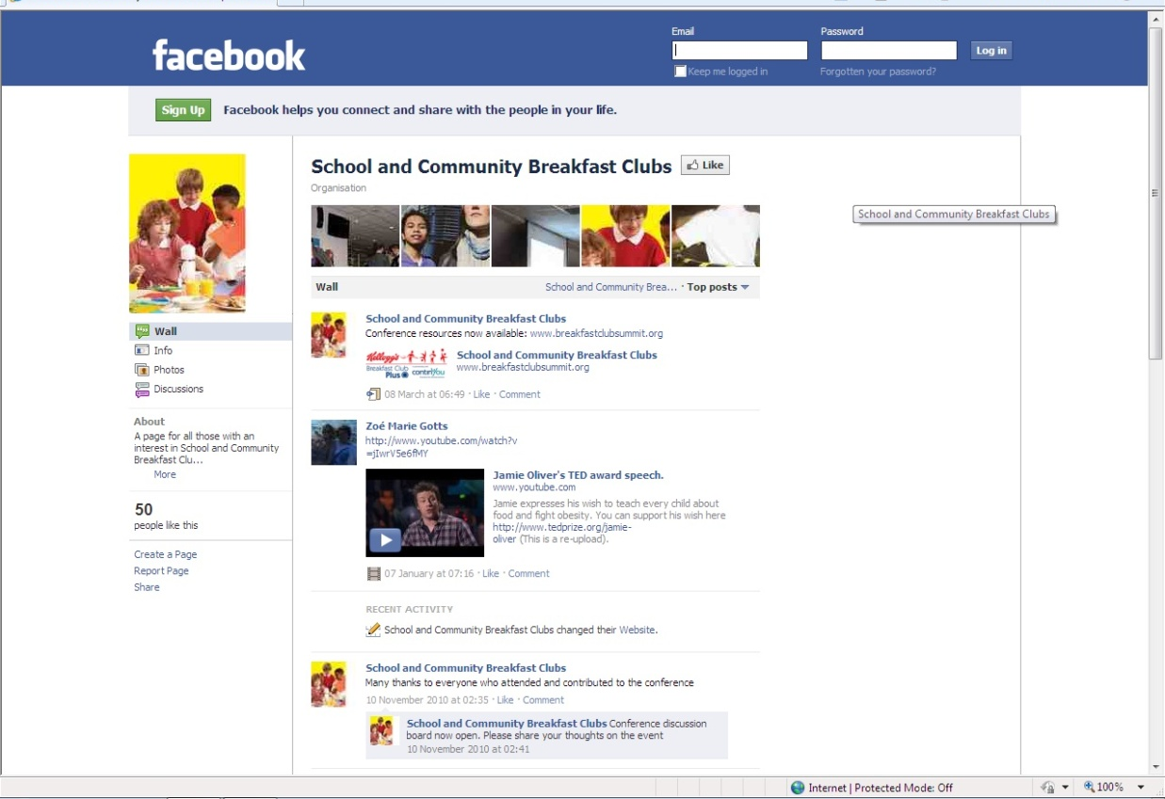

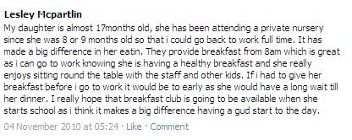
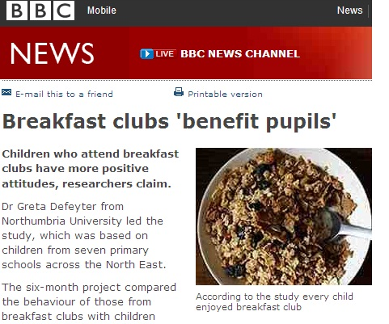
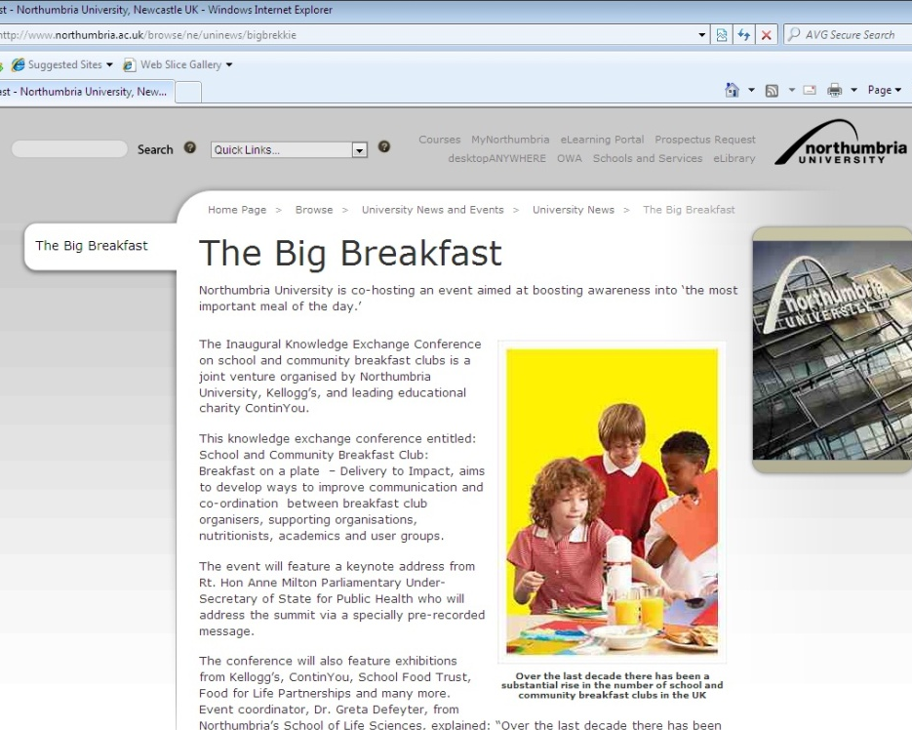
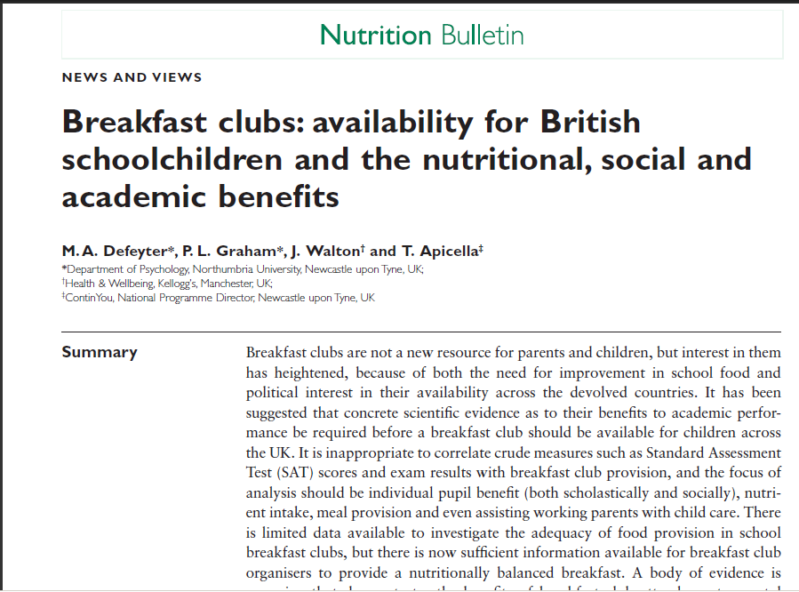
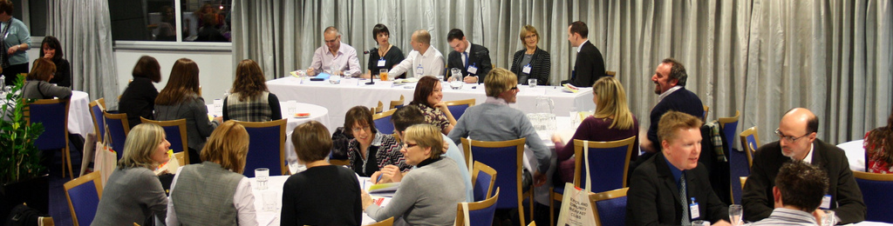


School and Community Breakfast Clubs:
How to Address the Lack of Communication Between Key Stakeholders
Margaret A. Defeyter & Pamela L. Graham
Department of Psychology, Northumbria University
“Coming together is a beginning, keeping together is progress, working together is success” Henry Ford
A two-day conference event was organised to promote an exchange of knowledge between key breakfast club stakeholders. The event was attended by 175 delegates including academics, policy makers, charity and industry representatives, head teachers, breakfast club organisers and school canteen staff.
Coming Together...
The day event began with a keynote address from the Parliamentary Undersecretary of State for Public Health, Anne Milton, followed by...
An evening Question Time event offered delegates an opportunity for open discussion with a panel on the key issues surrounding breakfast clubs. The panel consisted of representatives from industry, education and charity.
Keeping Together...
Dissemination of information beyond the event
Conference Webpage:
www.breakfastclubsummit.org
Social Networks:
Publications:
Includes downloadable resources such as:
-Footage of all conference presentations
-Advice on setting up and sustaining a breakfast club
-Information on breakfast clubs research
Talks
Posters
Exhibition Stands
Discussions facilitated by Zing Technology
Working Together...
All delegates pledged what action they intended to take as a result of attending the conference...
“Promote the importance of breakfast clubs within my organisation and produce more guidance for our website (School Food Trust)”
Delegates also provided feedback about the conference. Ratings of the event as a whole were very positive: 43% rated the event ‘excellent’, 52% ‘very good’ and 5% ‘good’. No one rated the event ‘satisfactory’ or ‘poor’.
Delegates will be contacted before the summer to find out what impact the conference had on their knowledge and actions after the event.

